Slide 1
Examining repeats with databases
Miguel Andrade
Faculty of Biology,
Johannes Gutenberg University
Mainz, Germany
andrade@uni-mainz.de

Slide 2
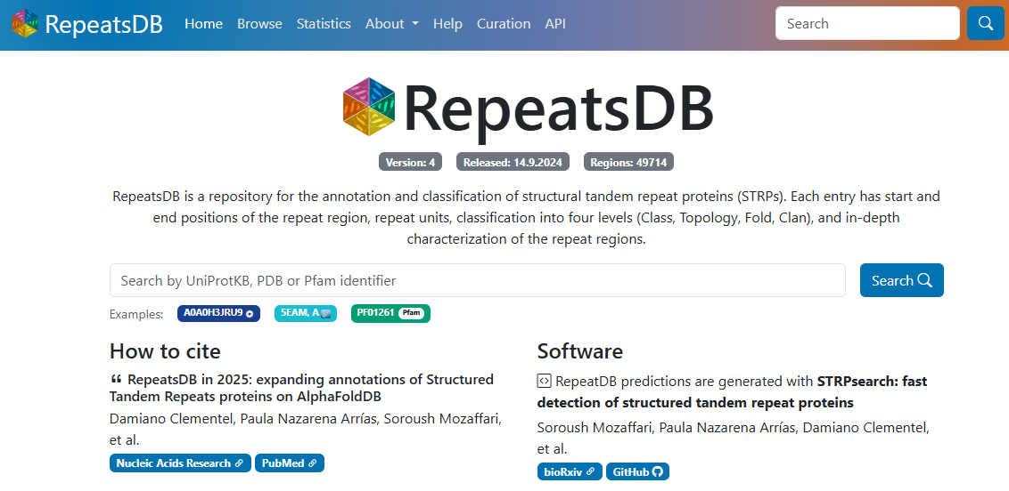
RepeatsDB

Slide 3
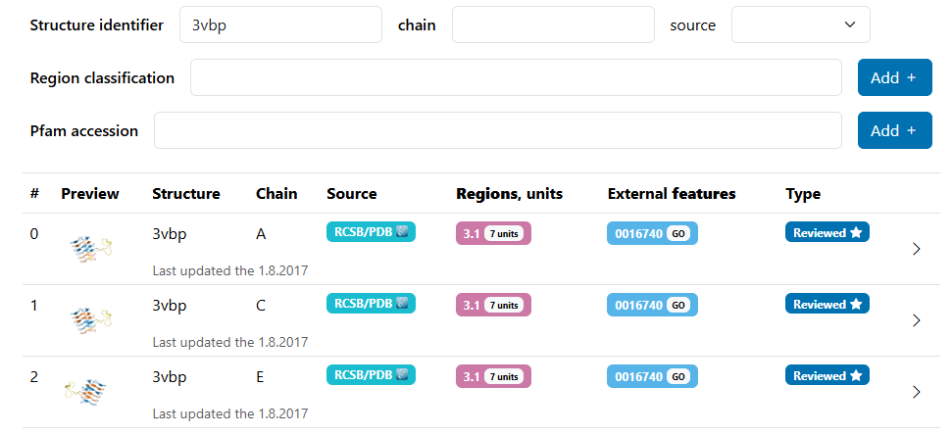
RepeatsDB

Slide 4
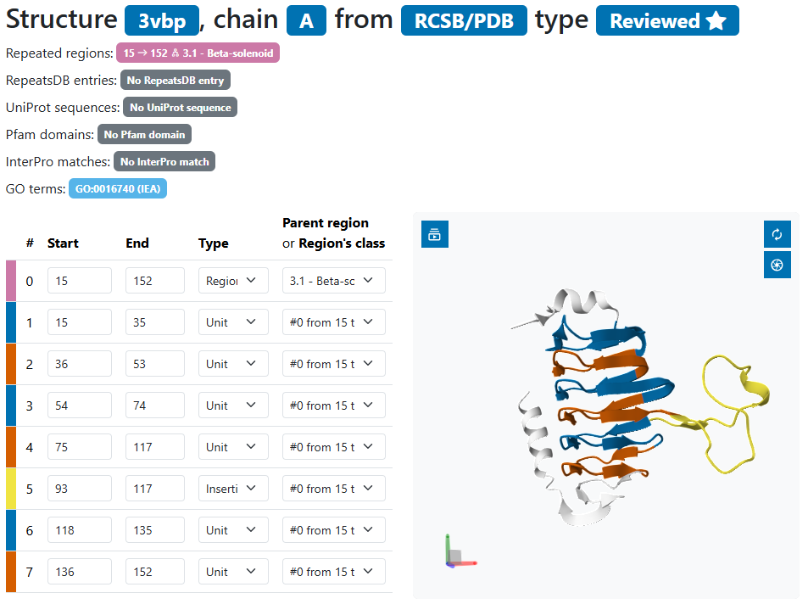
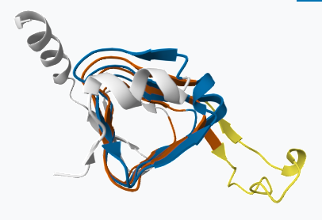
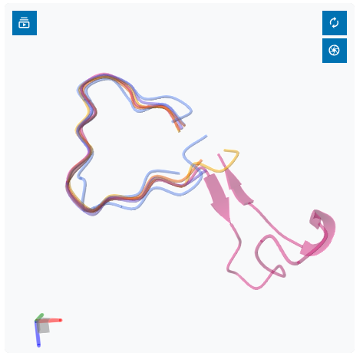
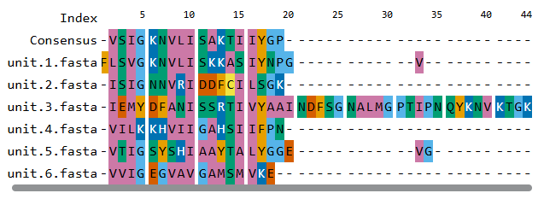
RepeatsDB

Slide 5
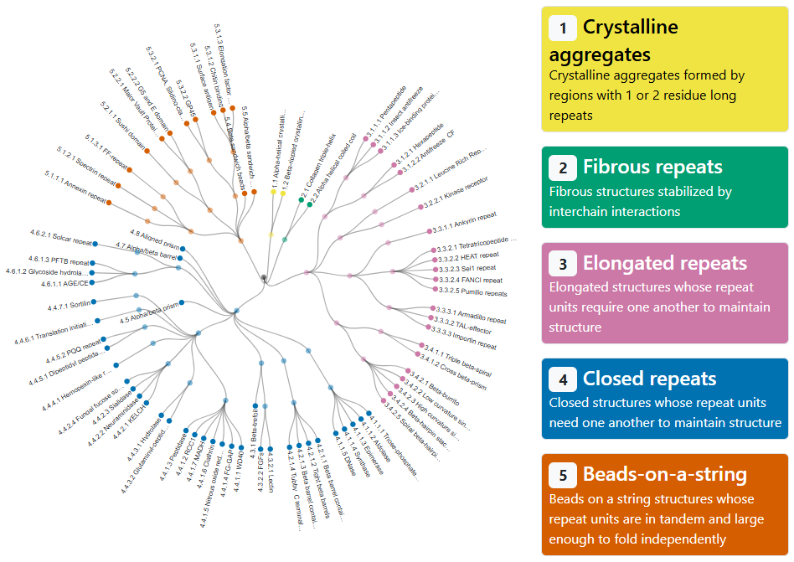
Exercise 1. Evaluating annotations of repeat structures in RepeatsDB
Go to RepeatsDB: http://repeatsdb.bio.unipd.it/
Click on an outside node of the repeat map (only categories 3 “elongated repeats” or 4 “closed repeats”)

Slide 6
Exercise 1. Evaluating annotations of repeat structures in RepeatsDB
Go to RepeatsDB: http://repeatsdb.bio.unipd.it/
Click on an outside node of the repeat map (only categories 3 “elongated repeats” or 4 “closed repeats”)
Choose one example and write down the PDB name and the chain (e.g. PDB 6yc3, chain B).
Check the assignment of the units. Is it correct? What about insertions? Are there mistakes? Write an evaluation: Looks good / one repeat wrong / many mistakes / total mess

Slide 7
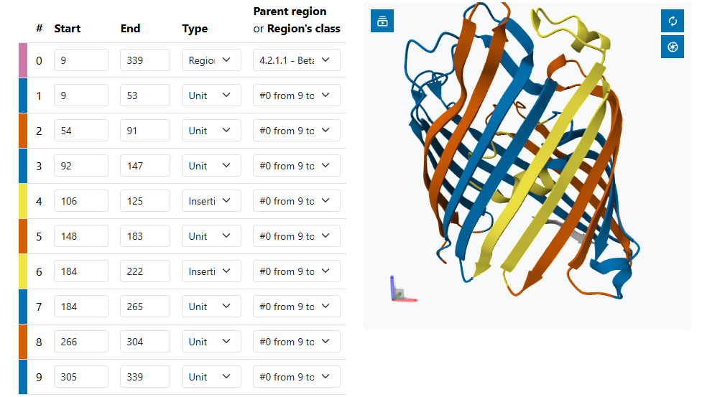
Example
PDB 6yc3, chain B
looks good
one repeat wrong
many mistakes
total mess

Slide 8
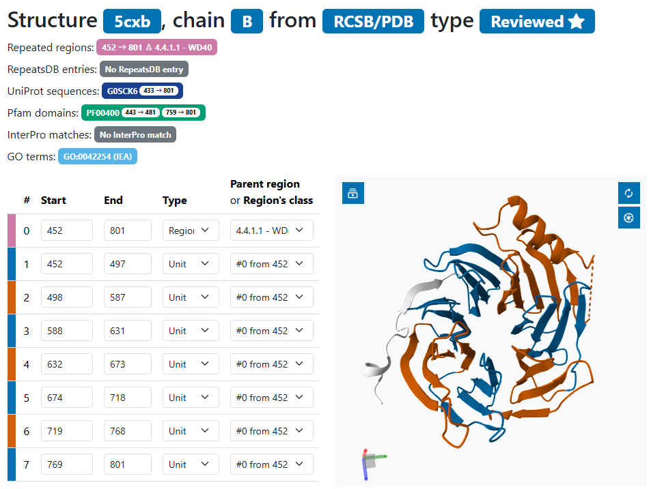
Example
PDB 1bt9, chain A
looks good
one repeat wrong
many mistakes
total mess

Slide 9
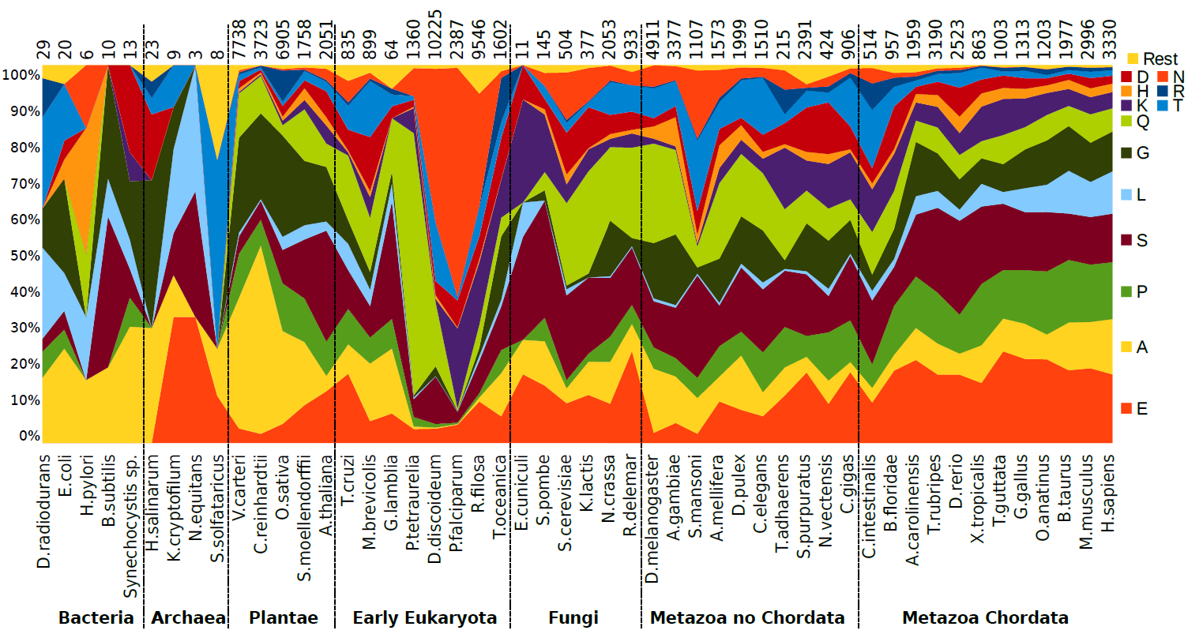

Evolution of homorepeats in 50 species
Pablo Mier

Slide 10
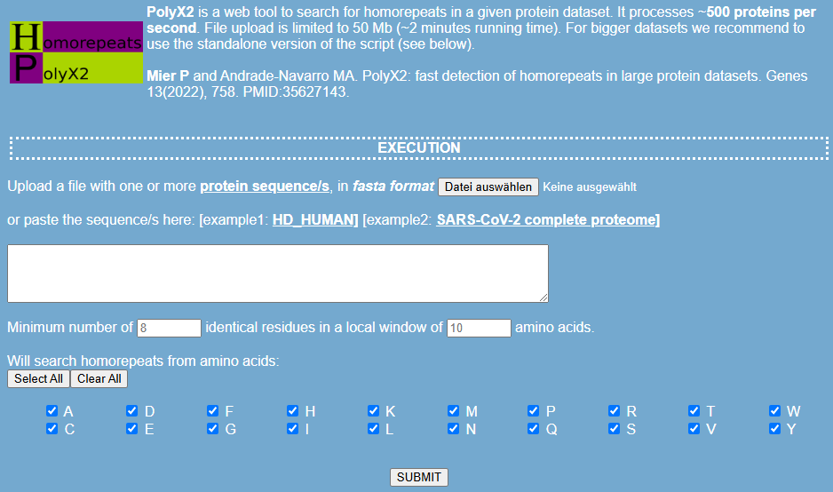
polyX2: Web tool to find homorepeats
Mier and Andrade-Navarro (2022) Genes

Slide 11

Exercise 2. Searching for homorepeats in a protein with polyX2
Find a random human protein in UniProt.
Write the Entry Name.

Slide 12
Exercise 2. Viewing homorepeats in an alignment with dAPE
Find a random human protein in UniProt.
Write the Entry Name.
Paste the sequence in polyX2
Find: (1) The longest pure homorepeat(s) (length and amino acid type)? (2) The longest polyA region allowing 2 residues in a window of 3?

Slide 13
Exercise 3. Find structures of short repeats
Go to the PDB web page: https://www.rcsb.org/
Go to Search > Advanced Search
Type a short repeat in the Sequence Motif: as many repeats as possible; Use Mode PROSITE and RegExp (example: QQQQ / another example: [SP]SA[SP]SA[SP]SA )
Click “count” to see if there are any cases
Check the structure (3D View) to see if the repeat is in the structure (it could be disordered = absent)
Write down the PDB name, RegExp and structure
Example 3NB9 QQQQ alpha-helix
Example 3FRC NNNN absent

