Slide 1
Repeats and composition bias
Miguel Andrade
Faculty of Biology,
Johannes Gutenberg University
Mainz, Germany
andrade@uni-mainz.de

Slide 2
Repeats

Slide 3
Frequency
14% proteins contains repeats (Marcotte et al, 1999)
1: Single amino acid repeats.
E.g. QQQQQQQQQQQQ
2: Longer imperfect tandem repeats. Assemble in structure.

Slide 4
Definition repeats
Sequence, length, imperfect, tandem
MRAVVKSPIMCHEKSPSVCSPLNMTSSVCSPAGINSVSSTTASF
GSFPVHSPITQGTPLTCSPNVENRGSRSHSPAHASNVGSPLSSPLSSMKSSISSPPSHCSVKSPVSSPNNVTLRSSVSSPANINN

Slide 5
Definition repeats
Sequence, length, imperfect, tandem
MRAVVKSPIMCHEKSPSVCSPLNMTSSVCSPAGINSVSSTTASFGSFPVHSPITQGTPLTCSPNVENRGSRSHSPAHASNVGSPLSSPLSSMKSSISSPPSHCSVKSPVSSPNNVTLRSSVSSPANINN

Slide 6
Definition repeats
Sequence, length, imperfect, tandem
MRAVVKSPIM CHE
KSPSVCSPLN
MTSSVCSPAG INSVSSTTASF
GSFPVHSPIT Q
GTPLTCSPNV EN
RGSRSHSPAH ASN
VGSPLSSPLS S
MKSSISSPPS HCS
VKSPVSSPNN VT
LRSSVSSPAN INN

Slide 7
Definition repeats
Sequence, length, imperfect, tandem
MRAVVKSPIM CHE
KSPSVCSPLN
MTSSVCSPAG INSVSSTTASF
GSFPVHSPIT Q
GTPLTCSPNV EN
RGSRSHSPAH ASN
VGSPLSSPLS S
MKSSISSPPS HCS
VKSPVSSPNN VT
LRSSVSSPAN INN

Slide 8
Tandem repeats fold together

Slide 9
Tandem repeats fold together

Slide 10
Tandem repeats fold together

Slide 11
Tandem repeats fold together

Slide 12
Tandem repeats fold together

Slide 13
Tandem repeats fold together

Slide 14
Definition repeats
Sequence, length, imperfect, tandem
MRAVVKSPIM CHE
KSPSVCSPLN
MTSSVCSPAG INSVSSTTASF
GSFPVHSPIT Q
GTPLTCSPNV EN
RGSRSHSPAH ASN
VGSPLSSPLS S
MKSSISSPPS HCS
VKSPVSSPNN VT
LRSSVSSPAN INN

Slide 15
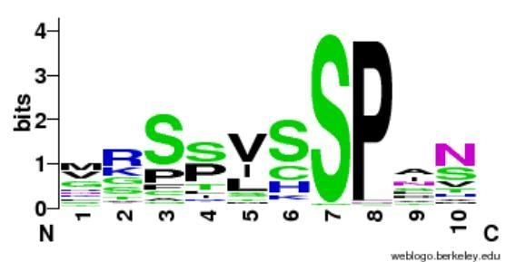
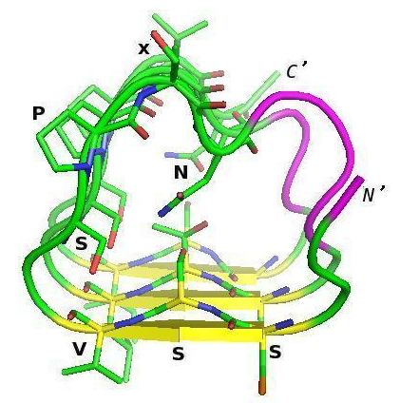
http://weblogo.berkeley.edu
(Vlassi et al, 2013)
Notes:
15

Slide 16
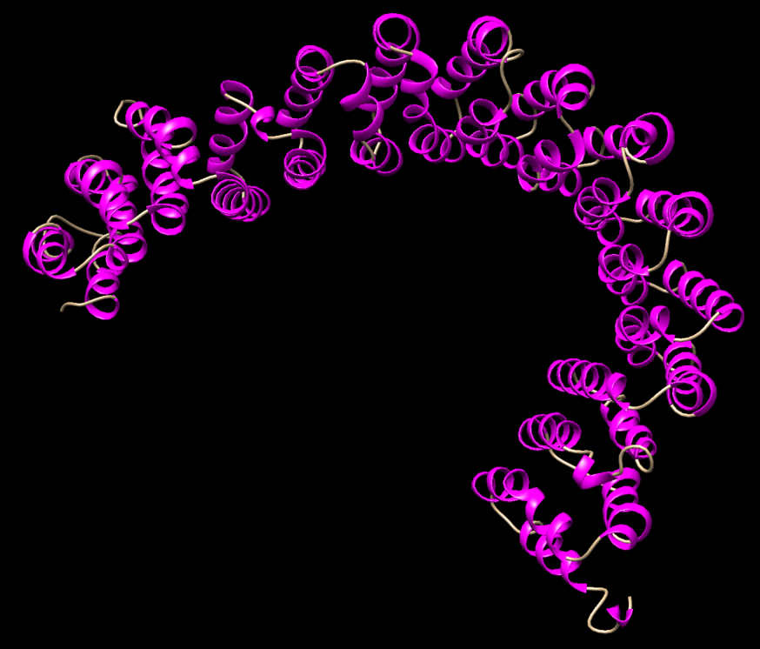
A subunit PP2A structure
PDB:1b3u
Groves et al. (1999) Cell

Slide 17
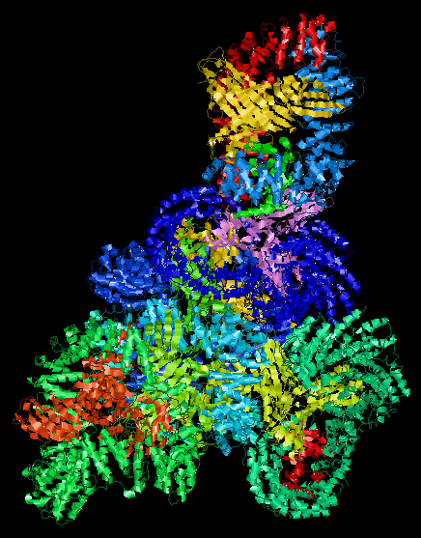
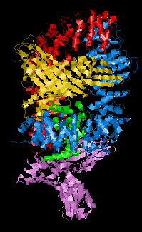
Ap1 Clathrin Adaptor Core
PDB:1w63
Heldwein et al. (2004) PNAS

Slide 18
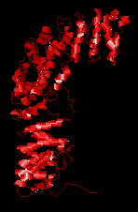

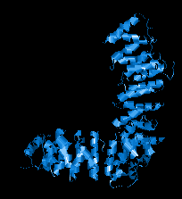
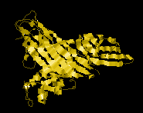
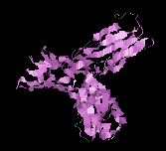
Ap1 Clathrin Adaptor Core
PDB:1w63
Heldwein et al. (2004) PNAS

Slide 19
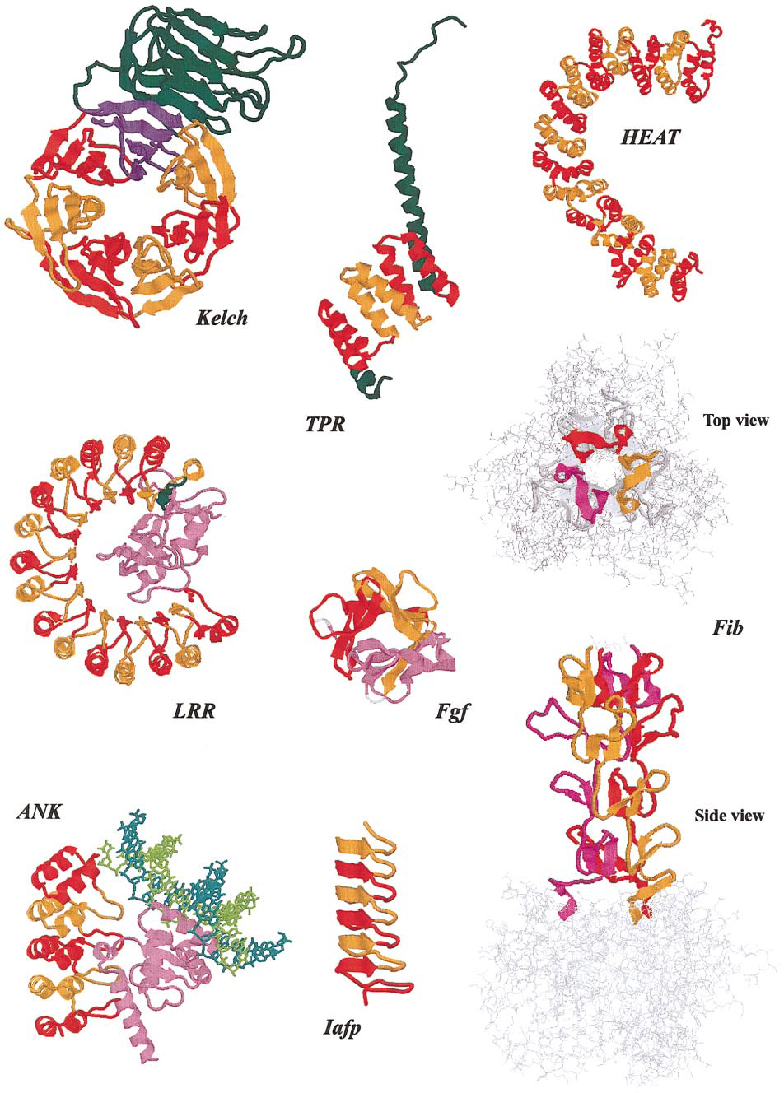
Andrade et al. (2001)
J Struct Biol

Slide 20
Detecting repeats in sequence
Often not straightforward.
N-terminal human Huntingtin.
Can you find repeats?
>sp|P42858|HD_HUMAN Huntingtin OS=Homo sapiens MATLEKLMKAFESLKSFQQQQQQQQQQQQQQQQQQQQQPPPPPPPPPPPQLPQPPPQAQP LLPQPQPPPPPPPPPPGPAVAEEPLHRPKKELSATKKDRVNHCLTICENIVAQSVRNSPE FQKLLGIAMELFLLCSDDAESDVRMVADECLNKVIKALMDSNLPRLQLELYKEIKKNGAP RSLRAALWRFAELAHLVRPQKCRPYLVNLLPCLTRTSKRPEESVQETLAAAVPKIMASFG NFANDNEIKVLLKAFIANLKSSSPTIRRTAAGSAVSICQHSRRTQYFYSWLLNVLLGLLV PVEDEHSTLLILGVLLTLRYLVPLLQQQVKDTSLKGSFGVTRKEMEVSPSAEQLVQVYEL TLHHTQHQDHNVVTGALELLQQLFRTPPPELLQTLTAVGGIGQLTAAKEESGGRSRSGSI VELIAGGGSSCSPVLSRKQKGKVLLGEEEALEDDSESRSDVSSSALTASVKDEISGELAA SSGVSTPGSAGHDIITEQPRSQHTLQADSVDLASCDLTSSATDGDEEDILSHSSSQVSAV PSDPAMDLNDGTQASSPISDSSQTTTEGPDSAVTPSDSSEIVLDGTDNQYLGLQIGQPQD EDEEATGILPDEASEAFRNSSMALQQAHLLKNMSHCRQPSDSSVDKFVLRDEATEPGDQE NKPCRIKGDIGQSTDDDSAPLVHCVRLLSASFLLTGGKNVLVPDRDVRVSVKALALSCVG AAVALHPESFFSKLYKVPLDTTEYPEEQYVSDILNYIDHGDPQVRGATAILCGTLICSIL

Slide 21
Detecting repeats in sequence
Often not straightforward.
N-terminal human Huntingtin.
Can you find repeats?
>sp|P42858|HD_HUMAN Huntingtin OS=Homo sapiens MATLEKLMKAFESLKSFQQQQQQQQQQQQQQQQQQQQQPPPPPPPPPPPQLPQPPPQAQP LLPQPQPPPPPPPPPPGPAVAEEPLHRPKKELSATKKDRVNHCLTICENIVAQSVRNSPE FQKLLGIAMELFLLCSDDAESDVRMVADECLNKVIKALMDSNLPRLQLELYKEIKKNGAP RSLRAALWRFAELAHLVRPQKCRPYLVNLLPCLTRTSKRPEESVQETLAAAVPKIMASFG NFANDNEIKVLLKAFIANLKSSSPTIRRTAAGSAVSICQHSRRTQYFYSWLLNVLLGLLV PVEDEHSTLLILGVLLTLRYLVPLLQQQVKDTSLKGSFGVTRKEMEVSPSAEQLVQVYEL TLHHTQHQDHNVVTGALELLQQLFRTPPPELLQTLTAVGGIGQLTAAKEESGGRSRSGSI VELIAGGGSSCSPVLSRKQKGKVLLGEEEALEDDSESRSDVSSSALTASVKDEISGELAA SSGVSTPGSAGHDIITEQPRSQHTLQADSVDLASCDLTSSATDGDEEDILSHSSSQVSAV PSDPAMDLNDGTQASSPISDSSQTTTEGPDSAVTPSDSSEIVLDGTDNQYLGLQIGQPQD EDEEATGILPDEASEAFRNSSMALQQAHLLKNMSHCRQPSDSSVDKFVLRDEATEPGDQE NKPCRIKGDIGQSTDDDSAPLVHCVRLLSASFLLTGGKNVLVPDRDVRVSVKALALSCVG AAVALHPESFFSKLYKVPLDTTEYPEEQYVSDILNYIDHGDPQVRGATAILCGTLICSIL

Slide 22
Detecting repeats in sequence
Often not straightforward.
N-terminal human Huntingtin.
Can you find repeats?
EFQKLLGIAMELFLLCSDDAESDVRMVADECLNKVIKA
CRPYLVNLLPCLTRTSKRP-EESVQETLAAAVPKIMAS NDNEIKVLLKAFIANLKSSSPTIRRTAAGSAVSICQHS
TQYFYSWLLNVLLGLLVPVEDEHSTLLILGVLLTLRYL
PSAEQLVQVYELTLHHTQHQDHNVVTGALELLQQLFRT

Slide 23
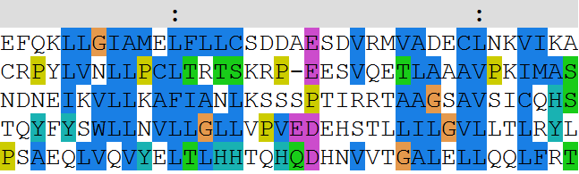
Detecting repeats in sequence
Often not straightforward.
N-terminal human Huntingtin.
Can you find repeats?
EFQKLLGIAMELFLLCSDDAESDVRMVADECLNKVIKA
CRPYLVNLLPCLTRTSKRP-EESVQETLAAAVPKIMAS NDNEIKVLLKAFIANLKSSSPTIRRTAAGSAVSICQHS
TQYFYSWLLNVLLGLLVPVEDEHSTLLILGVLLTLRYL
PSAEQLVQVYELTLHHTQHQDHNVVTGALELLQQLFRT

Slide 24
Detecting repeats in sequence
Dotplots
Comparing a sequence against itself

Slide 25
Detecting repeats in sequence
Dotplots
TLRSSVSSPANINNS
NMTSSVCSPANISV

Slide 26
Detecting repeats in sequence
Dotplots
TLRSSVSSPANINNS
|
1 match
NMTSSVCSPANISV

Slide 27
Detection of repeats
Dotplots
TLRSSVSSPANINNS
||| |||||
8 matches
NMTSSVCSPANISV

Slide 28
Detection of repeats
Dotplots
TLRSSVSSPANINNS
| |
2 matches
NMTSSVCSPANISV

Slide 29
Detecting repeats in sequence
Dotplots
TLRSSVSSPANINNS
|
1 match
NMTSSVCSPANISV

Slide 30
Detecting repeats in sequence
Dotplots
TLRSSVSSPANINNS
NMTSSVCSPANISV
8

Slide 31
Detecting repeats in sequence
Dotplots
TLRSSVSSPANINNS
NMTSSVCSPANISV
1821

Slide 32
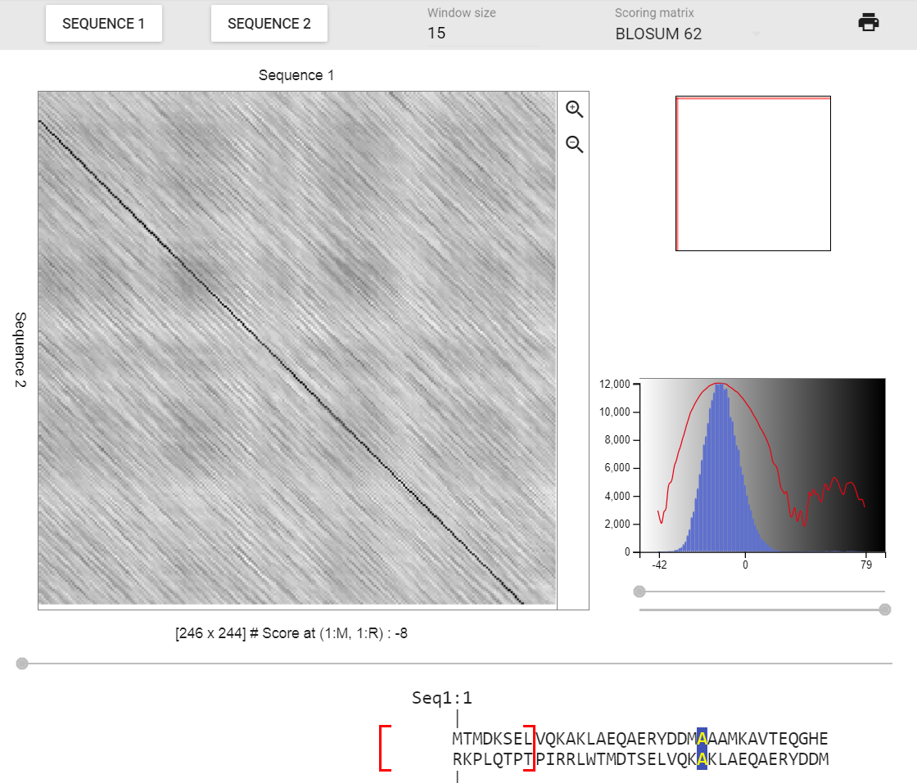
Exercise 1

Slide 33
Exercise 1. Using Dotlet with the human mineralocorticoid receptor (MR)
Go to the Dotlet web page:
http://dotlet.vital-it.ch
Click on the input button and paste the sequence of the human mineralocorticoid receptor (UniProt id P08235)
Try to find combinations of parameters that show patterns in the dot plot (Hint: You can adjust this finely using the arrows)
Find repetitions clicking in the diagonal patterns

Slide 34
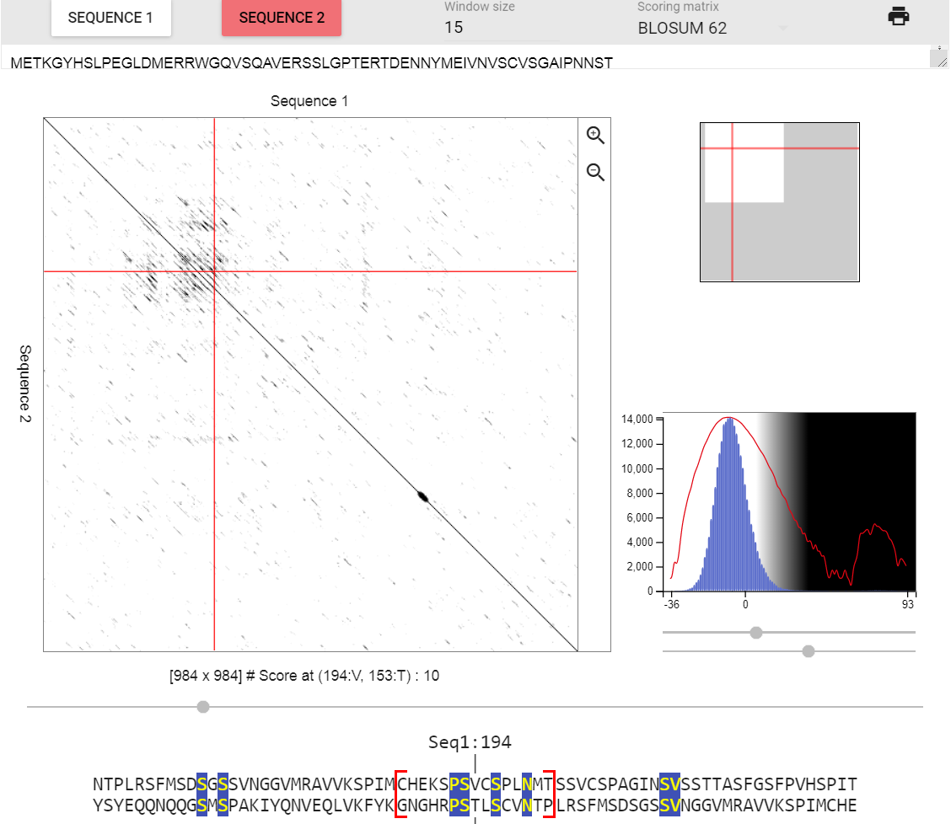
Exercise 1. Using Dotlet with the human mineralocorticoid receptor (MR)

Slide 35
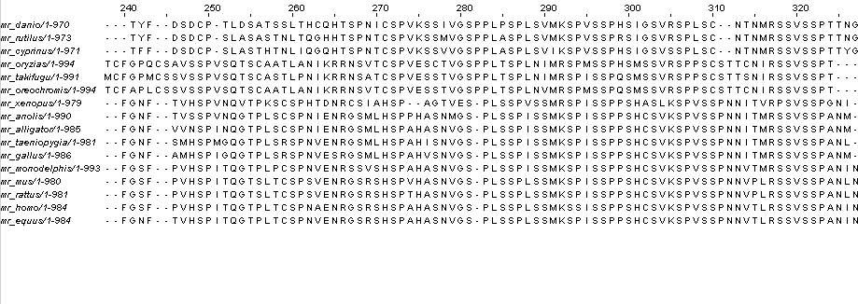
Detecting repeats in sequence
Using a multiple sequence alignment helps.
Conserved repeated patterns
JalView with Regular Expression searches

Slide 36
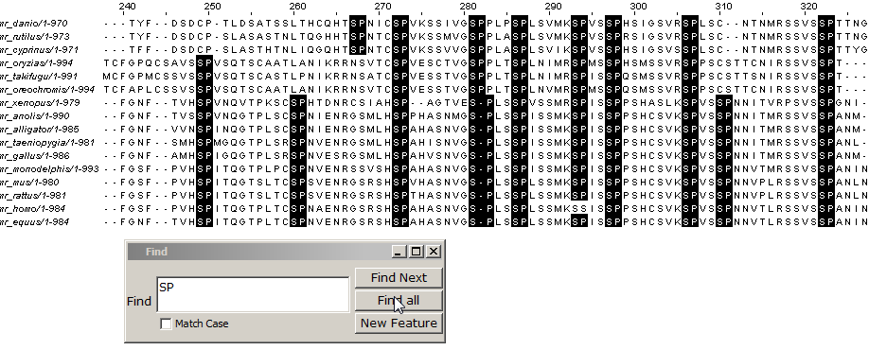
Detecting repeats in sequence
Using a multiple sequence alignment helps
Conserved repeated patterns
JalView with Regular Expression searches

Slide 37
Detecting repeats in sequence
Using a multiple sequence alignment helps
Conserved repeated patterns
JalView with Regular Expression searches

Slide 38
Detecting repeats in sequence
Using a multiple sequence alignment helps
Conserved repeated patterns
JalView with Regular Expression searches
Regular Expressions:
[LS]P.A
matches L or S, followed by P, followed by anything, followed by A

Slide 39
Detecting repeats in sequence
Using a multiple sequence alignment helps
Conserved repeated patterns
JalView with Regular Expression searches
Regular Expressions:
[LS]P.A
matches L or S, followed by P, followed by anything, followed by A
Which one is not matched?
LPTA, SPAA, LPPA, LPAP, SPLA

Slide 40
Detecting repeats in sequence
Using a multiple sequence alignment helps
Conserved repeated patterns
JalView with Regular Expression searches
Regular Expressions:
[LS]P.A
matches L or S, followed by P, followed by anything, followed by A
Which one is not matched?
LPTA, SPAA, LPPA, LPAP, SPLA

Slide 41
Exercise 2. Using JalView with a MSA of the MR with orthologs
Load the multiple sequence alignment of the MR in JalView: MR1_fasta.txt (from URL: https://cbdm.uni-mainz.de/ files/2015/02/MR1_fasta.txt)
Use the “Select > find" (of Ctrl+F) option with a regular expression and mark all matches (click the “Find all” option!)
Search the motif “SP”. Look for regions with repeats. Would you correct the alignment based on the hits? Experiment with other motifs.

Slide 42
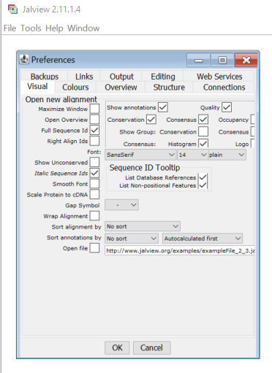
First time running JalView?
Remove annoying start:
Go to
Tools > Preferences > Visual
Un-tick option “Open file”

Slide 43
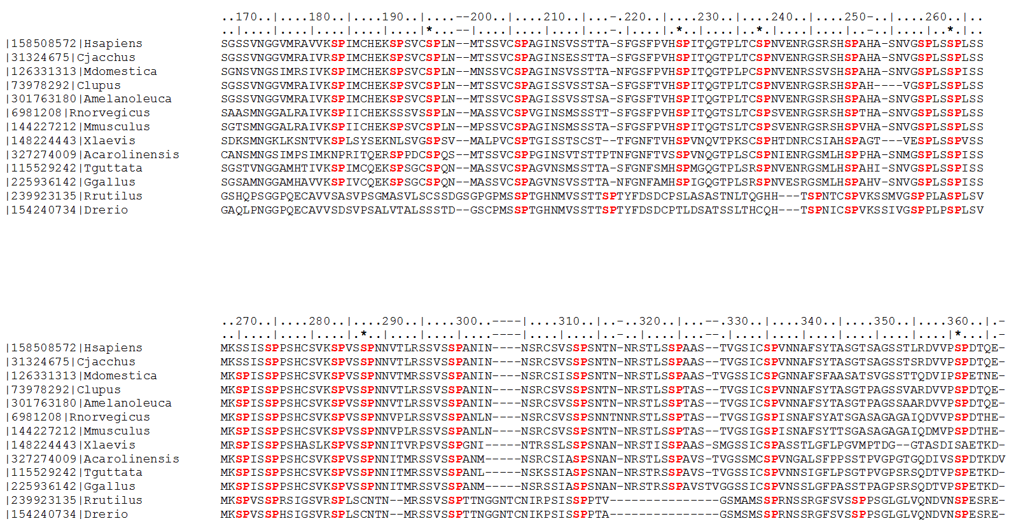
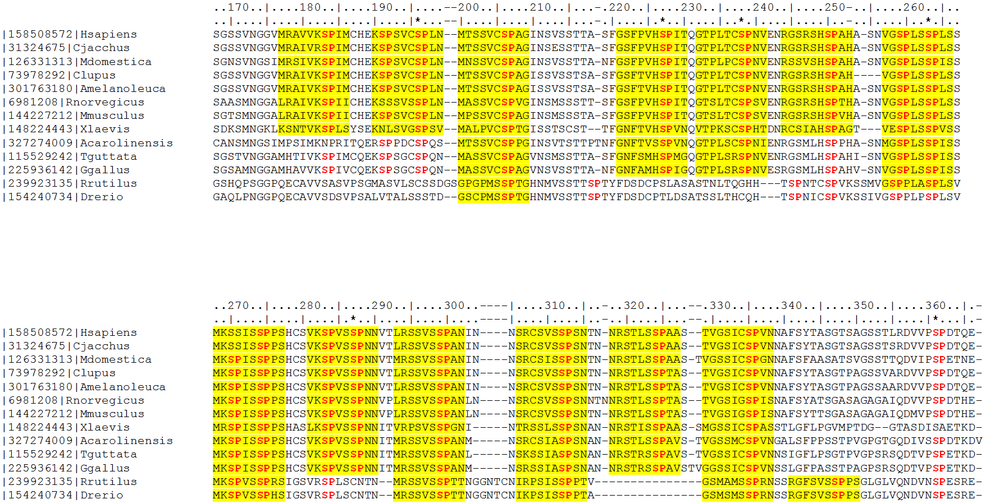
#T1
#T2
#T3
#T4
#T5
#T6
#T7
*
*
*
*
#F1
#F2
#F3
#F4
#T8
#T9
#T10
#T11
#T12
#T13
#T14
#T15
*
*
*
#F5
#F6
#F7
#F8
#F9
#F10
#F11
Vlassi et al. (2013) BMC Struct. Biol.
Notes:
43

Slide 44
Mineralocorticoid receptor
Repeat region
AF1a
ID
AF1b
DBD
LBD
984 aa
NTD
0
100
200
300
400
500
600
700
800
900
1000
aa
Vlassi et al. (2013) BMC Struct. Biol.
Notes:
44

Slide 45
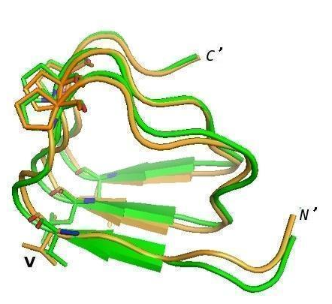
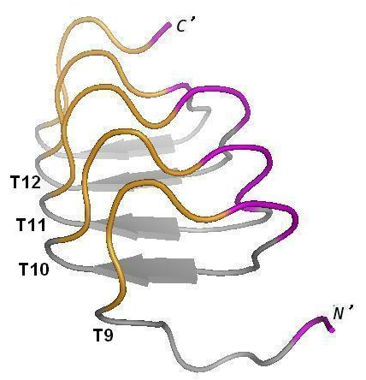
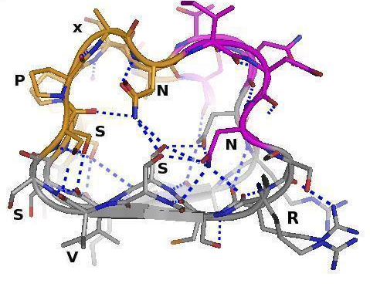
Notes:
45
45

Slide 46

Modelling the repeat region with AlphaFold…

Slide 47
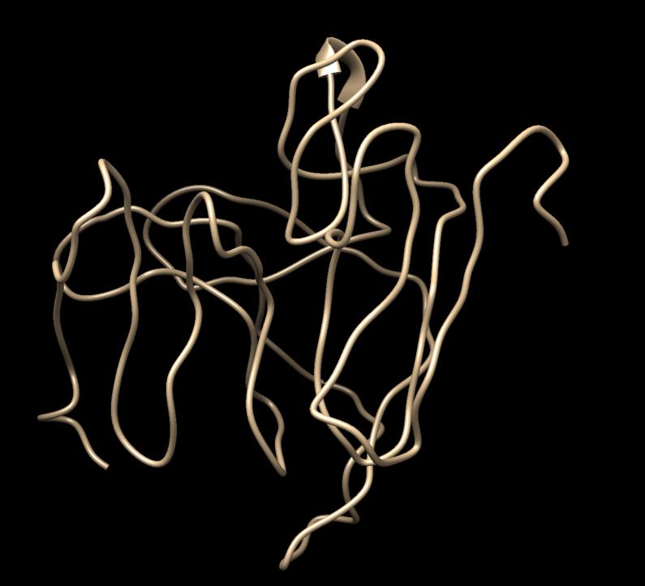
Modelling with CI-Tasser…

Slide 48
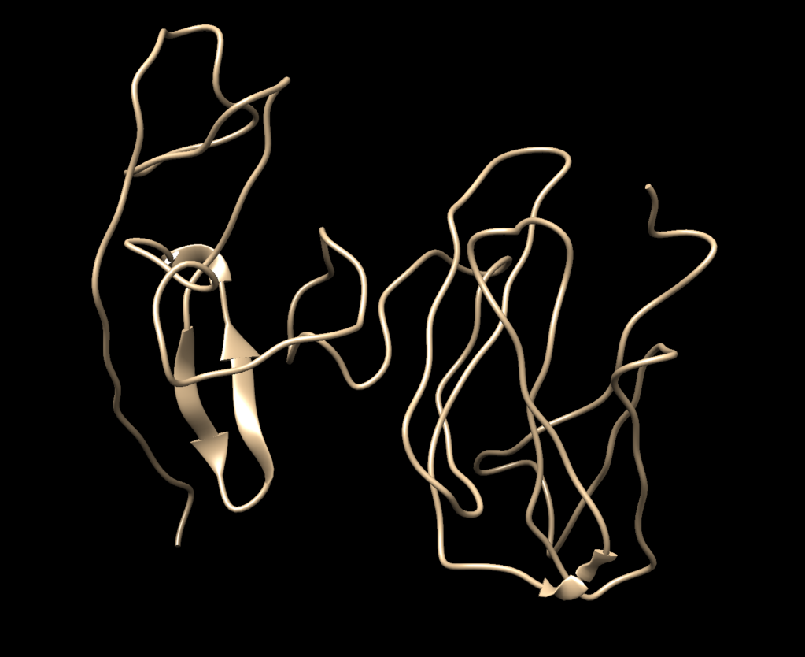
Modelling with trRosetta…

Slide 49
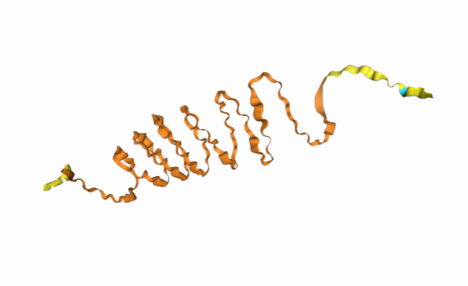
Modelling with AlphaFold3…
27 Nov 2024

Slide 50
Composition bias

Slide 51
Detection of CBRs
Compositionally biased regions (CBRs)
High frequency of one or two amino acids in a region.
E.g. QLPQPPPQAQPLLPQPQ
Also:
Single amino acid repeats (homorepeats)
E.g. QQQQQQQQQQQ (polyQ)

Slide 52
Detection of CBRs
Often straightforward.
N-terminal human Huntingtin.
Can you find CBRs?
>sp|P42858|HD_HUMAN Huntingtin OS=Homo sapiens MATLEKLMKAFESLKSFQQQQQQQQQQQQQQQQQQQQQPPPPPPPPPPPQLPQPPPQAQP LLPQPQPPPPPPPPPPGPAVAEEPLHRPKKELSATKKDRVNHCLTICENIVAQSVRNSPE FQKLLGIAMELFLLCSDDAESDVRMVADECLNKVIKALMDSNLPRLQLELYKEIKKNGAP RSLRAALWRFAELAHLVRPQKCRPYLVNLLPCLTRTSKRPEESVQETLAAAVPKIMASFG NFANDNEIKVLLKAFIANLKSSSPTIRRTAAGSAVSICQHSRRTQYFYSWLLNVLLGLLV PVEDEHSTLLILGVLLTLRYLVPLLQQQVKDTSLKGSFGVTRKEMEVSPSAEQLVQVYEL TLHHTQHQDHNVVTGALELLQQLFRTPPPELLQTLTAVGGIGQLTAAKEESGGRSRSGSI VELIAGGGSSCSPVLSRKQKGKVLLGEEEALEDDSESRSDVSSSALTASVKDEISGELAA SSGVSTPGSAGHDIITEQPRSQHTLQADSVDLASCDLTSSATDGDEEDILSHSSSQVSAV PSDPAMDLNDGTQASSPISDSSQTTTEGPDSAVTPSDSSEIVLDGTDNQYLGLQIGQPQD EDEEATGILPDEASEAFRNSSMALQQAHLLKNMSHCRQPSDSSVDKFVLRDEATEPGDQE NKPCRIKGDIGQSTDDDSAPLVHCVRLLSASFLLTGGKNVLVPDRDVRVSVKALALSCVG AAVALHPESFFSKLYKVPLDTTEYPEEQYVSDILNYIDHGDPQVRGATAILCGTLICSIL

Slide 53
Detection of CBRs
Often straightforward.
N-terminal human Huntingtin.
Can you find CBRs?
>sp|P42858|HD_HUMAN Huntingtin OS=Homo sapiens MATLEKLMKAFESLKSFQQQQQQQQQQQQQQQQQQQQQPPPPPPPPPPPQLPQPPPQAQP LLPQPQPPPPPPPPPPGPAVAEEPLHRPKKELSATKKDRVNHCLTICENIVAQSVRNSPE FQKLLGIAMELFLLCSDDAESDVRMVADECLNKVIKALMDSNLPRLQLELYKEIKKNGAP RSLRAALWRFAELAHLVRPQKCRPYLVNLLPCLTRTSKRPEESVQETLAAAVPKIMASFG NFANDNEIKVLLKAFIANLKSSSPTIRRTAAGSAVSICQHSRRTQYFYSWLLNVLLGLLV PVEDEHSTLLILGVLLTLRYLVPLLQQQVKDTSLKGSFGVTRKEMEVSPSAEQLVQVYEL TLHHTQHQDHNVVTGALELLQQLFRTPPPELLQTLTAVGGIGQLTAAKEESGGRSRSGSI VELIAGGGSSCSPVLSRKQKGKVLLGEEEALEDDSESRSDVSSSALTASVKDEISGELAA SSGVSTPGSAGHDIITEQPRSQHTLQADSVDLASCDLTSSATDGDEEDILSHSSSQVSAV PSDPAMDLNDGTQASSPISDSSQTTTEGPDSAVTPSDSSEIVLDGTDNQYLGLQIGQPQD EDEEATGILPDEASEAFRNSSMALQQAHLLKNMSHCRQPSDSSVDKFVLRDEATEPGDQE NKPCRIKGDIGQSTDDDSAPLVHCVRLLSASFLLTGGKNVLVPDRDVRVSVKALALSCVG AAVALHPESFFSKLYKVPLDTTEYPEEQYVSDILNYIDHGDPQVRGATAILCGTLICSIL

Slide 54
Detection of CBRs
Often straightforward.
N-terminal human Huntingtin.
Can you find CBRs?
>sp|P42858|HD_HUMAN Huntingtin OS=Homo sapiens MATLEKLMKAFESLKSFQQQQQQQQQQQQQQQQQQQQQPPPPPPPPPPPQLPQPPPQAQP LLPQPQPPPPPPPPPPGPAVAEEPLHRPKKELSATKKDRVNHCLTICENIVAQSVRNSPE FQKLLGIAMELFLLCSDDAESDVRMVADECLNKVIKALMDSNLPRLQLELYKEIKKNGAP RSLRAALWRFAELAHLVRPQKCRPYLVNLLPCLTRTSKRPEESVQETLAAAVPKIMASFG NFANDNEIKVLLKAFIANLKSSSPTIRRTAAGSAVSICQHSRRTQYFYSWLLNVLLGLLV PVEDEHSTLLILGVLLTLRYLVPLLQQQVKDTSLKGSFGVTRKEMEVSPSAEQLVQVYEL TLHHTQHQDHNVVTGALELLQQLFRTPPPELLQTLTAVGGIGQLTAAKEESGGRSRSGSI VELIAGGGSSCSPVLSRKQKGKVLLGEEEALEDDSESRSDVSSSALTASVKDEISGELAA SSGVSTPGSAGHDIITEQPRSQHTLQADSVDLASCDLTSSATDGDEEDILSHSSSQVSAV PSDPAMDLNDGTQASSPISDSSQTTTEGPDSAVTPSDSSEIVLDGTDNQYLGLQIGQPQD EDEEATGILPDEASEAFRNSSMALQQAHLLKNMSHCRQPSDSSVDKFVLRDEATEPGDQE NKPCRIKGDIGQSTDDDSAPLVHCVRLLSASFLLTGGKNVLVPDRDVRVSVKALALSCVG AAVALHPESFFSKLYKVPLDTTEYPEEQYVSDILNYIDHGDPQVRGATAILCGTLICSIL

Slide 55
Detection of CBRs
Often straightforward.
N-terminal human Huntingtin.
Can you find CBRs?
>sp|P42858|HD_HUMAN Huntingtin OS=Homo sapiens MATLEKLMKAFESLKSFQQQQQQQQQQQQQQQQQQQQQPPPPPPPPPPPQLPQPPPQAQP LLPQPQPPPPPPPPPPGPAVAEEPLHRPKKELSATKKDRVNHCLTICENIVAQSVRNSPE FQKLLGIAMELFLLCSDDAESDVRMVADECLNKVIKALMDSNLPRLQLELYKEIKKNGAP RSLRAALWRFAELAHLVRPQKCRPYLVNLLPCLTRTSKRPEESVQETLAAAVPKIMASFG NFANDNEIKVLLKAFIANLKSSSPTIRRTAAGSAVSICQHSRRTQYFYSWLLNVLLGLLV PVEDEHSTLLILGVLLTLRYLVPLLQQQVKDTSLKGSFGVTRKEMEVSPSAEQLVQVYEL TLHHTQHQDHNVVTGALELLQQLFRTPPPELLQTLTAVGGIGQLTAAKEESGGRSRSGSI VELIAGGGSSCSPVLSRKQKGKVLLGEEEALEDDSESRSDVSSSALTASVKDEISGELAA SSGVSTPGSAGHDIITEQPRSQHTLQADSVDLASCDLTSSATDGDEEDILSHSSSQVSAV PSDPAMDLNDGTQASSPISDSSQTTTEGPDSAVTPSDSSEIVLDGTDNQYLGLQIGQPQD EDEEATGILPDEASEAFRNSSMALQQAHLLKNMSHCRQPSDSSVDKFVLRDEATEPGDQE NKPCRIKGDIGQSTDDDSAPLVHCVRLLSASFLLTGGKNVLVPDRDVRVSVKALALSCVG AAVALHPESFFSKLYKVPLDTTEYPEEQYVSDILNYIDHGDPQVRGATAILCGTLICSIL

Slide 56
Function of CBRs
Conservation => Function
Length, amino acid type not necessarily conserved
Frequency: 1 in 3 proteins contains a compositionally biased region (Wootton, 1994), ~11% conserved (Sim and Creamer, 2004)

Slide 57
Function of CBRs
Conservation => Function
Length, amino acid type not necessarily conserved
Functions:
Passive: linkers
Active: binding, mediate protein interaction, structural integrity
(Sim and Creamer, 2004)

Slide 58
Structure of CBRs
Often variable or flexible: do not easily crystalize

Slide 59
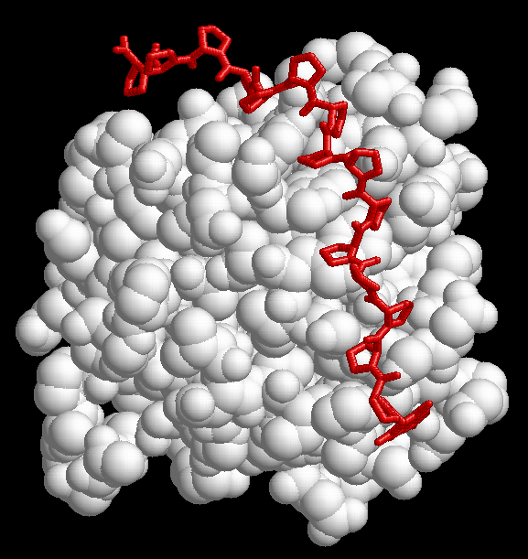
1CJF: profilin bound to polyP

Slide 60
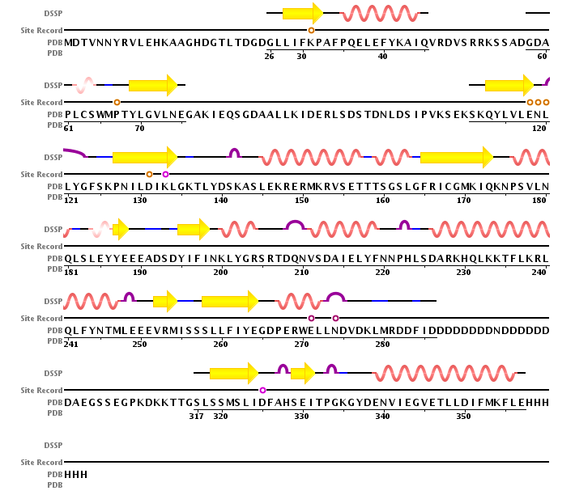
2IF8: Inositol Phosphate Multikinase Ipk2

Slide 61
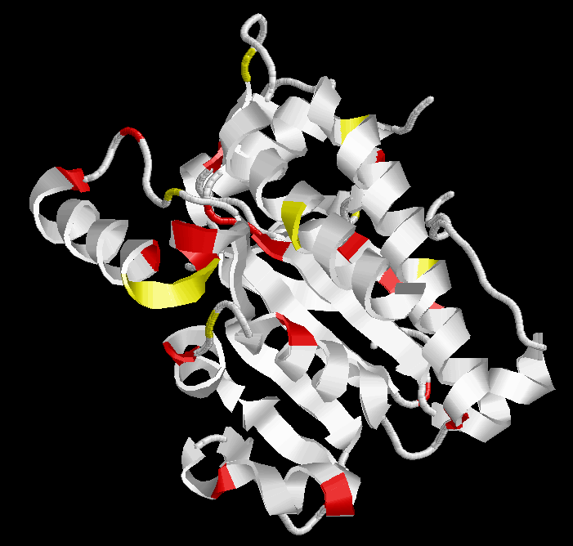
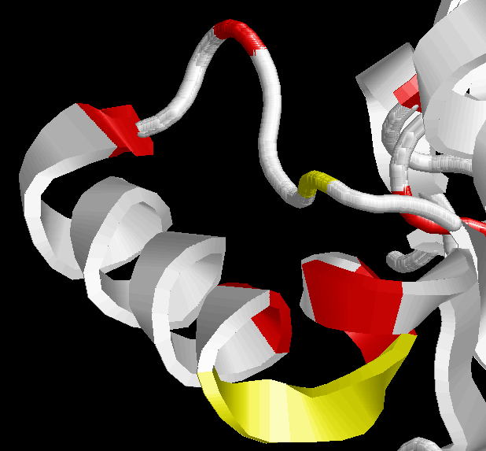
2IF8: Inositol Phosphate Multikinase Ipk2
RVSETTTSGSL

Slide 62
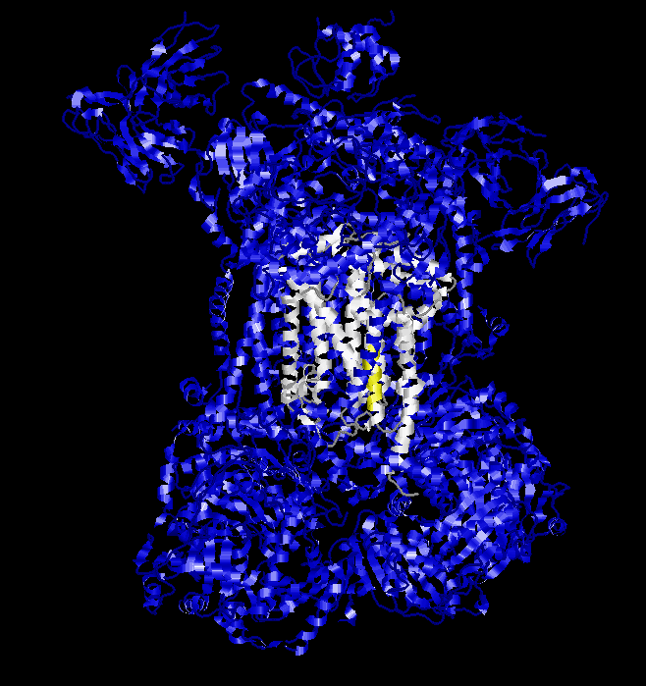
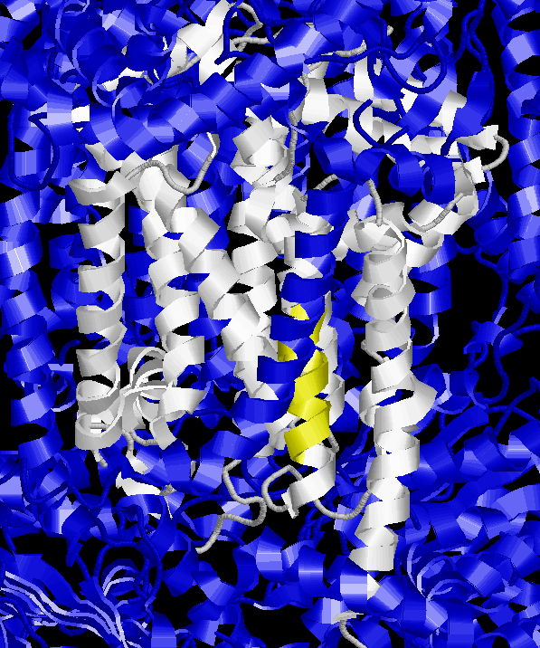
2CX5: mitochondrial cytochrome c
B subunit N-terminal

Slide 63
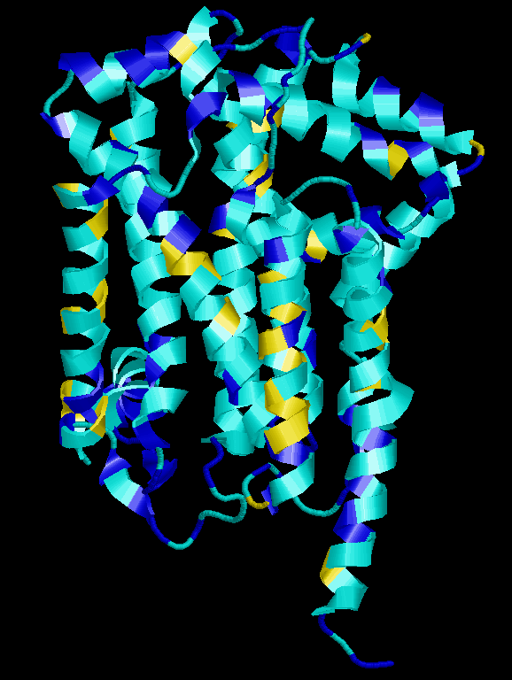

2CX5: mitochondrial cytochrome c
B subunit N-terminal
FFFFIFVFNF

Slide 64
Amino acid homorepeats (polyX)
Distribution is not random:
Eukaryota:
Most common: poly-Q, poly-N, poly-A, poly-S, poly-G
Prokaryota:
Most common: poly-S, poly-G, poly-A, poly-P
Relatively rare: poly-Q, poly-N
Very rare or absent in both eukaryota and prokaryota:
Poly-I, Poly-M, Poly-W, Poly-C, Poly-Y
Toxicity of long stretches of hydrophobic residues.
(Faux et al 2005)

Slide 65
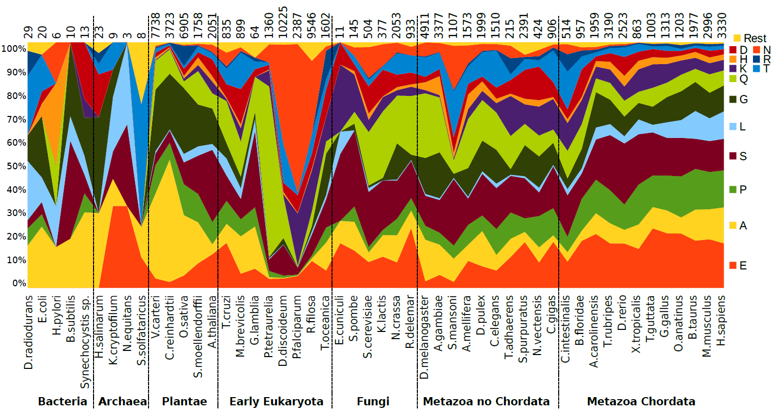

Amino acid homorepeats (polyX)
Pablo Mier
Mier et al. (2017) Proteins

Slide 66
Homorepeats are frequent but difficult to characterize
Pablo Mier
e.g. polyQ: MATLEKLMKAFESLKSFQQQQQQQQQQQQQQQQQQQQQQQPPPPPPPPPPPQLPQP
10% of human proteins have homorepeats
low sequence conservation
not possible to predict function by homology
Homorepeats need to be studied in context
Notes:
30% residues are disordered
50% human proteins have one long disordered segment

Slide 67

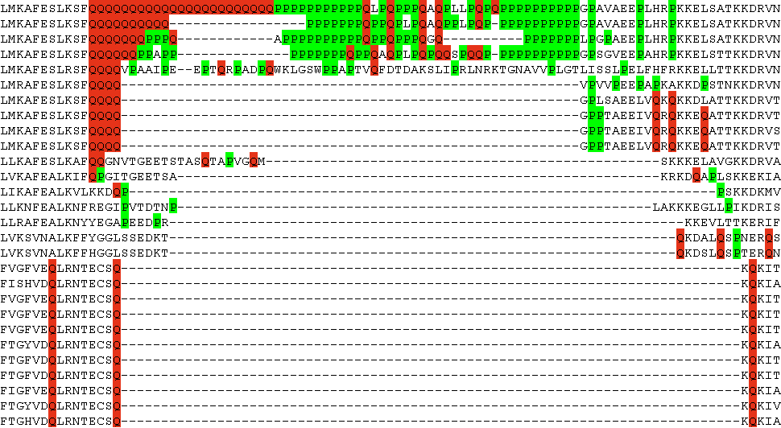
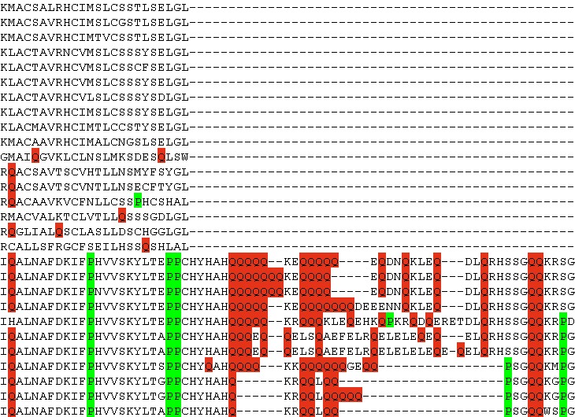
Function of polyQ
Martin
Schaefer
polyQ in Huntingtin
Human
Dog
Mouse
Opossum
Chicken
Frog
Zebrafish
Trout
Fugu
Stickleback
Lancelet
Capitella
Limpet
Nematostella
Trichoplax
Ciona intestinalis
Ciona savignyi
D. melanogaster
D. mojavensis
D. sechellia
D. erecta
D. yakuba
D. grimshawi
D. pseudoobscura
D. persimilis
D. ananassae
D. willistoni
D. virilis
Schaefer et al (2012) Nucleic Acids Res.

Slide 68
Exercise 3. Search for a polyQ insertion in the MR family
Open in Jalview the alignment of the mineralocorticoid receptor: MR1_fasta.txt
Find a polyQ insertion.
Do you see any other biased region nearby?

