Slide 1
Protein structure prediction
Miguel Andrade
Faculty of Biology,
Institute of Organismic and Molecular Evolution
Johannes Gutenberg University
Mainz, Germany
andrade@uni-mainz.de

Slide 2
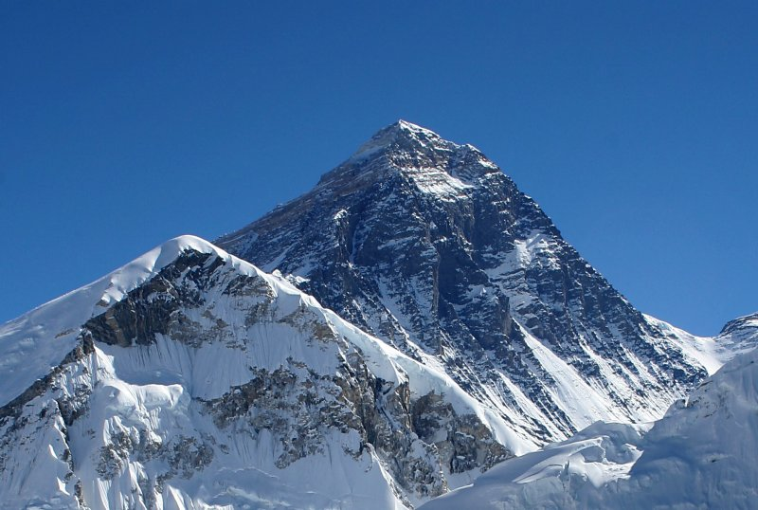
Mount Everest
Age: 60M years

Slide 3
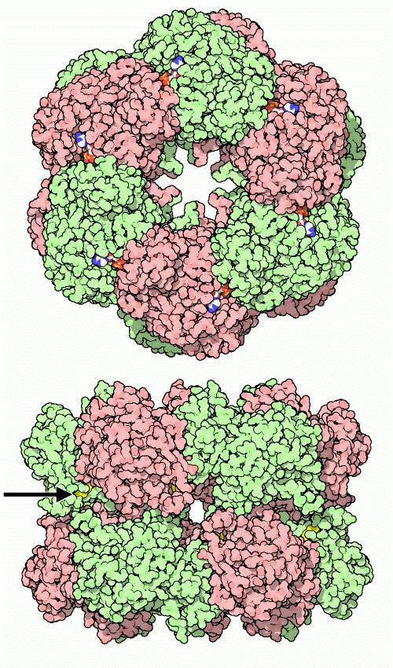
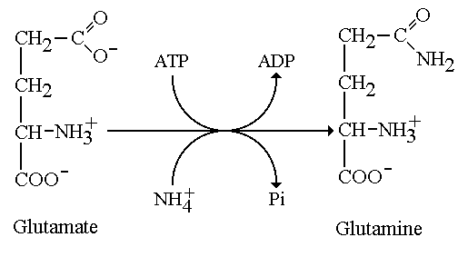
Glutamine synthetase
Age: +3500M years

Slide 4
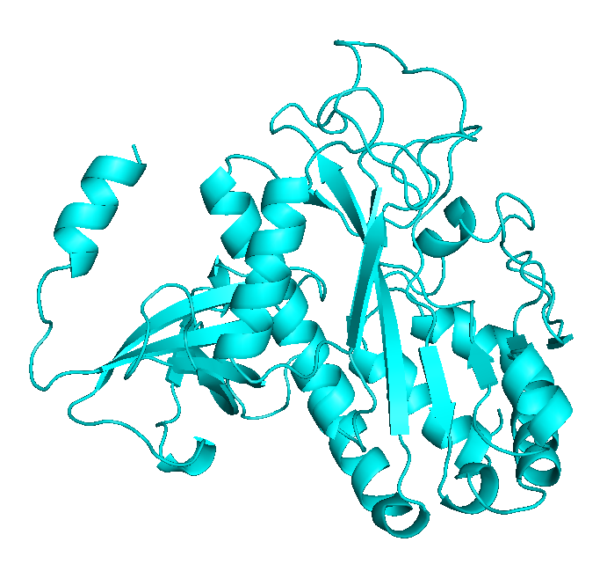
Glutamine synthetase
Human
PDB:2QC8

Slide 5
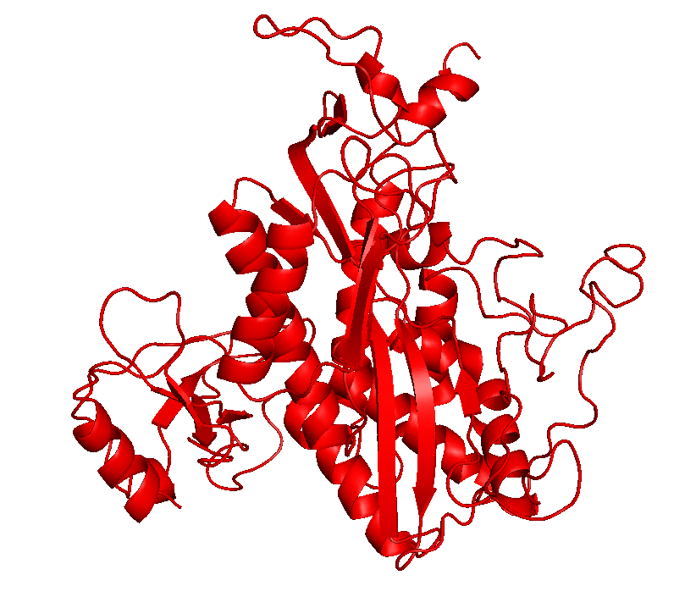
Glutamine synthetase
Salmonella typhimurium
PDB:2GLS

Slide 6
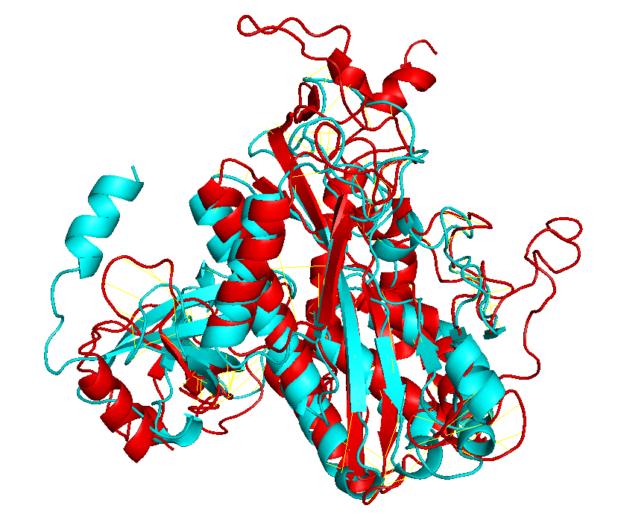
Glutamine synthetase

Slide 7
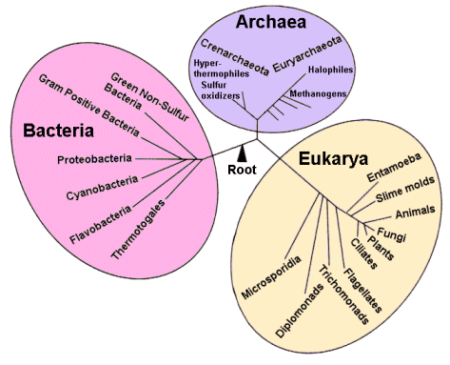
Time line
Earth: 4.6 By
Origin of life: 3.9 By – 3.5 By
Last Common Ancestor: 3.5 – 3.8 By
Glansdorff & Labedan (2008) Biology Direct
4.29 By
Sheridan et al. (2003) Geomicrobiology Journal

Slide 8
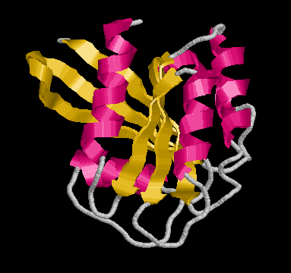
Sequence and function
Evolutionary constraints
MTQDELKKAVGWAALQYVQPGTIVGVGTGSTAAHFIDALGTMKGQIEGAVSSSDASTEKL
Sequence
Structure
Function

Slide 9
Sequence and function
Evolutionary constraints
Speciation/orthology
Sequence 1
Structure 1
Function 1
Sequence
Similarity
Sequence 2
Structure 2
Function 1
Gene duplication/paralogy
Sequence 1
Structure 1
Function 1
Sequence
Similarity
Sequence 2
Structure 2
Function 2

Slide 10
Sequence pairwise alignment
>gs_human gi|74271837|ref|NP_001028216.1| glutamine synthetase [Homo sapiens]
MTTSASSHLNKGIKQVYMSLPQGEKVQAMYIWIDGTGEGLRCKTRTLDSEPKCVEELPEWNFDGSSTLQS
EGSNSDMYLVPAAMFRDPFRKDPNKLVLCEVFKYNRRPAETNLRHTCKRIMDMVSNQHPWFGMEQEYTLM
GTDGHPFGWPSNGFPGPQGPYYCGVGADRAYGRDIVEAHYRACLYAGVKIAGTNAEVMPAQWEFQIGPCE
GISMGDHLWVARFILHRVCEDFGVIATFDPKPIPGNWNGAGCHTNFSTKAMREENGLKYIEEAIEKLSKR
HQYHIRAYDPKGGLDNARRLTGFHETSNINDFSAGVANRSASIRIPRTVGQEKKGYFEDRRPSANCDPFS
VTEALIRTCLLNETGDEPFQYKN
>gs_salmonella gi|16767272|ref|NP_462887.1| glutamine synthetase [Salmonella enterica subsp. enterica serovar Typhimurium str. LT2]
MSAEHVLTMLNEHEVKFVDLRFTDTKGKEQHVTIPAHQVNAEFFEEGKMFDGSSIGGWKGINESDMVLMP
DASTAVIDPFFADSTLIIRCDILEPGTLQGYDRDPRSIAKRAEDYLRATGIADTVLFGPEPEFFLFDDIR
FGASISGSHVAIDDIEGAWNSSTKYEGGNKGHRPGVKGGYFPVPPVDSAQDIRSEMCLVMEQMGLVVEAH
HHEVATAGQNEVATRFNTMTKKADEIQIYKYVVHNVAHRFGKTATFMPKPMFGDNGSGMHCHMSLAKNGT
NLFSGDKYAGLSEQALYYIGGVIKHAKAINALANPTTNSYKRLVPGYEAPVMLAYSARNRSASIRIPVVA
SPKARRIEVRFPDPAANPYLCFAALLMAGLDGIKNKIHPGEAMDKNLYDLPPEEAKEIPQVAGSLEEALN
ALDLDREFLKAGGVFTDEAIDAYIALRREEDDRVRMTPHPVEFELYYSV

Slide 11
Sequence pairwise alignment
BLAST (Altschul et al, 1990)
>lcl|39919 unnamed protein product
Length=469
Score = 70.5 bits (171), Expect = 1e-17, Method: Compositional matrix adjust.
Identities = 102/363 (28%), Positives = 138/363 (38%), Gaps = 96/363 (26%)
Query 62 FDGSSTLQSEGSN-SDMYLVPAA--MFRDPFRKDPNKLVLCEVFK------YNRRP---- 108
FDGSS +G N SDM L+P A DPF D ++ C++ + Y+R P
Sbjct 50 FDGSSIGGWKGINESDMVLMPDASTAVIDPFFADSTLIIRCDILEPGTLQGYDRDPRSIA 109
Query 109 --AETNLRHTCKRIMDMVSNQHPWFGMEQEYTLMGTDGHPFGWPSNGF------------ 154
AE LR T I D V FG E E+ L D FG +G
Sbjct 110 KRAEDYLRATG--IADTV-----LFGPEPEFFLF--DDIRFGASISGSHVAIDDIEGAWN 160
Query 155 -------------PGPQGPYYCGVGADRAYGRDI--------------VEAHYRACLYAG 187
PG +G Y+ D A +DI VEAH+ AG
Sbjct 161 SSTKYEGGNKGHRPGVKGGYFPVPPVDSA--QDIRSEMCLVMEQMGLVVEAHHHEVATAG 218
Query 188 VKIAGTNAEVMPAQWEFQIGPCEGISMGDHLWVARFILHRVCEDFGVIATFDPKPIPG-N 246
T M + D + + ++++H V FG ATF PKP+ G N
Sbjct 219 QNEVATRFNTMTKK-------------ADEIQIYKYVVHNVAHRFGKTATFMPKPMFGDN 265
Query 247 WNGAGCHTNFSTKAMREENGLKYIEEAIEKLSKRHQYHIRAYDPKGGLDNA--------- 297
+G CH + + +G KY LS++ Y+I NA
Sbjct 266 GSGMHCHMSLAKNGTNLFSGDKY-----AGLSEQALYYIGGVIKHAKAINALANPTTNSY 320
Query 298 RRLTGFHETSNINDFSAGVANRSASIRIPRTVGQEKKGYFEDRRPSANCDPFSVTEALIR 357
+RL +E + +SA NRSASIRIP V K E R P +P+ AL+
Sbjct 321 KRLVPGYEAPVMLAYSA--RNRSASIRIP-VVASPKARRIEVRFPDPAANPYLCFAALLM 377
Query 358 TCL 360
L
Sbjct 378 AGL 380

Slide 12
Multiple sequence alignment
>gs_human gi|74271837|ref|NP_001028216.1| glutamine synthetase [Homo sapiens]
MTTSASSHLNKGIKQVYMSLPQGEKVQAMYIWIDGTGEGLRCKTRTLDSEPKCVEELPEWNFDGSSTLQS
EGSNSDMYLVPAAMFRDPFRKDPNKLVLCEVFKYNRRPAETNLRHTCKRIMDMVSNQHPWFGMEQEYTLM
GTDGHPFGWPSNGFPGPQGPYYCGVGADRAYGRDIVEAHYRACLYAGVKIAGTNAEVMPAQWEFQIGPCE
GISMGDHLWVARFILHRVCEDFGVIATFDPKPIPGNWNGAGCHTNFSTKAMREENGLKYIEEAIEKLSKR
HQYHIRAYDPKGGLDNARRLTGFHETSNINDFSAGVANRSASIRIPRTVGQEKKGYFEDRRPSANCDPFS
VTEALIRTCLLNETGDEPFQYKN
>gs_vulca gi|307594850|ref|YP_003901167.1| glutamine synthetase [Vulcanisaeta distributa DSM 14429]
MPTRNLEIEPADLWRILKASGIKYVKFIIVDINGAPRSEIVPIDMAKDLFIDGMPFDASSIPSYSTVNKS
DFVAYVDPRAVYVEYWQDGKVADVFTMVSDIADKPSPLDPRRVLNDALEQARSKGYEFLMGVEVEFFVIK
EDGGKPVFADPGIYFDGWNVTVQSQFMKELITAIADAGINYTKTHHEVAPSQYEVNIGATDPLRLADQIV
YFKIMAKDIARKYGLVATFMPKPFWGVNGSGAHTHISVWKDGKNLFQSSTGKITEECGYAISAILSNARA
LSSFVAPLVNSYKRLVPHYEAPTRIVWGYANRSAMIRIPQYKMRINRIEYRHPDPSMNPYLAFTAIIKTM
IRGLEEKKEPPPPTEEVAYELANALETPATLEDTLKELSKSFLATELPSELVNAYIKIKQNEWEDYLTNV
GPWEKTWNIITQWEYNKYLVTA
>gs_salmonella gi|16767272|ref|NP_462887.1| glutamine synthetase [Salmonella enterica subsp. enterica serovar Typhimurium str. LT2]
MSAEHVLTMLNEHEVKFVDLRFTDTKGKEQHVTIPAHQVNAEFFEEGKMFDGSSIGGWKGINESDMVLMP
DASTAVIDPFFADSTLIIRCDILEPGTLQGYDRDPRSIAKRAEDYLRATGIADTVLFGPEPEFFLFDDIR
FGASISGSHVAIDDIEGAWNSSTKYEGGNKGHRPGVKGGYFPVPPVDSAQDIRSEMCLVMEQMGLVVEAH
HHEVATAGQNEVATRFNTMTKKADEIQIYKYVVHNVAHRFGKTATFMPKPMFGDNGSGMHCHMSLAKNGT
NLFSGDKYAGLSEQALYYIGGVIKHAKAINALANPTTNSYKRLVPGYEAPVMLAYSARNRSASIRIPVVA
SPKARRIEVRFPDPAANPYLCFAALLMAGLDGIKNKIHPGEAMDKNLYDLPPEEAKEIPQVAGSLEEALN
ALDLDREFLKAGGVFTDEAIDAYIALRREEDDRVRMTPHPVEFELYYSV
>gs_yeast gi|330443748|ref|NP_015360.2| Gln1p [Saccharomyces cerevisiae S288c]
MAEASIEKTQILQKYLELDQRGRIIAEYVWIDGTGNLRSKGRTLKKRITSIDQLPEWNFDGSSTNQAPGH
DSDIYLKPVAYYPDPFRRGDNIVVLAACYNNDGTPNKFNHRHEAAKLFAAHKDEEIWFGLEQEYTLFDMY
DDVYGWPKGGYPAPQGPYYCGVGAGKVYARDMIEAHYRACLYAGLEISGINAEVMPSQWEFQVGPCTGID
MGDQLWMARYFLHRVAEEFGIKISFHPKPLKGDWNGAGCHTNVSTKEMRQPGGMKYIEQAIEKLSKRHAE
HIKLYGSDNDMRLTGRHETASMTAFSSGVANRGSSIRIPRSVAKEGYGYFEDRRPASNIDPYLVTGIMCE
TVCGAIDNADMTKEFERESS

Slide 13

http://www.ebi.ac.uk/Tools/msa/muscle/

Slide 14
>gs_human gi|74271837|ref|NP_001028216.1| glutamine synthetase [Homo sapiens]
MTTSASSHLNKGIKQVYMSLPQGEKVQAMYIWIDGTGEGLRCKTRTLDSEPKCVEELPEW
N-FDGSSTLQSEGSNSD---MYLVPAAMFRDPFRKDPNKLVLCEVFKYNRRPA-ETNLRH
TCKRIMDMVSNQH----PWFGMEQEYTLMGT--------------DGHPFGW--------
-PSNGFPGPQGP--YYCGVGADRAYGRDIVEAHYRACLYAGVKIAGTNAEVMPA-QWEFQ
IGPCEGISMGDHLWVARFILHRVCEDFGVIATFDPKPIPGNWNGAGCHTNFSTKAMREEN
GLKYIEEAIEKLSKRHQYHIRAYDPKGG---------LDNARRLTGFHETSNINDFSAGV
ANRSASIRIPRTVGQEKKGYFEDRRPSANCDPFSVTEALIRT-CLLNETGDEP-------
------------------------------------------------------------
--------------FQYKN-----
>gs_yeast gi|330443748|ref|NP_015360.2| Gln1p [Saccharomyces cerevisiae S288c]
--MAEASIEKTQILQKYLELDQRGRIIAEYVWIDGTGN-LRSKGRTLKKRITSIDQLPEW
N-FDGSSTNQAPGHDSD---IYLKPVAYYPDPFRRGDNIVVLAACYNNDGTPN-KFNHRH
EAAKLFAAHKDEE----IWFGLEQEYTLFDM--------------YDDVYGW--------
-PKGGYPAPQGP--YYCGVGAGKVYARDMIEAHYRACLYAGLEISGINAEVMPS-QWEFQ
VGPCTGIDMGDQLWMARYFLHRVAEEFGIKISFHPKPLKGDWNGAGCHTNVSTKEMRQPG
GMKYIEQAIEKLSKRHAEHIKLYG-------------SDNDMRLTGRHETASMTAFSSGV
ANRGSSIRIPRSVAKEGYGYFEDRRPASNIDPYLVTGIMCETVCGAIDNADMT-------
------------------------------------------------------------
--------------KEFERESS—
>gs_vulca gi|307594850|ref|YP_003901167.1| glutamine synthetase [Vulcanisaeta distributa DSM 14429]
MPTRNLEIEPADLWRI---LKASGIKYVKFIIVDINGA---PRSEIVPIDMAK-DLFIDG
MPFDASSIPSYSTVNKSDFVAYVDPRAVYVEYWQDGKVADVFTMVSDIADKPS-PLDPRR
VLNDALEQARSKGYE--FLMGVEVEFFVIKE-----------------------------
--DGGKPVFADPGIYFDGWNVTV--QSQFMKELITAIADAGINYTKTHHEVAPS-QYEVN
IGATDPLRLADQIVYFKIMAKDIARKYGLVATFMPKPFWGV-NGSGAHTHIS---VWKDG
KNLF-QSSTGKITEECGYAISAILSNARALSSFVAPLVNSYKRLVPHYEAPTRIVW--GY
ANRSAMIRIPQ--YKMRINRIEYRHPDPSMNPYLAFTAIIKTMIRGLEEKKEPPPPTEEV
AYELA--NALETP---ATLEDTLK--ELSKSFLATE--LPSELVNAYIKIKQNEWEDYLT
NVGPWEKTWNIITQWEYNKYLVTA
>gs_salmonella gi|16767272|ref|NP_462887.1| glutamine synthetase [Salmonella enterica
-------MSAEHVLTM---LNEHEVKFVDLRFTDTKGK---EQHVTIPAHQVNAEFFEEG
KMFDGSSIGGWKGINESDMVLMPDASTAVIDPFFADSTLIIRCDILEPGTLQGYDRDPRS
IAKRAEDYLRATGIADTVLFGPEPEFFLFDDIRFGASISGSHVAIDDIEGAWNSSTKYEG
GNKGHRPGVKGG--YFPVPPVDS--AQDIRSEMCLVMEQMGLVVEAHHHEVATAGQNEVA
TRFNTMTKKADEIQIYKYVVHNVAHRFGKTATFMPKPMFGD-NGSGMHCHMS---LAKNG
TNLFSGDKYAGLSEQALYYIGGVIKHAKAINALANPTTNSYKRLVPGYEAPVMLAY--SA
RNRSASIRIPV-VASPKARRIEVRFPDPAANPYLCFAALLMAGLDGIKNKIHPGEAMDKN
LYDLPPEEAKEIPQVAGSLEEALNALDLDREFLKAGGVFTDEAIDAYIALRREEDDRVRM
TPHP----------VEFELYYSV-

Slide 15
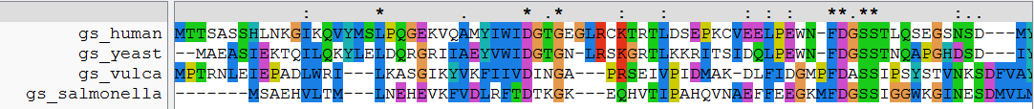
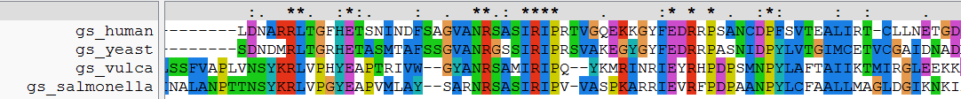
ClustalW, JalView

Slide 16
Determination of protein structure
X-ray crystallography (179K in PDB)
  need crystals
Nuclear Magnetic Resonance (NMR) (14K)
  proteins in solution (dynamics)
  lower size limit (400 aa)
Electron microscopy (17K)
  Recently resolution improving a lot!
Notes:
PDB stats: PDB data distribution

Slide 17
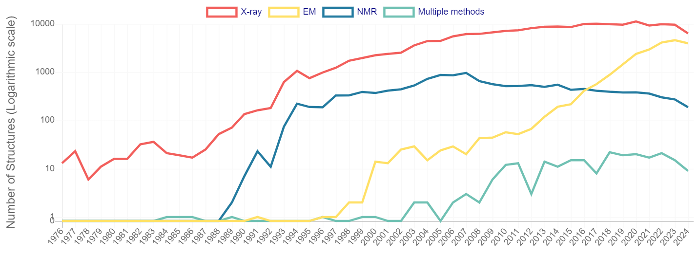
Determination of protein structure
Notes:
PDB stats: PDB data distribution

Slide 18
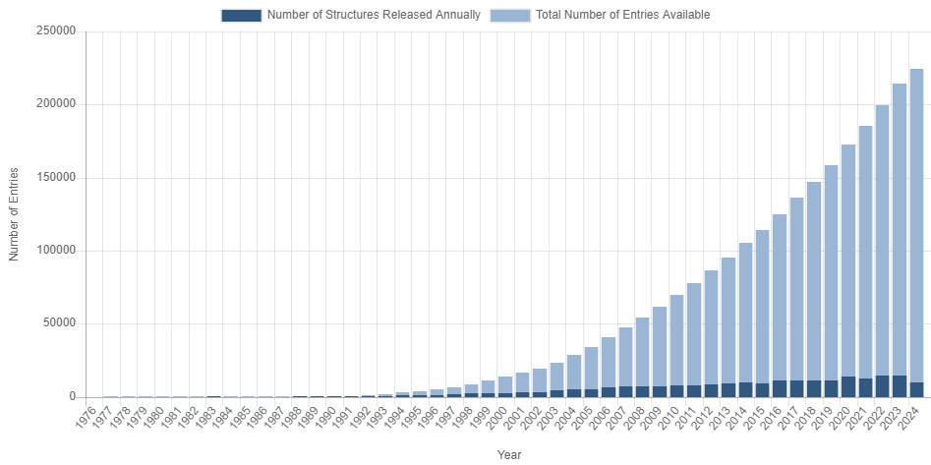
Determination of protein structure
Currently: 224K protein 3D structures
from around 65.0K sequences in UniProt (how do I know?)
246M sequences in UniProt
only 0.026%!
Notes:
PDB > Search > PDB Statistics / UniProt > Advanced search > Keyword 3D-structure

Slide 19
Determination of protein structure
Currently: 224K protein 3D structures
from around 65.0K sequences in UniProt (how do I know?)
246M sequences in UniProt
only 0.026%!
50% sequences covered (25% in 1995)

Slide 20
Protein structure prediction
Ab initio
Explore conformational space
Limit the number of atoms
Break the problem into fragments of sequence
Optimize hydrophobic residue burial and pairing of beta-strands
Limited success…

Slide 21
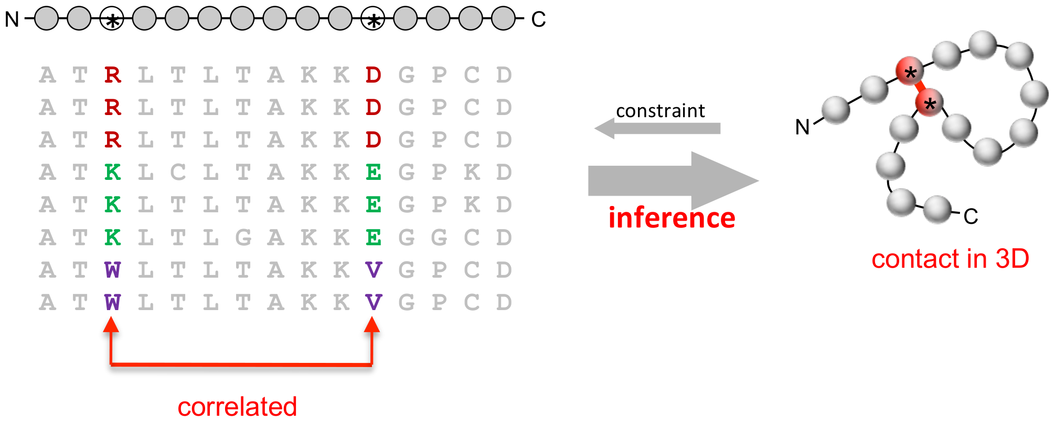
Protein structure prediction
Correlated mutations
Your query sequence
https://commons.wikimedia.org/wiki/File:Correlated_mutation.png

Slide 22
Protein structure prediction
Combined
Homology to solved structures
Correlated sequence variation in homologs
Generation of a structure following physical constraints

Slide 23

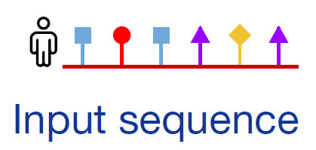
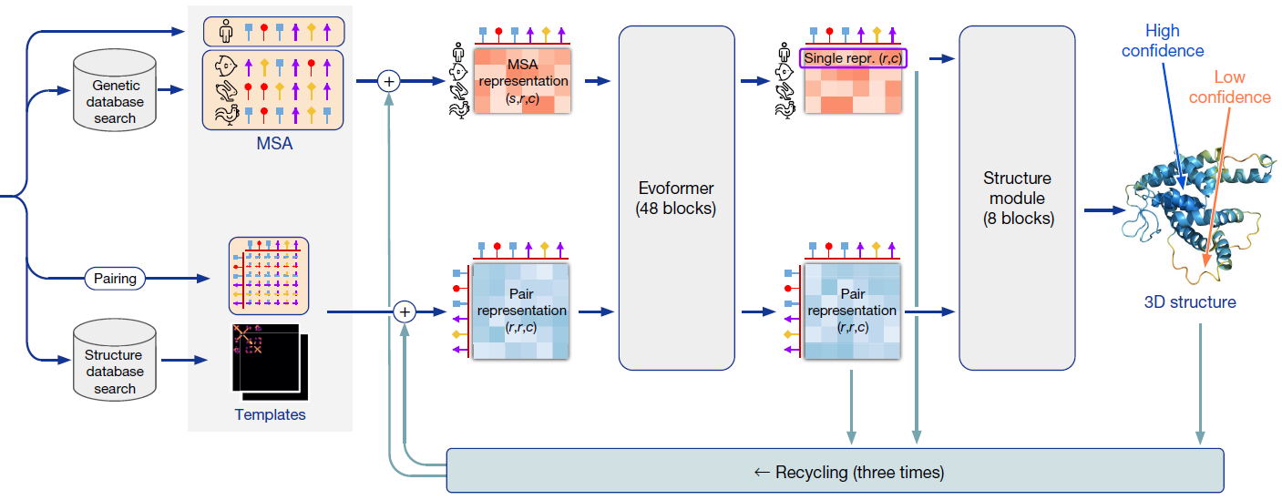
Protein structure prediction
AlphaFold: DeepMind, Google
Demis Hassabis
Jumper et al (2021) Nature

Slide 24
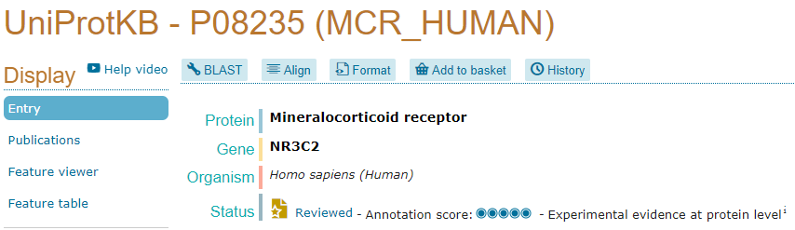
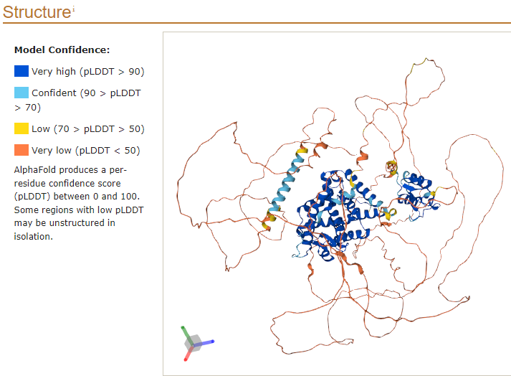
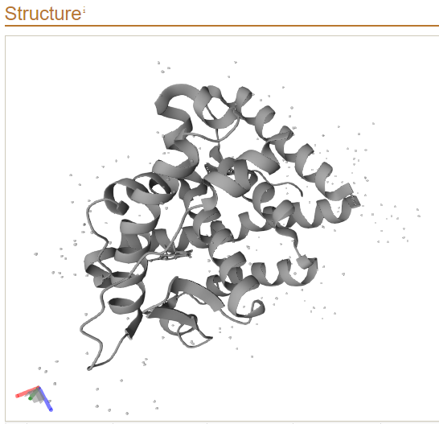
Protein structure prediction
AlphaFold: DeepMind, Google
86-117
600-674
728-984

Slide 25
Protein structure prediction
AlphaFold: DeepMind, Google
Precomputed models:
UniProt
https://alphafold.ebi.ac.uk/
(limited to model organisms)
Colab notebook (simplified version / limited server / takes hours)
Source code (Needs 3 Tb disk space)

Slide 26

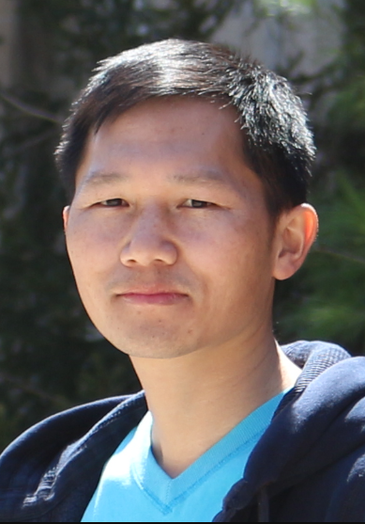
Protein structure prediction
trRosetta: David Baker &
Jianyi Yang
Needs large multiple sequence alignments to predict contacts
Predictions available for all PFAM domains
Example:
https://www.ebi.ac.uk/interpro/entry/pfam/PF07887/rosettafold/
Runs online at
https://yanglab.qd.sdu.edu.cn/trRosetta/
Du et al (2021) Nature Protocols

Slide 27
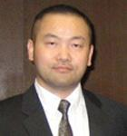
Protein structure prediction
C-I-Tasser: Yang Zhang
Run online at
https://zhanggroup.org/C-I-TASSER/
Zheng et al (2021) Cell Reports Methods

Slide 28
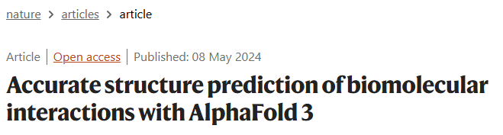

Protein structure prediction
AlphaFold Multimer
Predicts protein complexes
Evans et al (2022) bioRxiv
AlphaFold 3
Structure of proteins (with PTMs), ligands, RNA/DNA
Abramson et al (2024) Nature

Slide 29
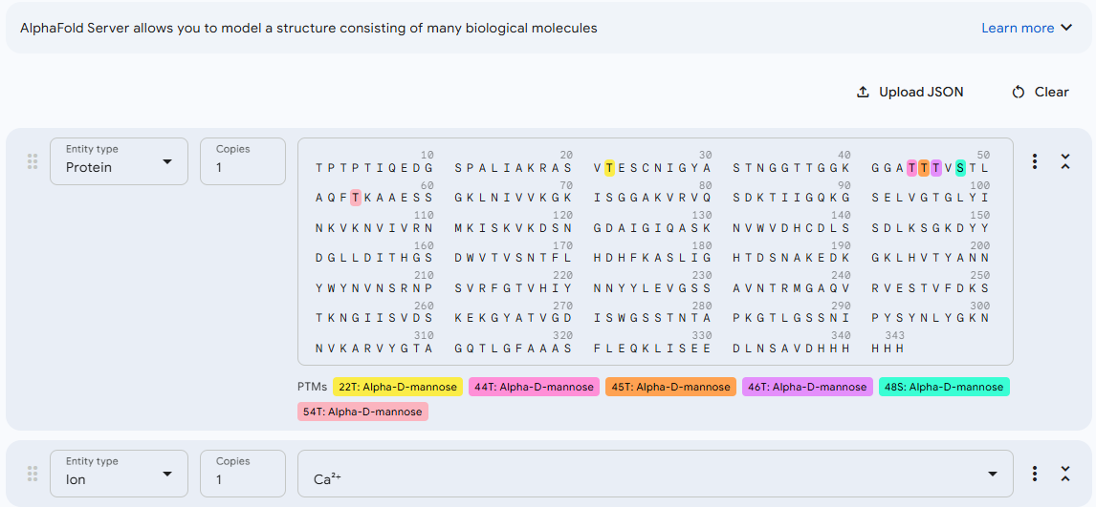
Protein structure prediction
AlphaFold 3
Structure of proteins (with PTMs), ligands, RNA/DNA
Abramson et al (2024) Nature

