Slide 1
Examining repeats with databases
Miguel Andrade
Faculty of Biology,
Johannes Gutenberg University
Mainz, Germany
andrade@uni-mainz.de

Slide 2
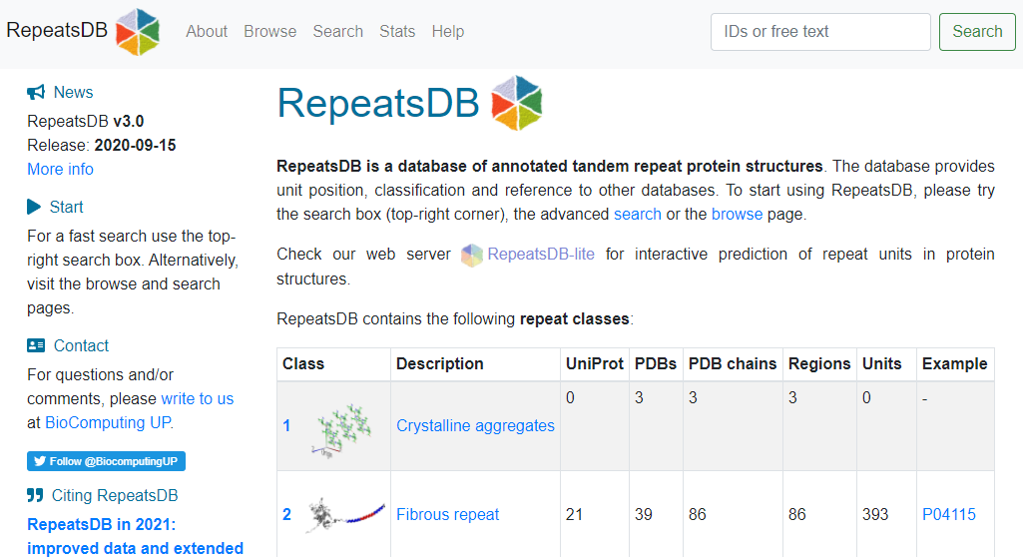
RepeatsDB

Slide 3
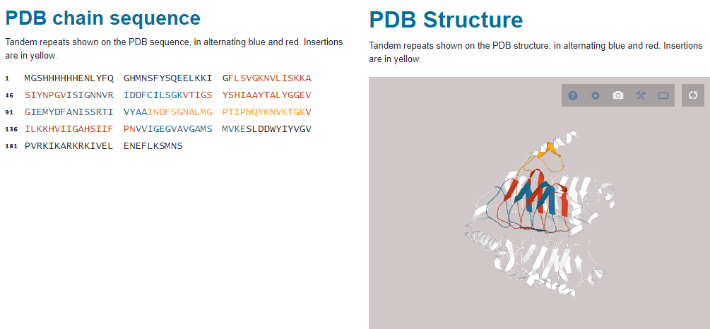
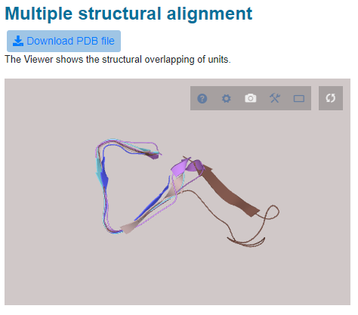
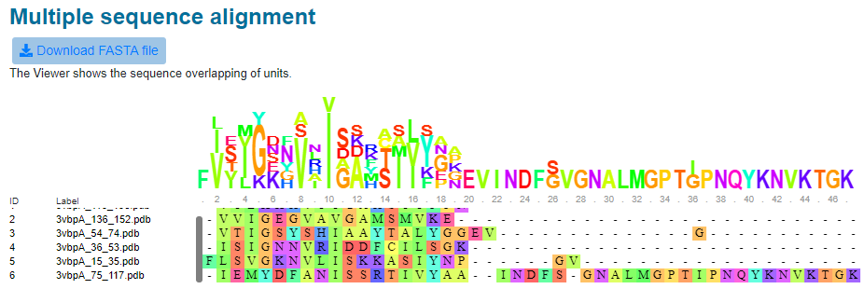
RepeatsDB
https://repeatsdb.bio.unipd.it/structure/3vbpA

Slide 4
Exercise 1. Examining repeat structures in repeatsDB
Go to RepeatsDB: http://repeatsdb.bio.unipd.it/
Click the “Search” tab, then search “Repeat unit number”
Choose one example and write down the PDB name (e.g. 6yc3B).
Check the assignment of the units. Is it correct? What about insertions? Are there mistakes? Write an evaluation: Looks good / one repeat wrong / many mistakes / total mess

Slide 5
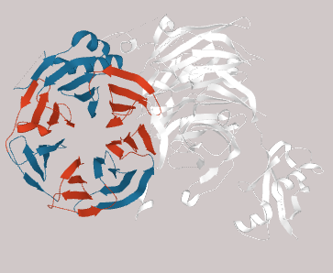
Example
https://repeatsdb.bio.unipd.it/structure/5cxbB
looks good
one repeat wrong
many mistakes
total mess

Slide 6
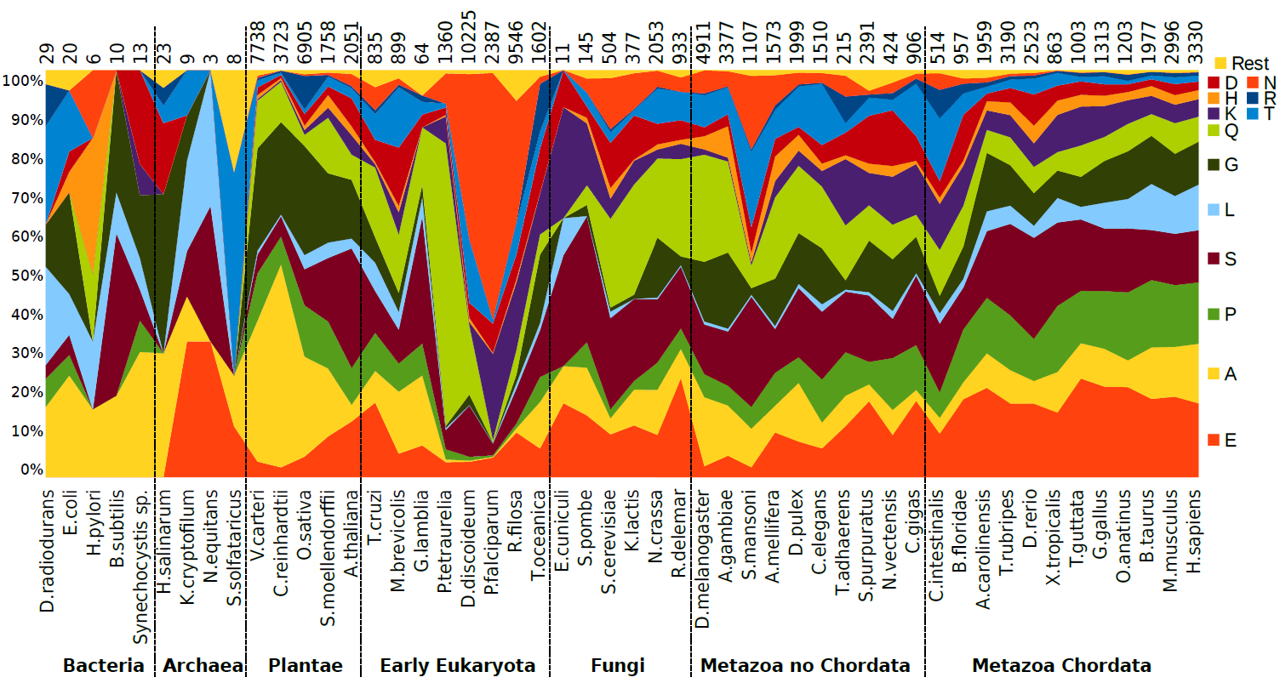

Evolution of homorepeats in 50 species
Pablo Mier

Slide 7
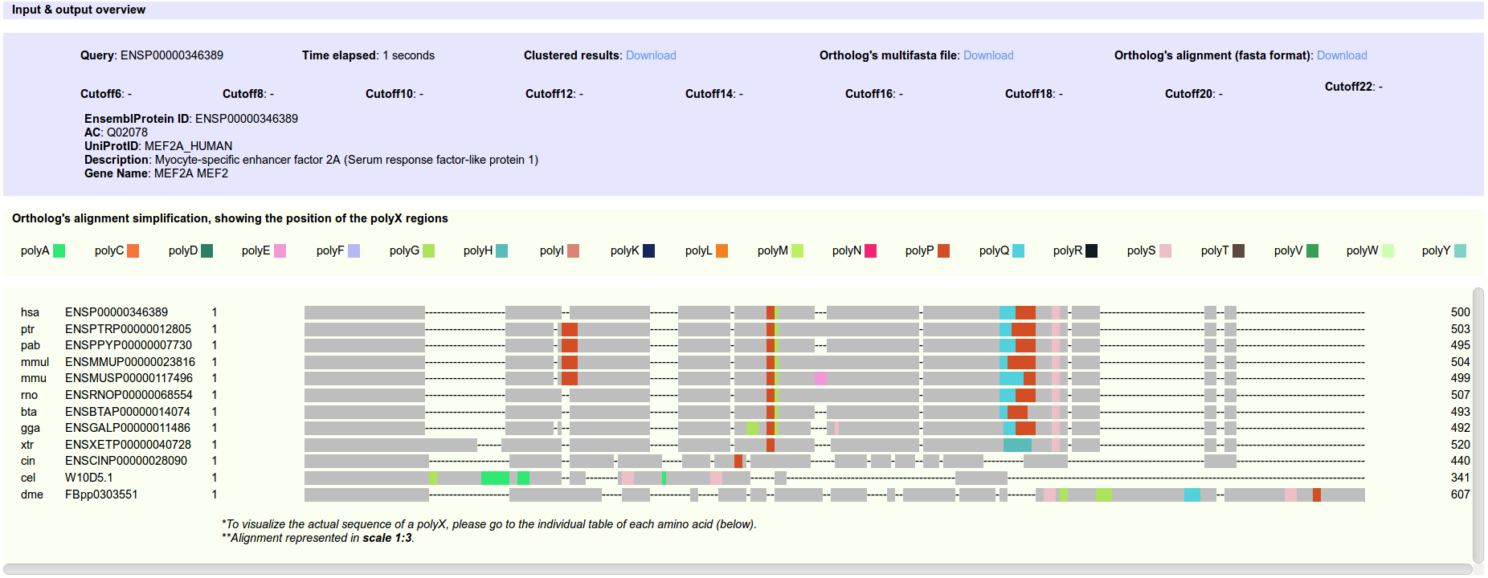

Context and evolution of homorepeats
dAtabase of PolyX Evolution
Mier et al. (2016) Bioinformatics

Slide 8
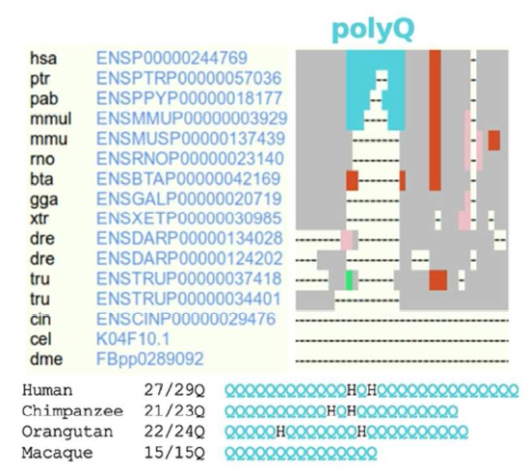
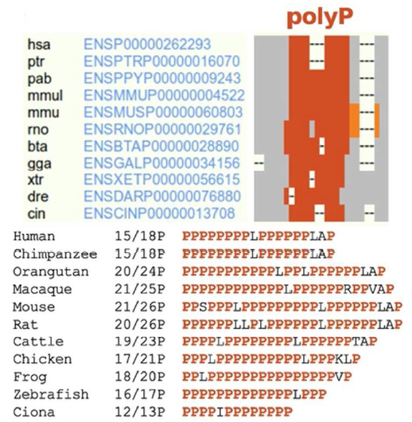
Context and evolution of homorepeats
dAtabase of PolyX Evolution
Mier et al. (2016) Bioinformatics
Notes:
Left: ataxin1; right: PRR11

Slide 9

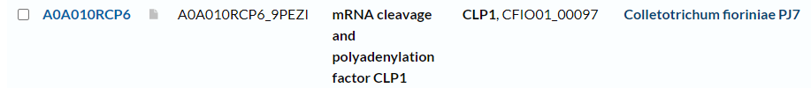
Exercise 2. Viewing homorepeats in an alignment with dAPE
Find a random human protein in UniProt. Make sure that it is a reviewed entry.
Write the Entry Name.

Slide 10
Exercise 2. Viewing homorepeats in an alignment with dAPE
Find a random human protein in UniProt. Make sure that it is a reviewed entry.
Write the Entry Name.
Copy the Entry ID (e.g. P10275).
Go to the dAPE web page:
http://cbdm-01.zdv.uni-mainz.de/~munoz/polyx/
Use the Entry ID in option A
Hit the “Report the evolution of its polyX" button
Write down: (1) Which type of polyX has the human protein? (2) Which additional polyX not in the human protein were found in the orthologs?

Slide 11
Exercise 3. Find structures of short repeats
Go to the PDB web page: https://www.rcsb.org/
Go to Search > Advanced Search
Type a short repeat in the Sequence Motif: as many repeats as possible; Use Mode PROSITE and RegExp (example: QQQQ / another example: [SP]SA[SP]SA[SP]SA )
Click “count” to see if there are any cases
Check the structure (3D View) to see if the repeat is in the structure (it could be disordered = absent)
Write down the PDB name, RegExp and structure
Example 3NB9 QQQQ alpha-helix
Example 3FRC NNNN absent

