Slide 1
Data analysis with R and the tidyverse
Jean-Fred Fontaine
Steffen Albrecht
March 2019
fontaine@uni-mainz.de
s.albrecht@uni-mainz.de

Slide 2
The course
Objectives
Powerful data analysis and visualization from little programming skills
R and the tidyverse
R: core statistical software
Tidyverse: extensions to R + more readable code
Schedule on 2 days
Brief introduction and overview of the basics
Tutorial on the tidyverse
More exercises and additional functions

Slide 3
Preparation
Install and open R Studio
Download the data files
https://cbdm.uni-mainz.de/mb19/
Download and decompress the folder datasets_danalysis.zip in your user directory
Set the R’s “working directory” to the decompressed folder named datasets
From the Menu Session / Set Working Directory / Choose Directory
Install packages tidyverse and ggvis in R Studio
From the menu: Tools / Install Packages …
Or from the console: install.packages(c("tidyverse ", "ggvis"))

Slide 4
Brief overview of the basics in R

Slide 5
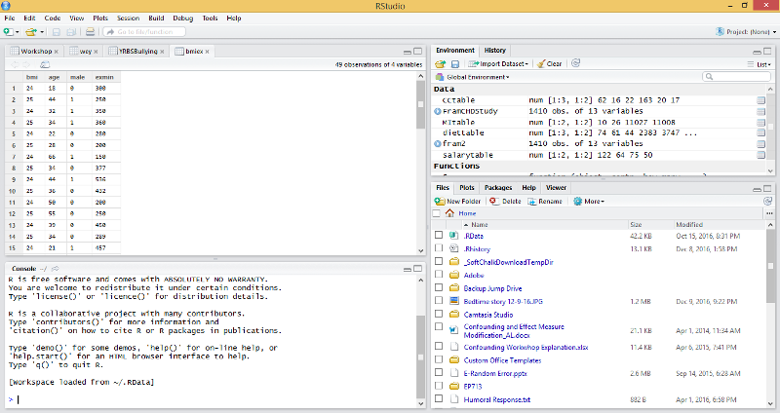
R Studio interface
Variables
Source code or data tables
Files, plots or help (F1)
R console

Slide 6
Tips
The # symbol indicates to R that what follows is a comment
Commands are separated by a new line
Lists, piped commands and content within parentheses or brackets can be spread over different lines
Parentheses and brackets must be closed
R is case sensitive
# LOAD LIBRARY
library(tidyverse)
# LOAD AND DISPLAY TABLE
column_names <- c("probe_id", "expression", "present")
cd103minus <- read_tsv(
"file.tsv",
col_names=column_names
)
cd103minus %>%
select(probe_id, expression) %>%
head()

Slide 7
Tips
Some keyboard shortcuts
[TAB] for text auto-completion of function or object names
[CTRL]+[ENTER] to run the selected lines from the code editor to the console
[ALT]+[-] to insert assignment symbols (<-)
[CTRL]+[SHIFT]+[m] to insert the pipe symbols (%>%)
In the console, use arrow keys to traverse through the history of commands
"Up arrow" – traverse backwards (older commands)
"Down arrow" – traverse forward (newer commands)

Slide 8
as calculator
Symbol | Meaning
+ | add
- | subtract
* | multiply
/ | divide
^ | power (e.g. 2^3 is equal to 8)
Simple operations
1+3 # will return 4
Statistical functions
sqrt(81) # will the square root of 81 that is 9
1 + abs(-4) # will return absolute value of -4 plus 1 = 5
The Order of Operations
Do calculations inside Parentheses first
6 × (5 + 3) = 6 × 8 = 48
Then compute Exponents (Powers, Roots) before multiplication and division
5 × 2²= 5 × 4 = 20
Then Multiply or Divide (before you Add or Subtract)
2 + 5 × 3 = 2 + 15 = 17
Otherwise just go left to right

Slide 9
Objects and variables
R stores everything in objects having defined types
Some common object types
numeric (e.g. 1, 25.5, 1e-6)
character (e.g. “ABCD”, “Hello World 24!”)
logical (TRUE or T, FALSE or F, NA for not applicable))
factor: categorical values (numeric index associated to character labels)
vector: used to store a set of objects
function: (e.g. library, abs, sqrt)
Variables
Names to remember and reuse objects
x <- 2 # variable x is assigned value 2
The class function returns the type
class(x) # R returns "numeric"
class("ABC") # R returns “character"

Slide 10
Vectors
# Vector of 4 numeric objects
x <- c(1.2, # 1st object
2.3, # 2nd object
0.2, # 3rd object
1.1) # 4th object
# Indexing some values
X # 1.2 2.3 0.2 1.1
x[1] # 1.2
x[ length(x) ] # 1.1
x[3] # 0.2
x[ c(2,3,4) ] # 2.3 0.2 1.1
x[ 2:4 ] # 2.3 0.2 1.1

Slide 11
Tables
Several types of tables
matrix - table of objects of the same type
data.frame - table of objects of same or different types
tibble – extension of data.frame for working with large tables
tibbles have a refined print method (default few rows and columns fit screen)
each column reports its type
numerics may be detailed as integers (int) or double precision values (dbl)

Slide 12
Tables
TABLE [ ROW, COL ]
TABLE$COL[ ROW ]
df <- data_frame(
x = 1:5, y = 1, z = x^2+y
)
df
# A tibble: 5 x 3
x y z
<int> <dbl> <dbl>
1 1 1 2
2 2 1 5
3 3 1 10
4 4 1 17
5 5 1 26
df[1,1] # 1
df[1,2] # 1
df[1,3] # 2
df[1,] # 1 1 2
df[1,3] # 2
df[2,3] # 5
df[,3] # 2 5 10 17 26
df$z # 2 5 10 17 26
df[ 4:5 , 1:2 ]
# A tibble: 2 x 2
x y
<int> <dbl>
1 4 1
2 5 1

Slide 13
FOR LOOPS
# Vector of character objects
x <- c("file1.csv", # 1st object
"file2.csv", # 2nd object
"file3.csv") # 3rd object
# Looping on some values
for(my_file in x){
text <- paste("We have", my_file)
print(text)
}
[1] "We have file1.csv"
[1] "We have file2.csv"
[1] "We have file3.csv"

Slide 14
LOGICAL OPERATIONS
1<2 # TRUE
! (1<3) # FALSE (logical NOT: !)
1 != 3 # TRUE
(3 != 1) & (2 >= 1.9) # TRUE (logical AND: &)
(3 == 1) | (3 < 5) # TRUE (logical OR: |)
y <- c(TRUE, FALSE, 5>2)
Y # TRUE FALSE TRUE
Symbol | Meaning
== | logical equals
!= | not equal
! | logical NOT
& | logical AND
| | logical OR
< | less than
<= | less than or equal to
> | greater than
>= | greater than or equal to
Command | Result
TRUE | TRUE
FALSE | FALSE
! TRUE | FALSE
! FALSE | TRUE
TRUE & TRUE | TRUE
TRUE & FALSE | FALSE
FALSE & FALSE | FALSE
TRUE | TRUE | TRUE
TRUE | FALSE | TRUE
FALSE | FALSE | FALSE

Slide 15
Some useful functions
For more details see help pages
Table statistics
rownames(x)
colnames(x)
dim(x) – number of rows and columns
summary(x) – summary statistics
Table join / merge
left_join()
full_join()
rbind() – add rows (base R)
cbind() – add columns (base R)
Statistics
length(x)
max(x)
min(x)
sum(x)
mean(x)
median(x)
var(x)
sd(x)
cor() – correlation coefficient
t.test() – Student’s t-test
Other
seq() – sequence of numbers

Slide 16
Tidyverse Tutorial
https://cbdm.uni-mainz.de/mb19/
Gregorio Alanis has created the tutorial but works now elsewhere.
Please email only your current teachers for questions:
fontaine@uni-mainz.de
s.albrecht@uni-mainz.de

