Slide 1
Low complexity regions in proteins
Marcin Grynberg
JGU, Mainz, 2023

Slide 2
Definition(s)

Slide 3
Complexity of low complexity
IDR
CBR
LCR
STR
LCR – low complexity region
STR – short tandem repeat
CBR – compositionally biased region
IDR – intrinsically disordered region
Notes:
These are regions that lack a stable three-dimensional structure and are highly flexible. For example, KKKKKKKKKK is a protein stretch that is likely to be disordered due to the high charge and low hydrophobicity of K (lysine).

Slide 4
Protein with Low Complexity Regions (LCRs) -
Dissatisfaction protein (Q9VML1)
MGTAGDRLLD IPCKVCGDRS SGKHYGIYSC DGCSGFFKRS IHRNRIYTCK ATGDLKGRCP VDKTHRNQCR ACRLAKCFQS AMNKDAVQHE RGPRKPKLHP QLHHHHHHAA AAAAAAHHAA AAHHHHHHHH HAHAAAAHHA AVAAAAASGL HHHHHAMPVS LVTNVSASFN YTQHISTHPP APAAPPSGFH LTASGAQQGP APPAGHLHHG GAGHQHATAF HHPGHGHALP APHGGVVSNP GGNSSAISGS GPGSTLPFPS HLLHHNLIAE AASKLPGITA TAVAAVVSST STPYASAAQT SSPSSNNHNY SSPSPSNSIQ SISSIGSRSG GGEEGLSLGS ESPRVNVETE TPSPSNSPPL SAGSISPAPT LTTSSGSPQH RQMSRHSLSE ATTPPSHASL MICASNNNNN NNNNNNNGEH KQSSYTSGSP TPTTPTPPPP RSGVGSTCNT ASSSSGFLEL LLSPDKCQEL IQYQVQHNTL LFPQQLLDSR LLSWEMLQET TARLLFMAVR WVKCLMPFQT LSKNDQHLLL QESWKELFLL NLAQWTIPLD LTPILESPLI RERVLQDEAT QTEMKTIQEI LCRFRQITPD GSEVGCMKAI ALFAPETAGL CDVQPVEMLQ DQAQCILSDH VRLRYPRQAT RFGRLLLLLP SLRTIRAATI EALFFKETIG NVPIARLLRD MYTMEPAQVD K

Slide 5
Protein with Low Complexity Regions (LCRs) -
Histidine-rich glycoprotein (P04196)
MKALIAALLL ITLQYSCAVS PTDCSAVEPE AEKALDLINK RRRDGYLFQL LRIADAHLDR VENTTVYYLV LDVQESDCSV LSRKYWNDCE PPDSRRPSEI VIGQCKVIAT RHSHESQDLR VIDFNCTTSS VSSALANTKD SPVLIDFFED TERYRKQANK ALEKYKEEND DFASFRVDRI ERVARVRGGE GTGYFVDFSV RNCPRHHFPR HPNVFGFCRA DLFYDVEALD LESPKNLVIN CEVFDPQEHE NINGVPPHLG HPFHWGGHER SSTTKPPFKP HGSRDHHHPH KPHEHGPPPP PDERDHSHGP PLPQGPPPLL PMSCSSCQHA TFGTNGAQRH SHNNNSSDLH PHKHHSHEQH PHGHHPHAHH PHEHDTHRQH PHGHHPHGHH PHGHHPHGHH PHGHHPHCHD FQDYGPCDPP PHNQGHCCHG HGPPPGHLRR RGPGKGPRPF HCRQIGSVYR LPPLRKGEVL PLPEANFPSF PLPHHKHPLK PDNQPFPQSV SESCPGKFKS GFPQVSMFFT HTFPK

Slide 6
Examples
CBR/LCR/homo CCCCCCCCCCCCCCCCCCCCCCCCCCCCCC
CBR/LCR/STR LCLCLCLCLCLCLCLCLCLCLCLCLCLCLCLCLC
CBR CxxxxxCxxxxxxxxCxxxxxCxxxxxxxxCxxxxC

Slide 7
LCR types
Type of LCRs | Examples
Homorepeats | AAAAAAAAAAAAAAAAA
Short tandem repeats | PHGHHPHGHHPHGHHPHGHHPHGHH
Fuzzy regions | PHKHHSHEQH
Fused regions | QQQQQQQQQQPPPPPPPPP

Slide 8
Some facts about LCRs
In about 60% of proteins
Eukaryotes: 15% of sequences are LCRs
Prokaryotes: 3% of sequences are LCRs
Mainly periodic or irregular repeats
Mostly in protein flanks
Enriched in hub proteins, especially transcription factors and other regulators

Slide 9
Evolution of LCRs
More abundant in eukaryotes
Younger proteins have more LCRs
Evolve faster than high complexity regions
Gain: mostly through repeat expansion, loss: mutations
Appear mainly through replication slippage
LCRs give short-term evolutionary gains (local gains) vs duplications (more general, long-lasting gains)

Slide 10
Functions

Slide 11
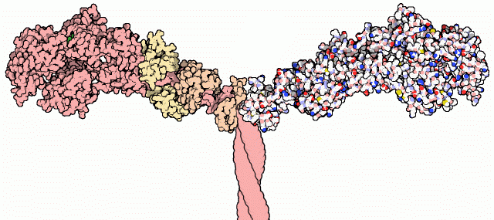
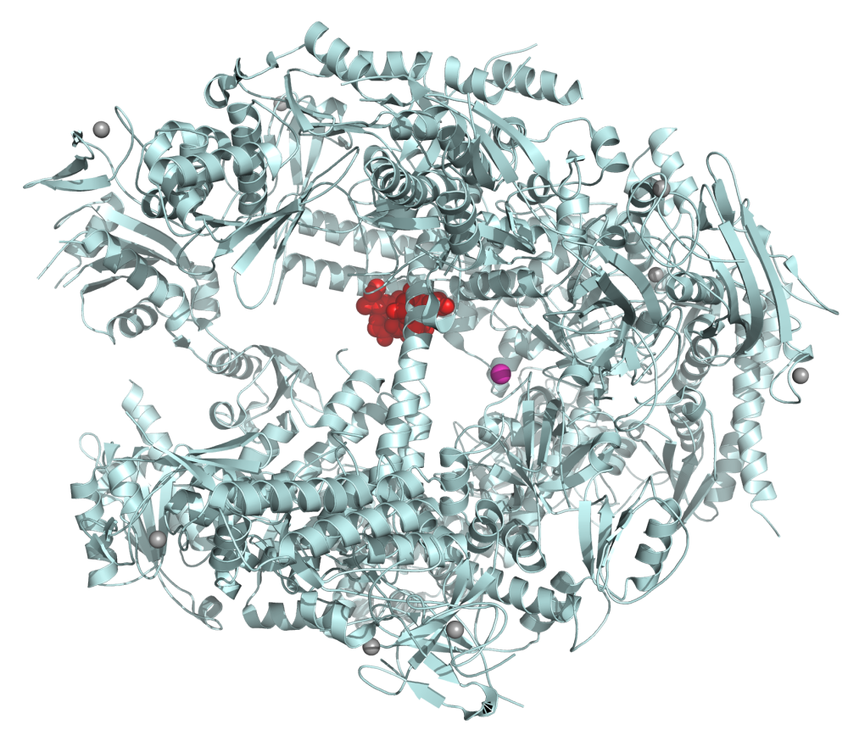
General functions
Unknown
Evolutionary
Structural
Regulatory
To zdjęcie, autor: Nieznany autor, licencja: CC BY-NC-ND
To zdjęcie, autor: Nieznany autor, licencja: CC BY-SA
To zdjęcie, autor: Nieznany autor, licencja: CC BY-SA

Slide 12
Unknown
To zdjęcie, autor: Nieznany autor, licencja: CC BY-NC

Slide 13
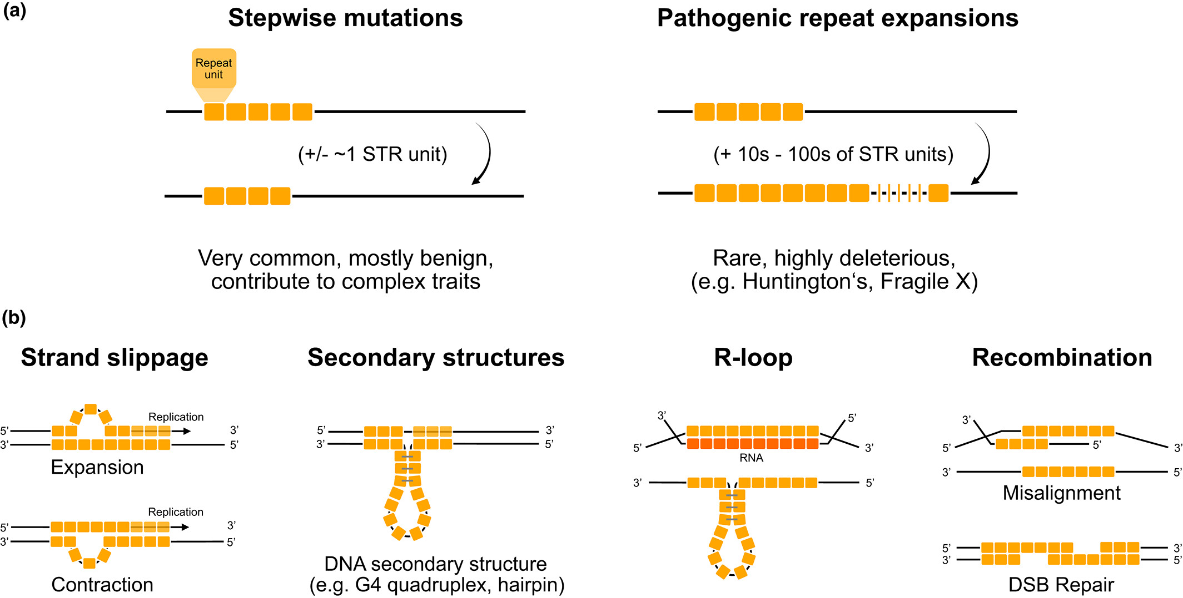
Evolutionary (propagation)
Misalignment types
Verbiest, J Evol Biol. 2023

Slide 14
Structural
EXERCISE
https://platoloco.aei.polsl.pl/#!/query
>CAA86293.1 Myosin [Homo sapiens] MSASSDAEMAVFGERAPYLRKSEKERIEAQNKPFDAKTSVFVAEPKESYVKSTIQSKEGGKVTVKTEGGA TLTVREDQVFPMNPPKYDKIEDMAMMTHLHEPGVLYNLKERYAAWMIYTYSGLFCVTVNPYKWLPVYKPE VVAAYRGKKRQEAPPHIFSISDNAYQFMLTDRENQSILITGESGAGKTVNTKRVIQYFATIAVTGEKKKD ESGKMQGTLEDQIISANPLLEAFGNAKTVRNDNSSRFGKFIRIHFGTTGKLASADIETYLLEKSRVTFQL KAERSYHIFYQITSNKKPDLIEMLLITTNPYDYAFVSQGEITVPSIDDQEELMATDSAIDILGFTPEEKV SIYKLTGAVMHYGNMKFKQKQREEQAEPDGTEVADKAAYLQSLNSADLLKALCYPRVKVGNEYVTKGQTV QQVYNAVGALAKAVYEKMFLWMVTRINQQLDTKQPRQYFIGVLDIAGFEIFDFNSLEQLCINFTNEKLQQ FFNHHMFVLEQEEYKKEGIEWTFIDFGMDLAACIELIEKPLGIFSILEEECMFPKATDTSFKNKLYDQHL GKSANFQKPKVVKGKAEAHFSLIHYAGTVDYNITGWLDKNKDPLNDTVVGLYQKSAMKTLASLFSTYASA EADSSAKKGAKKKGSSFQTVSALFRENLNKLMTNLRSTHPHFVRCIIPNETKTPGAMEHELVLHQLRCNG VLEGIRICRKGFPSRILYGDFKQRYKVLNASAIPEGQFIDSKKASEKLLASIDIDHTQYKFGHTKVFFKA GLLGLLEEMRDEKLAQIITRTQAVCRGFLMRVEYQKMLQRREALFCIQYNVRAFMNVKHWPWMKLFFKIK PLLKSAETEKEMATMKEEFQKTKDELAKSEAKRKELEEKMVTLLKEKNDLQLQVQSEADSLADAEERCEQ LIKNKIQLEAKIKEVTERAEEEEEINAELTAKKRKLEDECSELKKDIDDLELTLAKVEKEKHATENKVKN LTEEMAGLDETIAKLSKEKKALQETHQQTLDDLQAEEDKVNILTKAKTKLEQQVDDLEGSLEQEKKLRMD LERAKRKLEGDLKLAQESTMDMENDKQQLDEKLEKKEFEISNLISKIEDEQAVEIQLQKKIKELQARIEE LGEEIEAERASRAKAEKQRSDLSRELEEISERLEEAGGATSAQVELNKKREAEFQKLRRDLEEATLQHEA MVAALRKKHADSMAELGEQIDNLQRVKQKLEKEKSELKMETDDLSSNAEAISKAKGNLEKMCRSLEDQVS ELKTKEEEQQRLINDLTAQRARLQTEAGEYSRQLDEKDALVSQLSRSKQASTQQIEELKHQLEEETKAKN ALAHALQSSRHDCDLLREQYEEEQEGKAELQRALSKANSEVAQWRTKYETDAIQRTEELEEAKKKLAQRL QEAEEHVEAVNAKCASLEKTKQRLQNEVEDLMLDVERSNAACAALDKKQRNFDKVLSEWKQKYEETQAEL EASQKESRSLSTELFKVKNVYEESLDQLETLRRENKNLQQEISDLTEQIAEGGKQIHELEKIKKQVEQEK CEIQAALEEAEASLEHEEGKILRIQLELNQVKSEVDRKIAEKDEEIDQLKRNHTRVVETMQSTLDAEIRS RNDALRVKKKMEGDLNEMEIQLNHANRLAAESLRNYRNTQGILKETQLHLDDALRGQEDLKEQLAIVERR ANLLQAEIEELWATLEQTERSRKIAEQELLDASERVQLLHTQNTSLINTKKKLENDVSQLQSEVEEVIQE SRNAEEKAKKAITDAAMMAEELKKEQDTSAHLERMKKNLEQTVKDLQHRLDEAEQLALKGGKKQIQKLEA RVRELEGEVENEQKRNAEAVKGLRKHERRVKELTYQTEEDRKNVLRLQDLVDKLQAKVKSYKRQAEEAEE QSNANLSKFRKLQHELEEAEERAHIAESQVNKLRVKSREVHTKISAE
PlaToLoCo – myosin [query]
https://platoloco.aei.polsl.pl/#!/query

Slide 15
Myosins at work

Slide 16
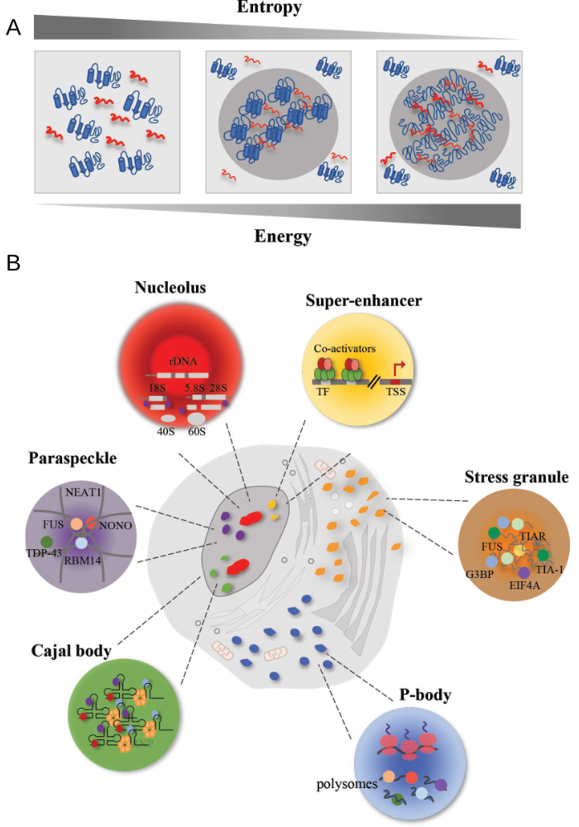
Structural (phase separation)
Nucleolus – ribosome biogenesis
P-body – mRNA turnover
Paraspeckle – sequestration of proteins/mRNAs
Cajal body – biogenesis, maturation and recycling of snRNPs, histone mRNA processing and telomere maintenance
Stress granule – protection of RNA from stress
Super enhancer – signal transduction complexes (signalosomes)
https://en.wikipedia.org/wiki/Biomolecular_condensate

Slide 17
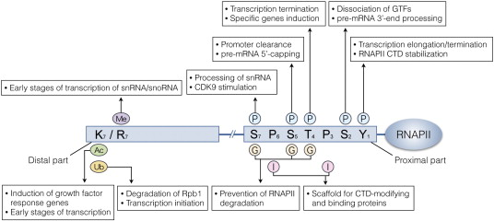
Regulatory – RNA polymerase II CTD
>sp|P24928.2|RPB1_HUMAN RecName: Full=DNA-directed RNA polymerase II subunit RPB1 MHGGGPPSGDSACPLRTIKRVQFGVLSPDELKRMSVTEGGIKYPETTEGGRPKLGGLMDPRQGVIERTGR CQTCAGNMTECPGHFGHIELAKPVFHVGFLVKTMKVLRCVCFFCSKLLVDSNNPKIKDILAKSKGQPKKR LTHVYDLCKGKNICEGGEEMDNKFGVEQPEGDEDLTKEKGHGGCGRYQPRIRRSGLELYAEWKHVNEDSQ EKKILLSPERVHEIFKRISDEECFVLGMEPRYARPEWMIVTVLPVPPLSVRPAVVMQGSARNQDDLTHKL ADIVKINNQLRRNEQNGAAAHVIAEDVKLLQFHVATMVDNELPGLPRAMQKSGRPLKSLKQRLKGKEGRV RGNLMGKRVDFSARTVITPDPNLSIDQVGVPRSIAANMTFAEIVTPFNIDRLQELVRRGNSQYPGAKYII RDNGDRIDLRFHPKPSDLHLQTGYKVERHMCDGDIVIFNRQPTLHKMSMMGHRVRILPWSTFRLNLSVTT PYNADFDGDEMNLHLPQSLETRAEIQELAMVPRMIVTPQSNRPVMGIVQDTLTAVRKFTKRDVFLERGEV MNLLMFLSTWDGKVPQPAILKPRPLWTGKQIFSLIIPGHINCIRTHSTHPDDEDSGPYKHISPGDTKVVV ENGELIMGILCKKSLGTSAGSLVHISYLEMGHDITRLFYSNIQTVINNWLLIEGHTIGIGDSIADSKTYQ DIQNTIKKAKQDVIEVIEKAHNNELEPTPGNTLRQTFENQVNRILNDARDKTGSSAQKSLSEYNNFKSMV VSGAKGSKINISQVIAVVGQQNVEGKRIPFGFKHRTLPHFIKDDYGPESRGFVENSYLAGLTPTEFFFHA MGGREGLIDTAVKTAETGYIQRRLIKSMESVMVKYDATVRNSINQVVQLRYGEDGLAGESVEFQNLATLK PSNKAFEKKFRFDYTNERALRRTLQEDLVKDVLSNAHIQNELEREFERMREDREVLRVIFPTGDSKVVLP CNLLRMIWNAQKIFHINPRLPSDLHPIKVVEGVKELSKKLVIVNGDDPLSRQAQENATLLFNIHLRSTLC SRRMAEEFRLSGEAFDWLLGEIESKFNQAIAHPGEMVGALAAQSLGEPATQMTLNTFHYAGVSAKNVTLG VPRLKELINISKKPKTPSLTVFLLGQSARDAERAKDILCRLEHTTLRKVTANTAIYYDPNPQSTVVAEDQ EWVNVYYEMPDFDVARISPWLLRVELDRKHMTDRKLTMEQIAEKINAGFGDDLNCIFNDDNAEKLVLRIR IMNSDENKMQEEEEVVDKMDDDVFLRCIESNMLTDMTLQGIEQISKVYMHLPQTDNKKKIIITEDGEFKA LQEWILETDGVSLMRVLSEKDVDPVRTTSNDIVEIFTVLGIEAVRKALERELYHVISFDGSYVNYRHLAL LCDTMTCRGHLMAITRHGVNRQDTGPLMKCSFEETVDVLMEAAAHGESDPMKGVSENIMLGQLAPAGTGC FDLLLDAEKCKYGMEIPTNIPGLGAAGPTGMFFGSAPSPMGGISPAMTPWNQGATPAYGAWSPSVGSGMT PGAAGFSPSAASDASGFSPGYSPAWSPTPGSPGSPGPSSPYIPSPGGAMSPSYSPTSPAYEPRSPGGYTP QSPSYSPTSPSYSPTSPSYSPTSPNYSPTSPSYSPTSPSYSPTSPSYSPTSPSYSPTSPSYSPTSPSYSP TSPSYSPTSPSYSPTSPSYSPTSPSYSPTSPSYSPTSPSYSPTSPSYSPTSPSYSPTSPSYSPTSPNYSP TSPNYTPTSPSYSPTSPSYSPTSPNYTPTSPNYSPTSPSYSPTSPSYSPTSPSYSPSSPRYTPQSPTYTP SSPSYSPSSPSYSPASPKYTPTSPSYSPSSPEYTPTSPKYSPTSPKYSPTSPKYSPTSPTYSPTTPKYSP TSPTYSPTSPVYTPTSPKYSPTSPTYSPTSPKYSPTSPTYSPTSPKGSTYSPTSPGYSPTSPTYSLTSPA ISPDDSDEEN
Srivastava, Biotechnol Adv., 2015

Slide 18
Searching/Finding

Slide 19
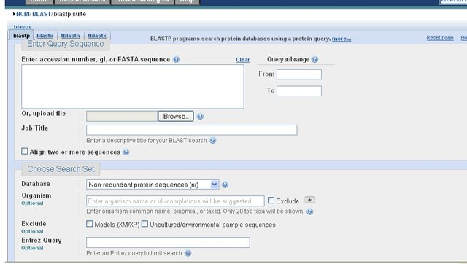
Old BLAST programme website
https://www.researchgate.net/publication/275340268_A_comparative_study_of_MSA_tools_based_on_sequence_Alignment_feachers_and_platform_Independency_to_select_the_appropriate_tool_desired

Slide 20
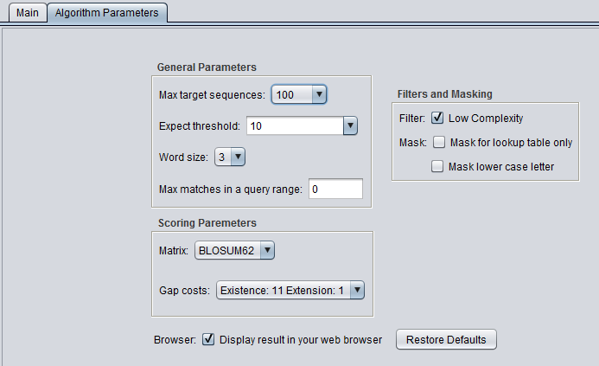
Old BLAST programme parameters
https://wiki.c2b2.columbia.edu/workbench/index.php/File:BLAST_Parameters_blastx.png

Slide 21
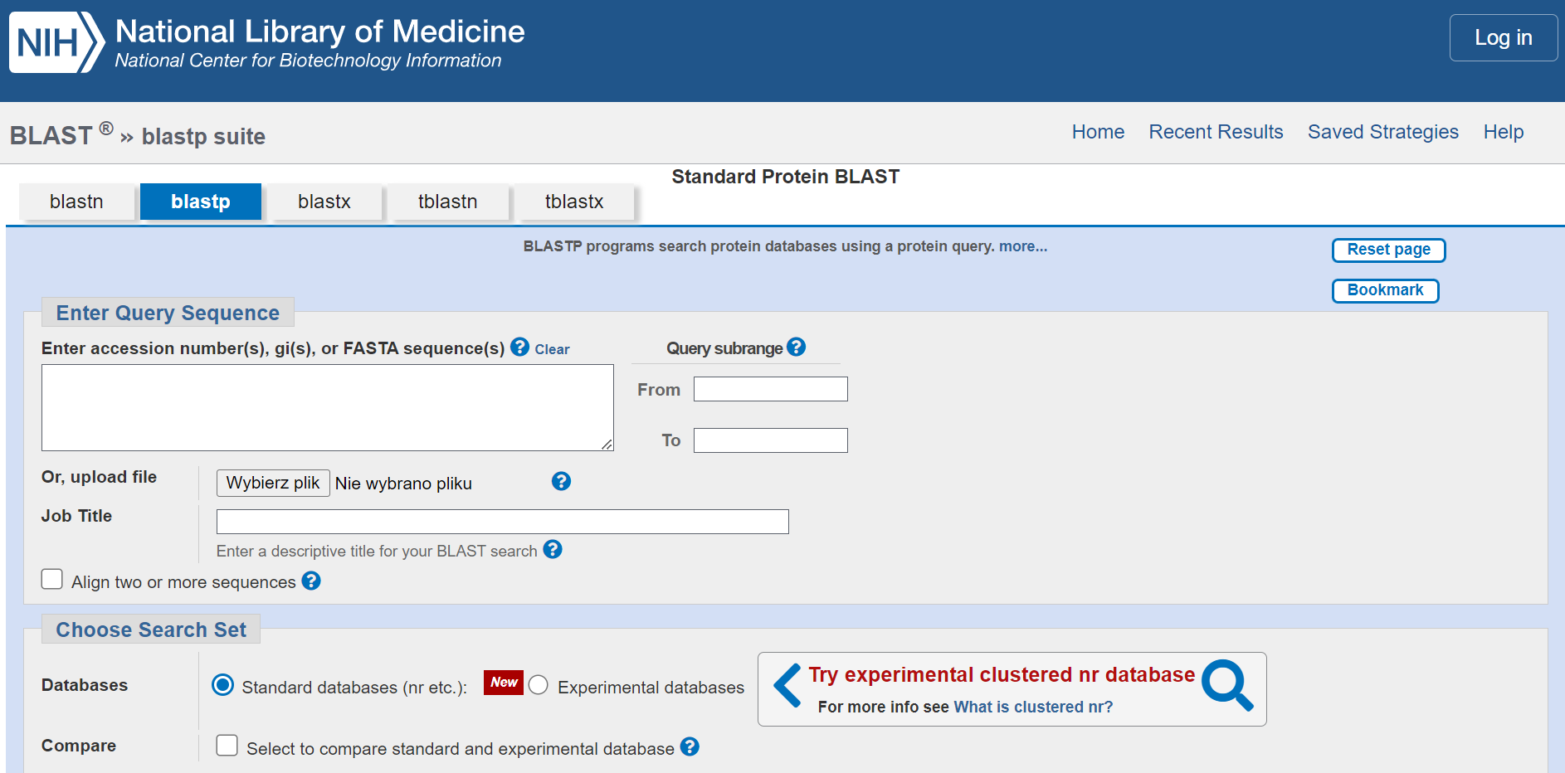
New BLAST programme website
https://blast.ncbi.nlm.nih.gov/Blast.cgi?PROGRAM=blastp&PAGE_TYPE=BlastSearch&LINK_LOC=blasthome

Slide 22
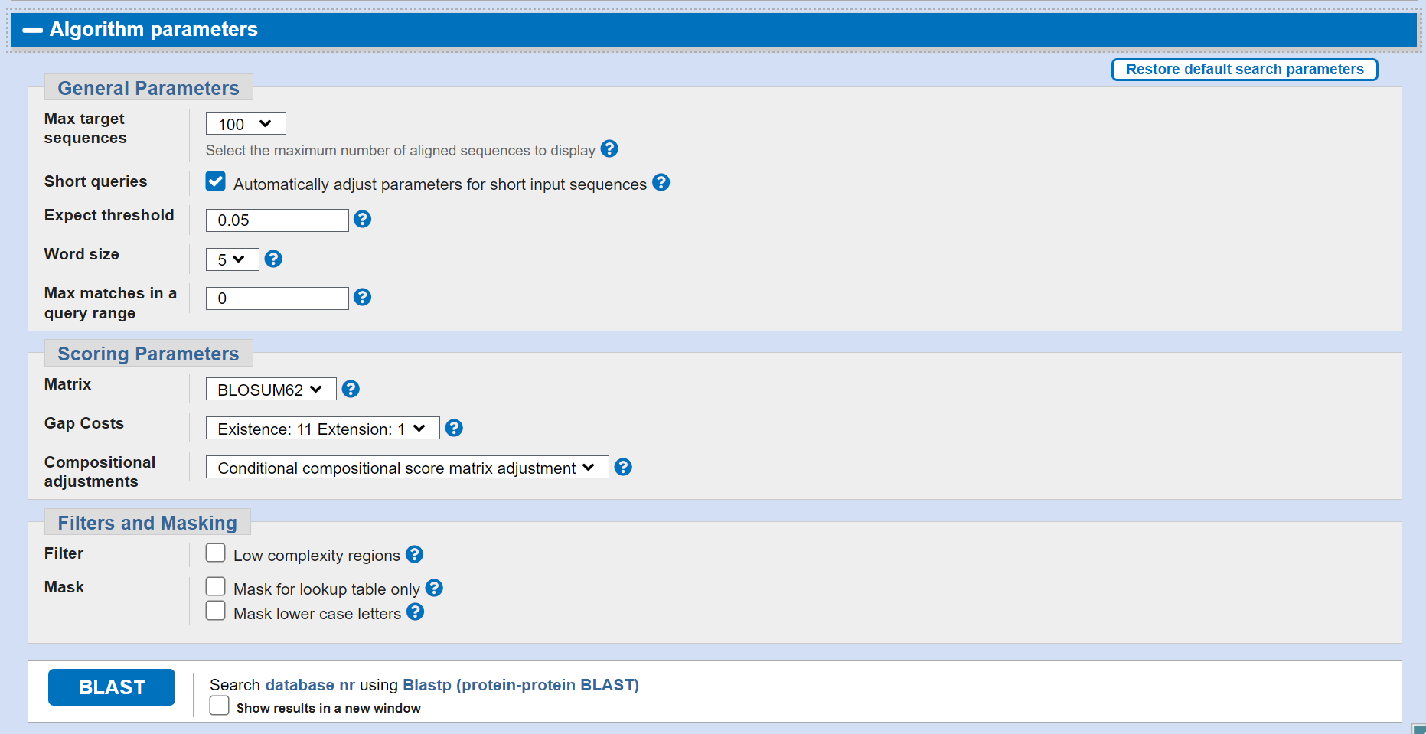
New BLAST programme parameters
https://blast.ncbi.nlm.nih.gov/Blast.cgi?PROGRAM=blastp&PAGE_TYPE=BlastSearch&LINK_LOC=blasthome

Slide 23
BLAST
How it works
Local alignment
Identifies high-scoring segment pairs (HSPs)
Looks for ‚neighbouring words’, extensions of the first word
Assemblies the best alignment for query
Why not for LCRs
Loose info about length differences

Slide 24
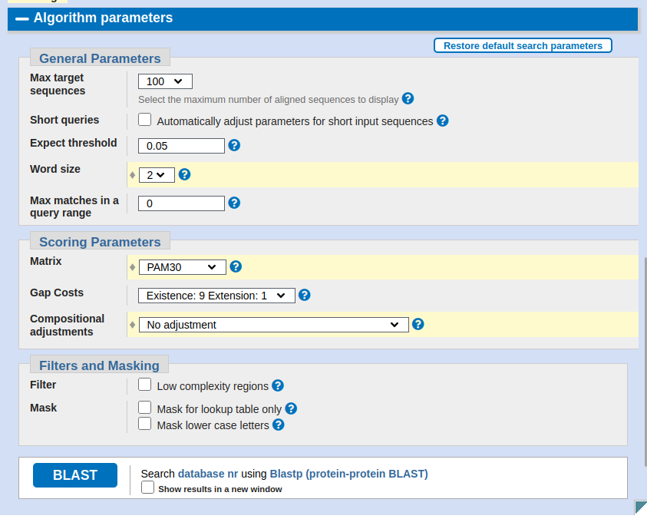
LCR-BLAST
Word size
2
Use matrix for short sequences
PAM30
Compositional adjustments
off
Filter and masking low complexity
all off
Jarnot, P., Ziemska-Legięcka, J., Grynberg, M., Gruca, A. (2020). LCR-BLAST—A New Modification of BLAST to Search for Similar Low Complexity Regions in Protein Sequences. In: Gruca, A., Czachórski, T., Deorowicz, S., Harężlak, K., Piotrowska, A. (eds) Man-Machine Interactions 6. ICMMI 2019. Advances in Intelligent Systems and Computing, vol 1061 . Springer, Cham. https://doi.org/10.1007/978-3-030-31964-9_16

Slide 25
Structures
Good influence
Bad influence
Collagens [glycine, proline, hydroxyproline] – triple helices
Myosins [alanine, glycine] – coiled coils
Keratins [cysteine] – disulfide bonds
Silk [glycine, alanine] – beta sheets
Cell wall proteins [serine, threonine] – flexible structures
Amyloids [glutamine, asparagine] – beta sheets
Prions [glycine, proline] – alpha to beta
Polyglutamine diseases – beta sheet structures accumulation

Slide 26
Useful links

Slide 27
Programmes
Search your protein for LCRs
PlaToLoCo: https://platoloco.aei.polsl.pl/#!/query [LCRs and CBRs]
LCD-Composer: http://lcd-composer.bmb.colostate.edu:9000/
Identify sequence repeats
REP2: http://cbdm-01.zdv.uni-mainz.de/~munoz/rep/
Ard2: http://cbdm-01.zdv.uni-mainz.de/~fournier/ard2/
RES: http://cbdm-01.zdv.uni-mainz.de/~munoz/res/
LCT: http://cbdm-01.zdv.uni-mainz.de/~munoz/lct/
T-REKS: https://bioinfo.crbm.cnrs.fr/index.php?route=tools&tool=3
TAPO: https://bioinfo.crbm.cnrs.fr/index.php?route=tools&tool=2 [structure]
Meta-Repeat-Finder: https://bioinfo.crbm.cnrs.fr/index.php?route=tools&tool=15
Identify intrinsically disordered regions
ESpritz: http://old.protein.bio.unipd.it/espritz/
SODA: http://old.protein.bio.unipd.it/soda/
Mobi 2.0: https://biocomputingup.it/services/mobi2
IUPred: https://iupred3.elte.hu/

Slide 28
Databases
LCR predictions
dAPE: http://cbdm-01.zdv.uni-mainz.de/~munoz/polyx/
LCRAnnotationsDB: https://lcrannotdb.lcr-lab.org/
Repeats
PRDB: https://bioinfo.crbm.cnrs.fr/index.php?route=databases&tool=17
dAPE: http://cbdm-01.zdv.uni-mainz.de/~munoz/polyx/
Prediction of disorder
DisProt: https://disprot.org/
MobiDB: https://mobidb.org/

Slide 29
References

Slide 30
Reading/references
Radó-Trilla N, Albà M. Dissecting the role of low-complexity regions in the evolution of vertebrate proteins. BMC Evol Biol. 2012 Aug 24;12:155. doi: 10.1186/1471-2148-12-155. PMID: 22920595; PMCID: PMC3523016.
Toll-Riera M, Radó-Trilla N, Martys F, Albà MM. Role of low-complexity sequences in the formation of novel protein coding sequences. Mol Biol Evol. 2012 Mar;29(3):883-6. doi: 10.1093/molbev/msr263. Epub 2011 Oct 31. PMID: 22045997.
Radó-Trilla N, Arató K, Pegueroles C, Raya A, de la Luna S, Albà MM. Key Role of Amino Acid Repeat Expansions in the Functional Diversification of Duplicated Transcription Factors. Mol Biol Evol. 2015 Sep;32(9):2263-72. doi: 10.1093/molbev/msv103. Epub 2015 Apr 29. PMID: 25931513; PMCID: PMC4540963.
Persi E, Wolf YI, Karamycheva S, Makarova KS, Koonin EV. Compensatory relationship between low-complexity regions and gene paralogy in the evolution of prokaryotes. Proc Natl Acad Sci U S A. 2023 Apr 18;120(16):e2300154120. doi: 10.1073/pnas.2300154120. Epub 2023 Apr 10. PMID: 37036997; PMCID: PMC10120016.
Kashi Y, King DG. Simple sequence repeats as advantageous mutators in evolution. Trends Genet. 2006 May;22(5):253-9. doi: 10.1016/j.tig.2006.03.005. Epub 2006 Mar 29. PMID: 16567018.
Verbiest M, Maksimov M, Jin Y, Anisimova M, Gymrek M, Bilgin Sonay T. Mutation and selection processes regulating short tandem repeats give rise to genetic and phenotypic diversity across species. J Evol Biol. 2023 Feb;36(2):321-336. doi: 10.1111/jeb.14106. Epub 2022 Oct 26. PMID: 36289560; PMCID: PMC9990875.
Lee B, Jaberi-Lashkari N, Calo E. A unified view of low complexity regions (LCRs) across species. Elife. 2022 Sep 13;11:e77058. doi: 10.7554/eLife.77058. PMID: 36098382; PMCID: PMC9470157.
Jarnot P, Ziemska-Legiecka J, Grynberg M, Gruca A. Insights from analyses of low complexity regions with canonical methods for protein sequence comparison. Brief Bioinform. 2022 Sep 20;23(5):bbac299. doi: 10.1093/bib/bbac299. Erratum in: Brief Bioinform. 2022 Nov 19;23(6): PMID: 35914952; PMCID: PMC9487646.
Mier P, Paladin L, Tamana S, Petrosian S, Hajdu-Soltész B, Urbanek A, Gruca A, Plewczynski D, Grynberg M, Bernadó P, Gáspári Z, Ouzounis CA, Promponas VJ, Kajava AV, Hancock JM, Tosatto SCE, Dosztanyi Z, Andrade-Navarro MA. Disentangling the complexity of low complexity proteins. Brief Bioinform. 2020 Mar 23;21(2):458-472. doi: 10.1093/bib/bbz007. PMID: 30698641; PMCID: PMC7299295.
Cascarina SM, Elder MR, Ross ED. Atypical structural tendencies among low-complexity domains in the Protein Data Bank proteome. PLoS Comput Biol. 2020 Jan 27;16(1):e1007487. doi: 10.1371/journal.pcbi.1007487. PMID: 31986130; PMCID: PMC7004392.
Srivastava R, Ahn SH. Modifications of RNA polymerase II CTD: Connections to the histone code and cellular function. Biotechnol Adv. 2015 Nov 1;33(6 Pt 1):856-72. doi: 10.1016/j.biotechadv.2015.07.008. Epub 2015 Aug 1. PMID: 26241863.

Slide 31
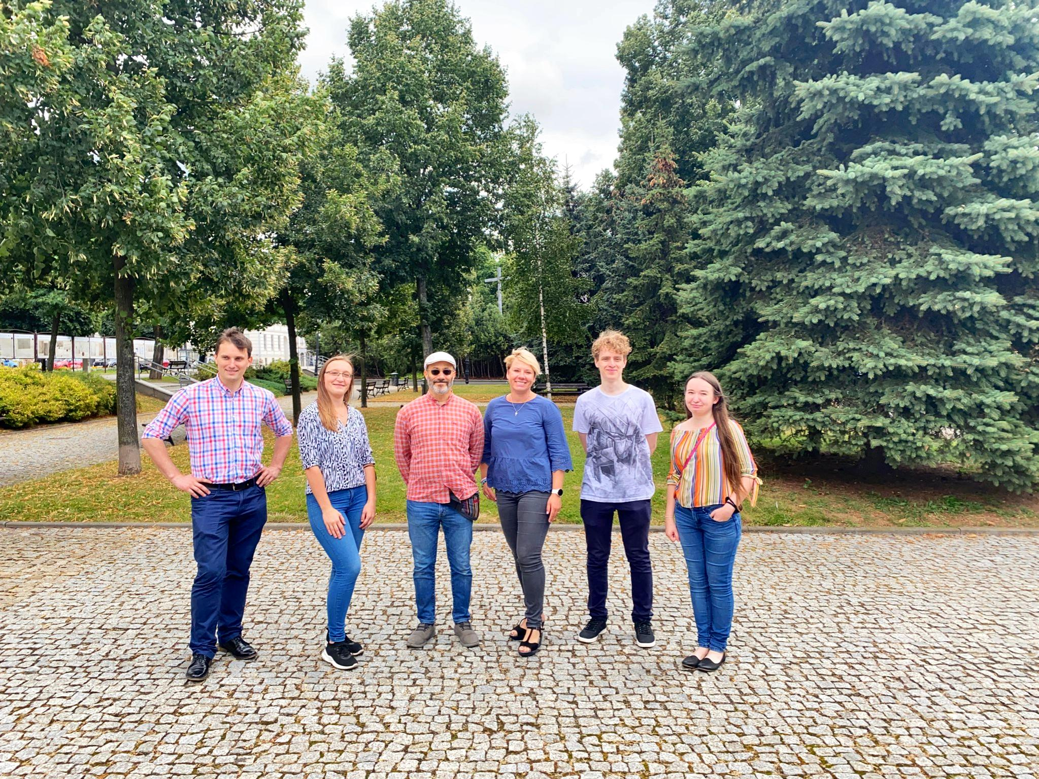
https://lcr-lab.org/
The work was funded by the project OPUS 20 2020/39/B/ST6/03447.

