Slide 1
Introduction to biostatistics
Hristo Todorov,
AG Prof. Dr. Susanne Gerber

Slide 2
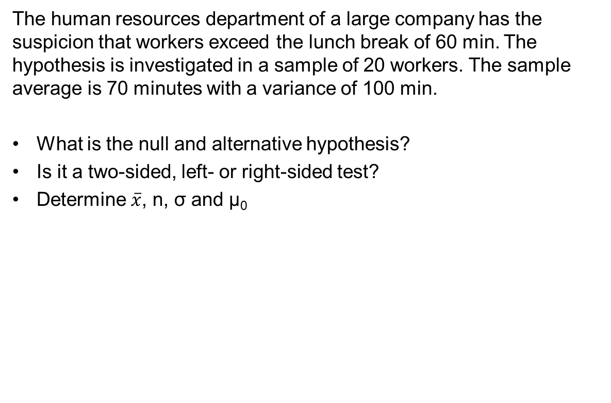
The human resources department of a large company has the suspicion that workers exceed the lunch break of 60 min. The hypothesis is investigated in a sample of 20 workers. The sample average is 70 minutes with a variance of 100 min.
What is the null and alternative hypothesis?
Is it a two-sided, left- or right-sided test?
Determine $\overline{x}$, n, σ and µ₀

Slide 3
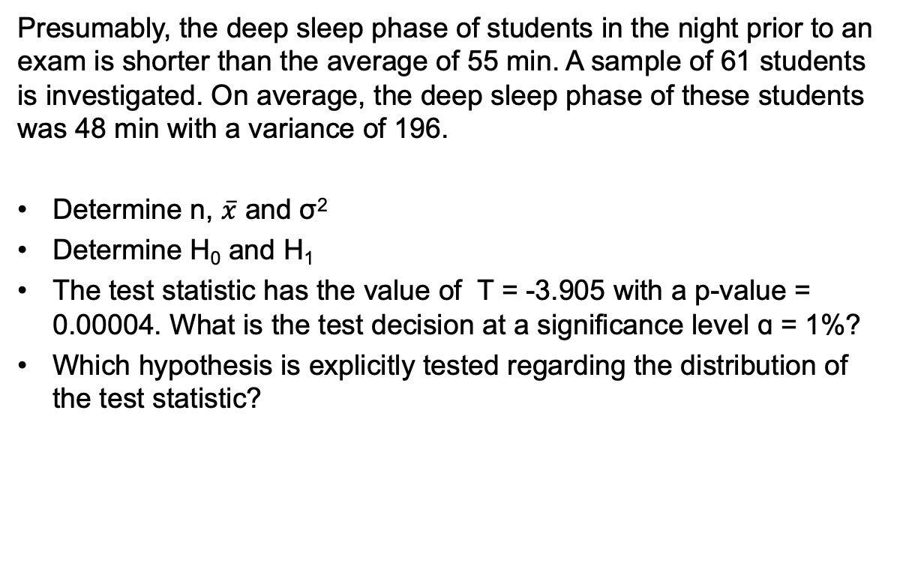
Presumably, the deep sleep phase of students in the night prior to an exam is shorter than the average of 55 min. A sample of 61 students is investigated. On average, the deep sleep phase of these students was 48 min with a variance of 196.
Determine n, $\overline{x}$ and σ²
Determine H₀ and H₁
The test statistic has the value of T = -3.905 with a p-value = 0.00004. What is the test decision at a significance level ɑ = 1%?
Which hypothesis is explicitly tested regarding the distribution of the test statistic?

Slide 4
The owner of a vegetarian restaurant is being sued by a client. The client has photographic proof, that 8 out of 25 soups that he ordered were not vegetarian because there was a fly in them. The court requires a hypothesis test using this sample to investigate if the proportion of soups with a fly in them is over the limit of 10% allowed by the law.
Define H₀ and H₁ for the population parameter p
Is this a two-, left or right sided test?

