Slide 1
Examining repeats with databases
Miguel Andrade
Faculty of Biology,
Johannes Gutenberg University
Mainz, Germany
andrade@uni-mainz.de

Slide 2
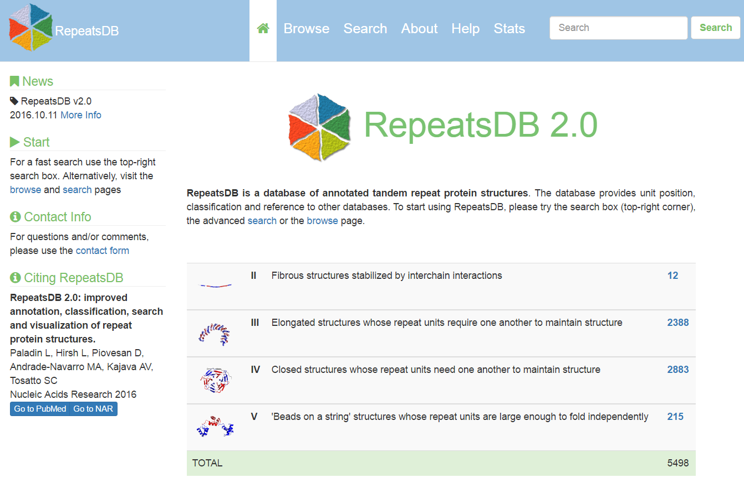
RepeatsDB

Slide 3
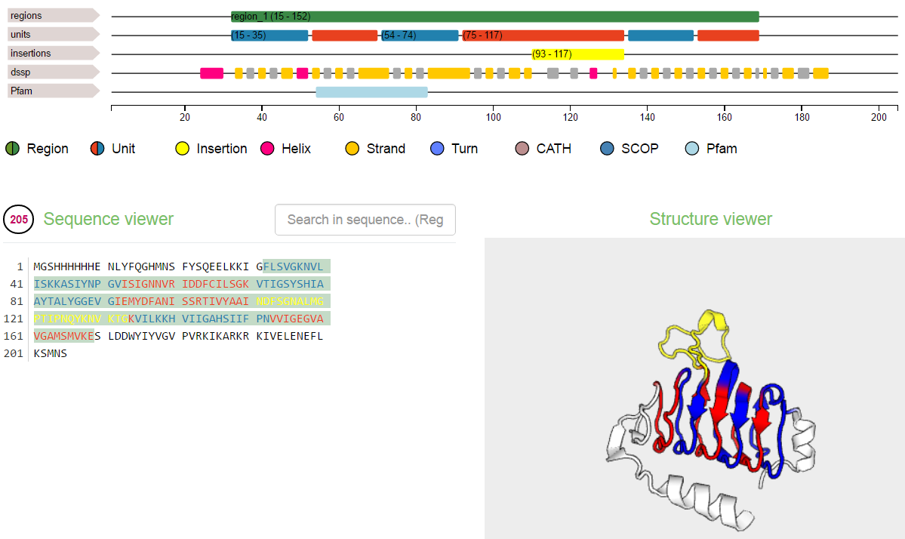
RepeatsDB
http://repeatsdb.bio.unipd.it/protein/3vbpA

Slide 4
Exercise 1. Examining repeat structures in repeatsDB
Go to RepeatsDB: http://repeatsdb.bio.unipd.it/
Go to Search, then select database RepeatsDB, and Search field, No.units (fill both From and To with the same number)
Choose one example (you might look for an unreviewed one) and write the PDB name in your card.
Check the assignment of the units. Is it correct? What about insertions? Are there mistakes? Write an evaluation in the card: Looks good / one repeat wrong / many mistakes / total mess

Slide 5
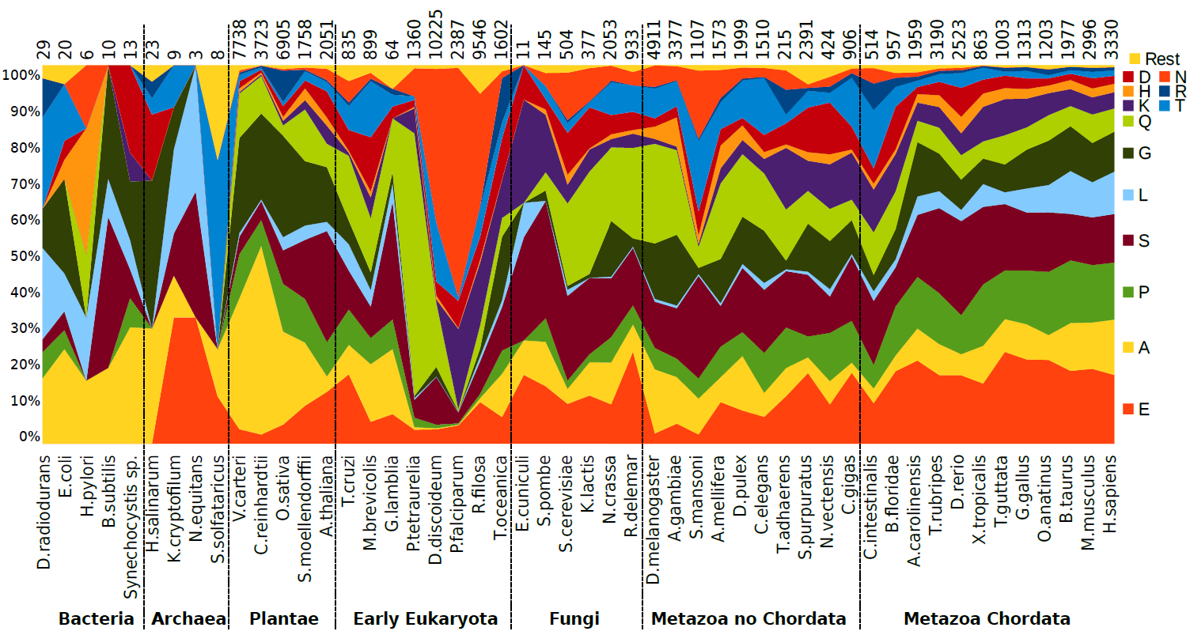

Evolution of homorepeats in 50 species
Pablo Mier

Slide 6
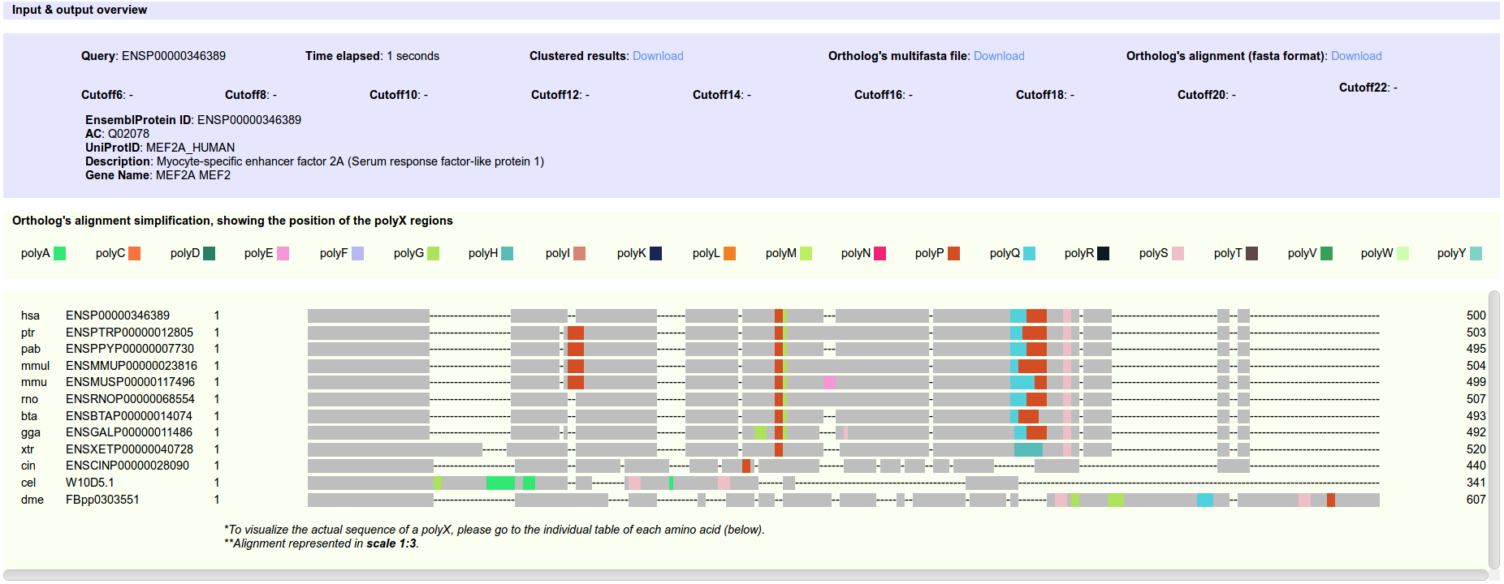

Context and evolution of homorepeats
dAtabase of PolyX Evolution
Mier et al. (2016) Bioinformatics

Slide 7
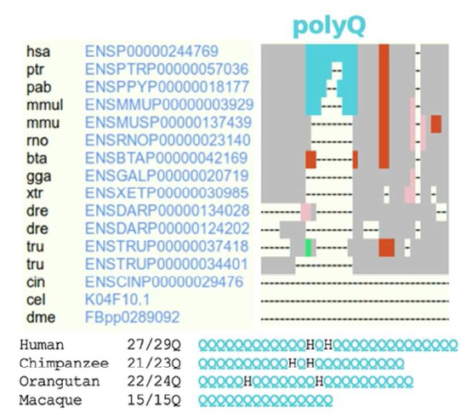
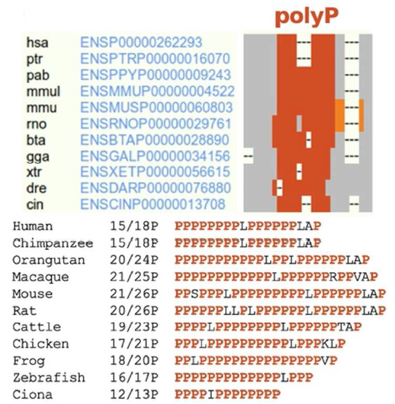
Context and evolution of homorepeats
dAtabase of PolyX Evolution
Mier et al. (2016) Bioinformatics
Notes:
Left: ataxin1; right: PRR11

Slide 8
Exercise 2. Viewing homorepeats in an alignment with dAPE
Find a random human protein in UniProt using this URL:
https://www.uniprot.org/uniprot/?query=organism%3A%22Homo+sapiens+%28Human%29+%5B9606%5D%22+reviewed%3Ayes&random=yes. Write the Entry Name in your card.
Copy the Entry ID (e.g. P10275).
Go to the dAPE web page:
http://cbdm-01.zdv.uni-mainz.de/~munoz/polyx/
Use the Entry ID in option A
Hit the “Report the evolution of its polyX" button
Write down in you card: (1) Which type of polyX has the human protein? (2) Which additional polyX not in the human protein were found in the orthologs?

Slide 9
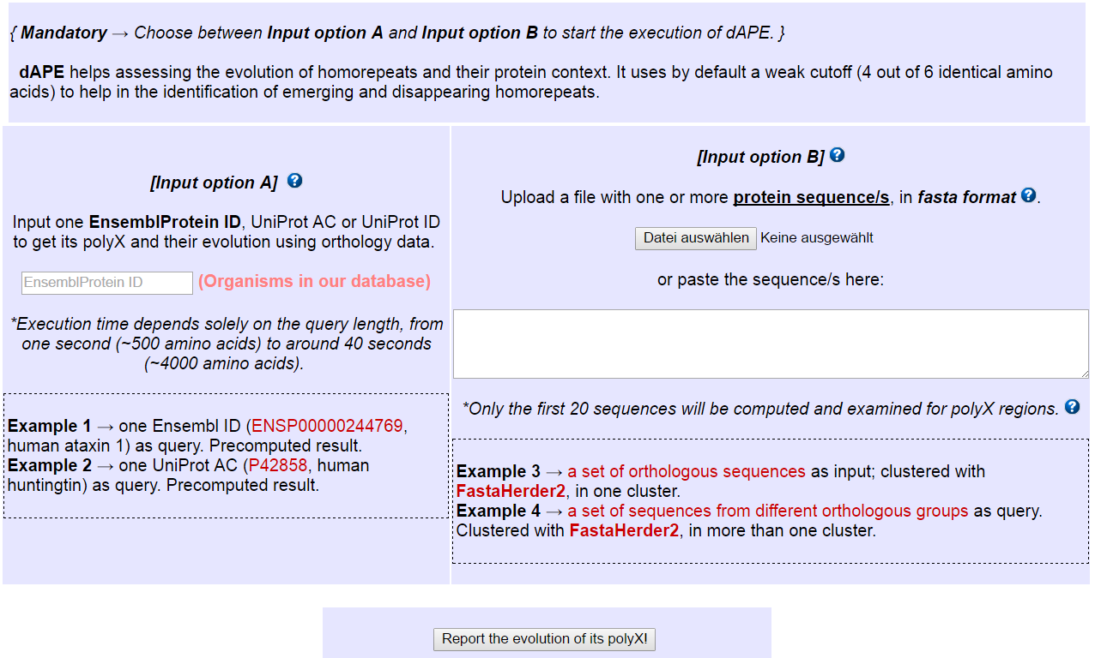
Exercise 2. Viewing homorepeats in an alignment with dAPE
Entry ID here

