Slide 1
Homology 3D modeling
Miguel Andrade
Faculty of Biology,
Institute of Organismic and Molecular Evolution
Johannes Gutenberg University
Mainz, Germany
andrade@uni-mainz.de

Slide 2
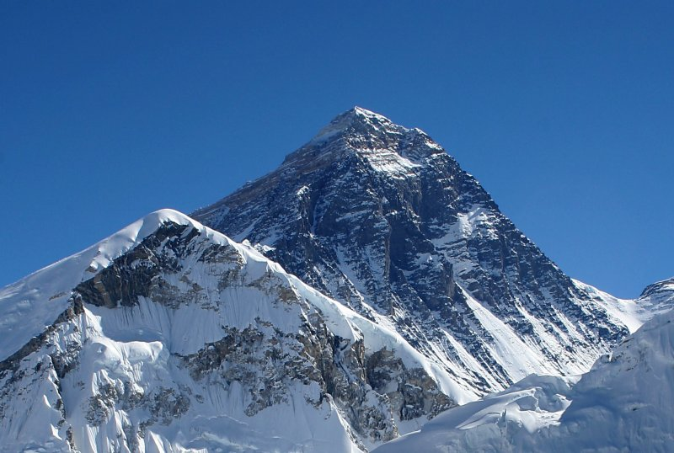
Mount Everest
Age: 60M years

Slide 3
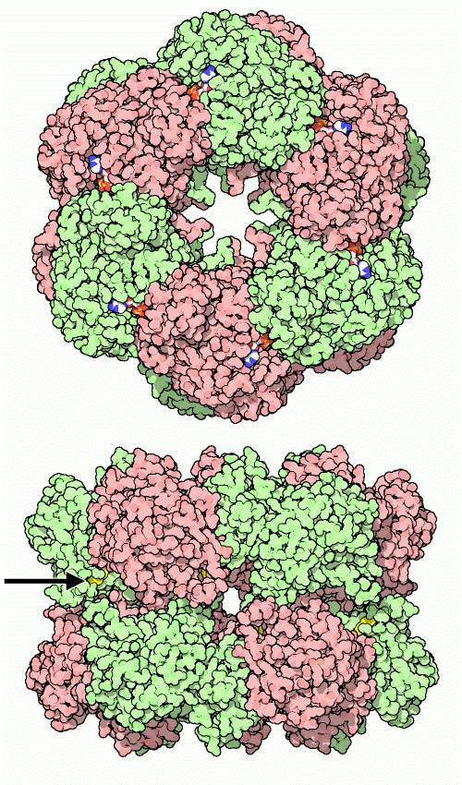
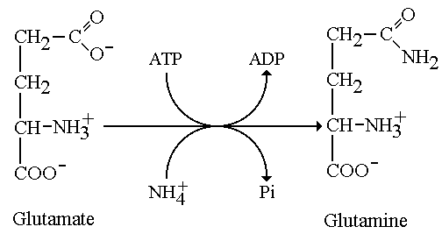
Glutamine synthetase
Age: +3500M years

Slide 4
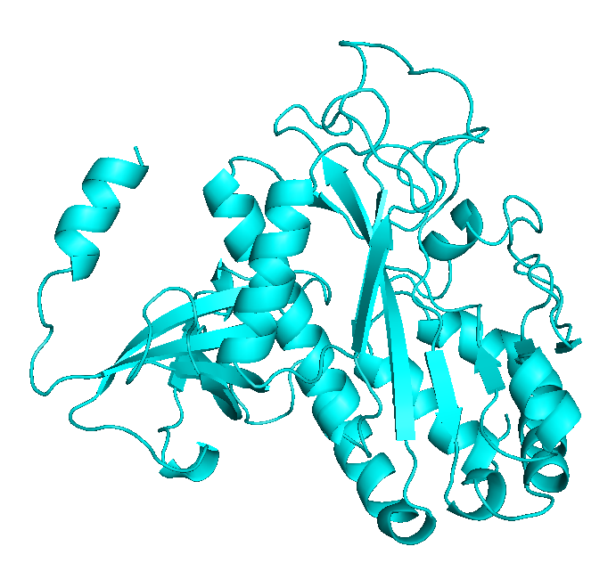
Glutamine synthetase
Human
PDB:2QC8

Slide 5
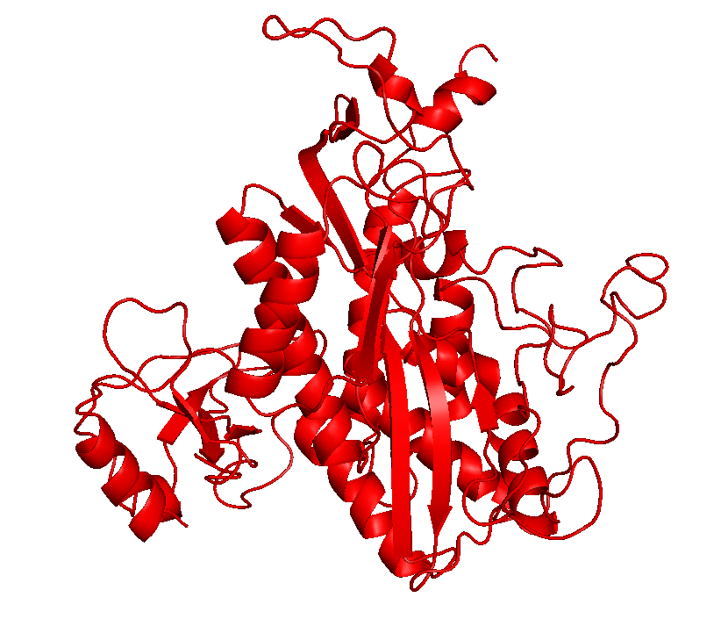
Glutamine synthetase
Salmonella typhimurium
PDB:2GLS

Slide 6
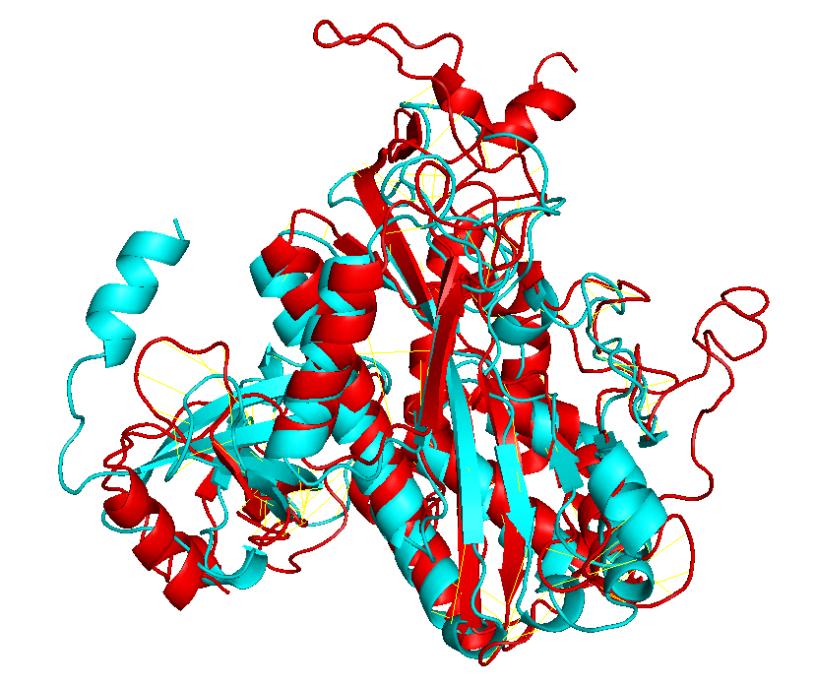
Glutamine synthetase

Slide 7
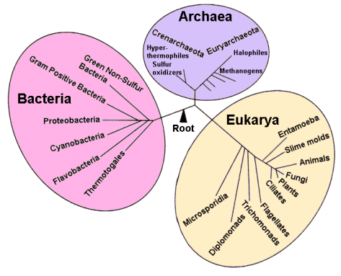
Time line
Earth: 4.6 By
Origin of life: 3.9 By – 3.5 By
Last Common Ancestor: 3.5 – 3.8 By
Glansdorff & Labedan (2008) Biology Direct
4.29 By
Sheridan et al. (2003) Geomicrobiology Journal

Slide 8
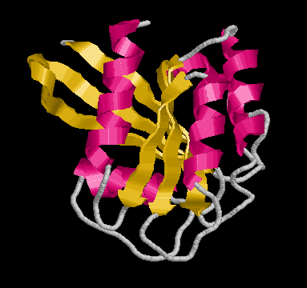
Sequence and function
Evolutionary constraints
MTQDELKKAVGWAALQYVQPGTIVGVGTGSTAAHFIDALGTMKGQIEGAVSSSDASTEKL
Sequence
Structure
Function

Slide 9
Sequence and function
Evolutionary constraints
Speciation/orthology
Sequence 1
Structure 1
Function 1
Sequence
Similarity
Sequence 2
Structure 2
Function 1
Gene duplication/paralogy
Sequence 1
Structure 1
Function 1
Sequence
Similarity
Sequence 2
Structure 2
Function 2

Slide 10
Sequence pairwise alignment
>gs_human gi|74271837|ref|NP_001028216.1| glutamine synthetase [Homo sapiens]
MTTSASSHLNKGIKQVYMSLPQGEKVQAMYIWIDGTGEGLRCKTRTLDSEPKCVEELPEWNFDGSSTLQS
EGSNSDMYLVPAAMFRDPFRKDPNKLVLCEVFKYNRRPAETNLRHTCKRIMDMVSNQHPWFGMEQEYTLM
GTDGHPFGWPSNGFPGPQGPYYCGVGADRAYGRDIVEAHYRACLYAGVKIAGTNAEVMPAQWEFQIGPCE
GISMGDHLWVARFILHRVCEDFGVIATFDPKPIPGNWNGAGCHTNFSTKAMREENGLKYIEEAIEKLSKR
HQYHIRAYDPKGGLDNARRLTGFHETSNINDFSAGVANRSASIRIPRTVGQEKKGYFEDRRPSANCDPFS
VTEALIRTCLLNETGDEPFQYKN
>gs_salmonella gi|16767272|ref|NP_462887.1| glutamine synthetase [Salmonella enterica subsp. enterica serovar Typhimurium str. LT2]
MSAEHVLTMLNEHEVKFVDLRFTDTKGKEQHVTIPAHQVNAEFFEEGKMFDGSSIGGWKGINESDMVLMP
DASTAVIDPFFADSTLIIRCDILEPGTLQGYDRDPRSIAKRAEDYLRATGIADTVLFGPEPEFFLFDDIR
FGASISGSHVAIDDIEGAWNSSTKYEGGNKGHRPGVKGGYFPVPPVDSAQDIRSEMCLVMEQMGLVVEAH
HHEVATAGQNEVATRFNTMTKKADEIQIYKYVVHNVAHRFGKTATFMPKPMFGDNGSGMHCHMSLAKNGT
NLFSGDKYAGLSEQALYYIGGVIKHAKAINALANPTTNSYKRLVPGYEAPVMLAYSARNRSASIRIPVVA
SPKARRIEVRFPDPAANPYLCFAALLMAGLDGIKNKIHPGEAMDKNLYDLPPEEAKEIPQVAGSLEEALN
ALDLDREFLKAGGVFTDEAIDAYIALRREEDDRVRMTPHPVEFELYYSV

Slide 11
Sequence pairwise alignment
BLAST (Altschul et al, 1990)
>lcl|39919 unnamed protein product
Length=469
Score = 70.5 bits (171), Expect = 1e-17, Method: Compositional matrix adjust.
Identities = 102/363 (28%), Positives = 138/363 (38%), Gaps = 96/363 (26%)
Query 62 FDGSSTLQSEGSN-SDMYLVPAA--MFRDPFRKDPNKLVLCEVFK------YNRRP---- 108
FDGSS +G N SDM L+P A DPF D ++ C++ + Y+R P
Sbjct 50 FDGSSIGGWKGINESDMVLMPDASTAVIDPFFADSTLIIRCDILEPGTLQGYDRDPRSIA 109
Query 109 --AETNLRHTCKRIMDMVSNQHPWFGMEQEYTLMGTDGHPFGWPSNGF------------ 154
AE LR T I D V FG E E+ L D FG +G
Sbjct 110 KRAEDYLRATG--IADTV-----LFGPEPEFFLF--DDIRFGASISGSHVAIDDIEGAWN 160
Query 155 -------------PGPQGPYYCGVGADRAYGRDI--------------VEAHYRACLYAG 187
PG +G Y+ D A +DI VEAH+ AG
Sbjct 161 SSTKYEGGNKGHRPGVKGGYFPVPPVDSA--QDIRSEMCLVMEQMGLVVEAHHHEVATAG 218
Query 188 VKIAGTNAEVMPAQWEFQIGPCEGISMGDHLWVARFILHRVCEDFGVIATFDPKPIPG-N 246
T M + D + + ++++H V FG ATF PKP+ G N
Sbjct 219 QNEVATRFNTMTKK-------------ADEIQIYKYVVHNVAHRFGKTATFMPKPMFGDN 265
Query 247 WNGAGCHTNFSTKAMREENGLKYIEEAIEKLSKRHQYHIRAYDPKGGLDNA--------- 297
+G CH + + +G KY LS++ Y+I NA
Sbjct 266 GSGMHCHMSLAKNGTNLFSGDKY-----AGLSEQALYYIGGVIKHAKAINALANPTTNSY 320
Query 298 RRLTGFHETSNINDFSAGVANRSASIRIPRTVGQEKKGYFEDRRPSANCDPFSVTEALIR 357
+RL +E + +SA NRSASIRIP V K E R P +P+ AL+
Sbjct 321 KRLVPGYEAPVMLAYSA--RNRSASIRIP-VVASPKARRIEVRFPDPAANPYLCFAALLM 377
Query 358 TCL 360
L
Sbjct 378 AGL 380

Slide 12
Multiple sequence alignment
>gs_human gi|74271837|ref|NP_001028216.1| glutamine synthetase [Homo sapiens]
MTTSASSHLNKGIKQVYMSLPQGEKVQAMYIWIDGTGEGLRCKTRTLDSEPKCVEELPEWNFDGSSTLQS
EGSNSDMYLVPAAMFRDPFRKDPNKLVLCEVFKYNRRPAETNLRHTCKRIMDMVSNQHPWFGMEQEYTLM
GTDGHPFGWPSNGFPGPQGPYYCGVGADRAYGRDIVEAHYRACLYAGVKIAGTNAEVMPAQWEFQIGPCE
GISMGDHLWVARFILHRVCEDFGVIATFDPKPIPGNWNGAGCHTNFSTKAMREENGLKYIEEAIEKLSKR
HQYHIRAYDPKGGLDNARRLTGFHETSNINDFSAGVANRSASIRIPRTVGQEKKGYFEDRRPSANCDPFS
VTEALIRTCLLNETGDEPFQYKN
>gs_vulca gi|307594850|ref|YP_003901167.1| glutamine synthetase [Vulcanisaeta distributa DSM 14429]
MPTRNLEIEPADLWRILKASGIKYVKFIIVDINGAPRSEIVPIDMAKDLFIDGMPFDASSIPSYSTVNKS
DFVAYVDPRAVYVEYWQDGKVADVFTMVSDIADKPSPLDPRRVLNDALEQARSKGYEFLMGVEVEFFVIK
EDGGKPVFADPGIYFDGWNVTVQSQFMKELITAIADAGINYTKTHHEVAPSQYEVNIGATDPLRLADQIV
YFKIMAKDIARKYGLVATFMPKPFWGVNGSGAHTHISVWKDGKNLFQSSTGKITEECGYAISAILSNARA
LSSFVAPLVNSYKRLVPHYEAPTRIVWGYANRSAMIRIPQYKMRINRIEYRHPDPSMNPYLAFTAIIKTM
IRGLEEKKEPPPPTEEVAYELANALETPATLEDTLKELSKSFLATELPSELVNAYIKIKQNEWEDYLTNV
GPWEKTWNIITQWEYNKYLVTA
>gs_salmonella gi|16767272|ref|NP_462887.1| glutamine synthetase [Salmonella enterica subsp. enterica serovar Typhimurium str. LT2]
MSAEHVLTMLNEHEVKFVDLRFTDTKGKEQHVTIPAHQVNAEFFEEGKMFDGSSIGGWKGINESDMVLMP
DASTAVIDPFFADSTLIIRCDILEPGTLQGYDRDPRSIAKRAEDYLRATGIADTVLFGPEPEFFLFDDIR
FGASISGSHVAIDDIEGAWNSSTKYEGGNKGHRPGVKGGYFPVPPVDSAQDIRSEMCLVMEQMGLVVEAH
HHEVATAGQNEVATRFNTMTKKADEIQIYKYVVHNVAHRFGKTATFMPKPMFGDNGSGMHCHMSLAKNGT
NLFSGDKYAGLSEQALYYIGGVIKHAKAINALANPTTNSYKRLVPGYEAPVMLAYSARNRSASIRIPVVA
SPKARRIEVRFPDPAANPYLCFAALLMAGLDGIKNKIHPGEAMDKNLYDLPPEEAKEIPQVAGSLEEALN
ALDLDREFLKAGGVFTDEAIDAYIALRREEDDRVRMTPHPVEFELYYSV
>gs_yeast gi|330443748|ref|NP_015360.2| Gln1p [Saccharomyces cerevisiae S288c]
MAEASIEKTQILQKYLELDQRGRIIAEYVWIDGTGNLRSKGRTLKKRITSIDQLPEWNFDGSSTNQAPGH
DSDIYLKPVAYYPDPFRRGDNIVVLAACYNNDGTPNKFNHRHEAAKLFAAHKDEEIWFGLEQEYTLFDMY
DDVYGWPKGGYPAPQGPYYCGVGAGKVYARDMIEAHYRACLYAGLEISGINAEVMPSQWEFQVGPCTGID
MGDQLWMARYFLHRVAEEFGIKISFHPKPLKGDWNGAGCHTNVSTKEMRQPGGMKYIEQAIEKLSKRHAE
HIKLYGSDNDMRLTGRHETASMTAFSSGVANRGSSIRIPRSVAKEGYGYFEDRRPASNIDPYLVTGIMCE
TVCGAIDNADMTKEFERESS

Slide 13

http://www.ebi.ac.uk/Tools/msa/muscle/

Slide 14
>gs_human gi|74271837|ref|NP_001028216.1| glutamine synthetase [Homo sapiens]
MTTSASSHLNKGIKQVYMSLPQGEKVQAMYIWIDGTGEGLRCKTRTLDSEPKCVEELPEW
N-FDGSSTLQSEGSNSD---MYLVPAAMFRDPFRKDPNKLVLCEVFKYNRRPA-ETNLRH
TCKRIMDMVSNQH----PWFGMEQEYTLMGT--------------DGHPFGW--------
-PSNGFPGPQGP--YYCGVGADRAYGRDIVEAHYRACLYAGVKIAGTNAEVMPA-QWEFQ
IGPCEGISMGDHLWVARFILHRVCEDFGVIATFDPKPIPGNWNGAGCHTNFSTKAMREEN
GLKYIEEAIEKLSKRHQYHIRAYDPKGG---------LDNARRLTGFHETSNINDFSAGV
ANRSASIRIPRTVGQEKKGYFEDRRPSANCDPFSVTEALIRT-CLLNETGDEP-------
------------------------------------------------------------
--------------FQYKN-----
>gs_yeast gi|330443748|ref|NP_015360.2| Gln1p [Saccharomyces cerevisiae S288c]
--MAEASIEKTQILQKYLELDQRGRIIAEYVWIDGTGN-LRSKGRTLKKRITSIDQLPEW
N-FDGSSTNQAPGHDSD---IYLKPVAYYPDPFRRGDNIVVLAACYNNDGTPN-KFNHRH
EAAKLFAAHKDEE----IWFGLEQEYTLFDM--------------YDDVYGW--------
-PKGGYPAPQGP--YYCGVGAGKVYARDMIEAHYRACLYAGLEISGINAEVMPS-QWEFQ
VGPCTGIDMGDQLWMARYFLHRVAEEFGIKISFHPKPLKGDWNGAGCHTNVSTKEMRQPG
GMKYIEQAIEKLSKRHAEHIKLYG-------------SDNDMRLTGRHETASMTAFSSGV
ANRGSSIRIPRSVAKEGYGYFEDRRPASNIDPYLVTGIMCETVCGAIDNADMT-------
------------------------------------------------------------
--------------KEFERESS—
>gs_vulca gi|307594850|ref|YP_003901167.1| glutamine synthetase [Vulcanisaeta distributa DSM 14429]
MPTRNLEIEPADLWRI---LKASGIKYVKFIIVDINGA---PRSEIVPIDMAK-DLFIDG
MPFDASSIPSYSTVNKSDFVAYVDPRAVYVEYWQDGKVADVFTMVSDIADKPS-PLDPRR
VLNDALEQARSKGYE--FLMGVEVEFFVIKE-----------------------------
--DGGKPVFADPGIYFDGWNVTV--QSQFMKELITAIADAGINYTKTHHEVAPS-QYEVN
IGATDPLRLADQIVYFKIMAKDIARKYGLVATFMPKPFWGV-NGSGAHTHIS---VWKDG
KNLF-QSSTGKITEECGYAISAILSNARALSSFVAPLVNSYKRLVPHYEAPTRIVW--GY
ANRSAMIRIPQ--YKMRINRIEYRHPDPSMNPYLAFTAIIKTMIRGLEEKKEPPPPTEEV
AYELA--NALETP---ATLEDTLK--ELSKSFLATE--LPSELVNAYIKIKQNEWEDYLT
NVGPWEKTWNIITQWEYNKYLVTA
>gs_salmonella gi|16767272|ref|NP_462887.1| glutamine synthetase [Salmonella enterica
-------MSAEHVLTM---LNEHEVKFVDLRFTDTKGK---EQHVTIPAHQVNAEFFEEG
KMFDGSSIGGWKGINESDMVLMPDASTAVIDPFFADSTLIIRCDILEPGTLQGYDRDPRS
IAKRAEDYLRATGIADTVLFGPEPEFFLFDDIRFGASISGSHVAIDDIEGAWNSSTKYEG
GNKGHRPGVKGG--YFPVPPVDS--AQDIRSEMCLVMEQMGLVVEAHHHEVATAGQNEVA
TRFNTMTKKADEIQIYKYVVHNVAHRFGKTATFMPKPMFGD-NGSGMHCHMS---LAKNG
TNLFSGDKYAGLSEQALYYIGGVIKHAKAINALANPTTNSYKRLVPGYEAPVMLAY--SA
RNRSASIRIPV-VASPKARRIEVRFPDPAANPYLCFAALLMAGLDGIKNKIHPGEAMDKN
LYDLPPEEAKEIPQVAGSLEEALNALDLDREFLKAGGVFTDEAIDAYIALRREEDDRVRM
TPHP----------VEFELYYSV-

Slide 15
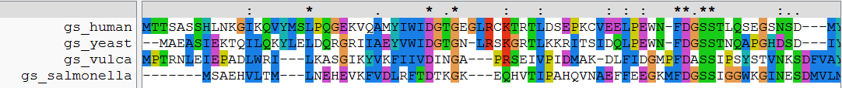
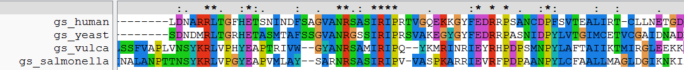
ClustalW, JalView

Slide 16
Determination of protein structure
X-ray crystallography (111K in PDB)
  need crystals
Nuclear Magnetic Resonance (NMR) (10.4K)
  proteins in solution
  lower size limit (600 aa)
Electron microscopy (1.2K)
  Low resolution (>5A)

Slide 17

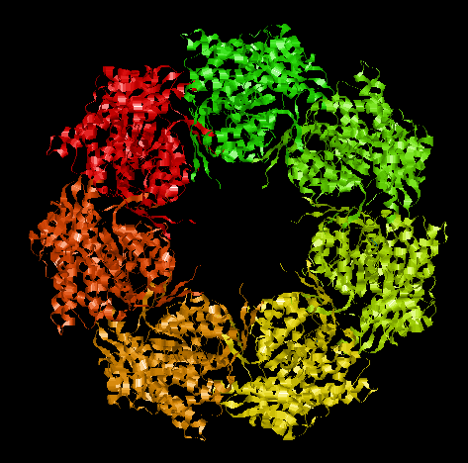
Determination of protein structure
resolution 2.4 A

Slide 18
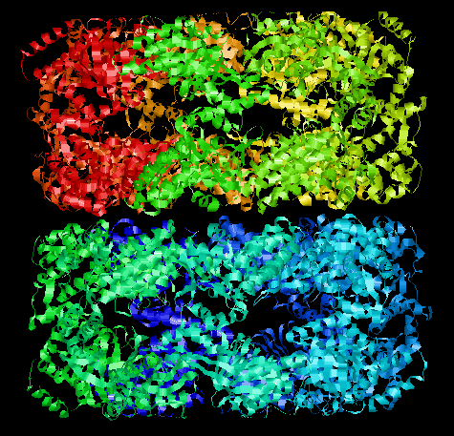
Determination of protein structure
resolution 2.4 A

Slide 19
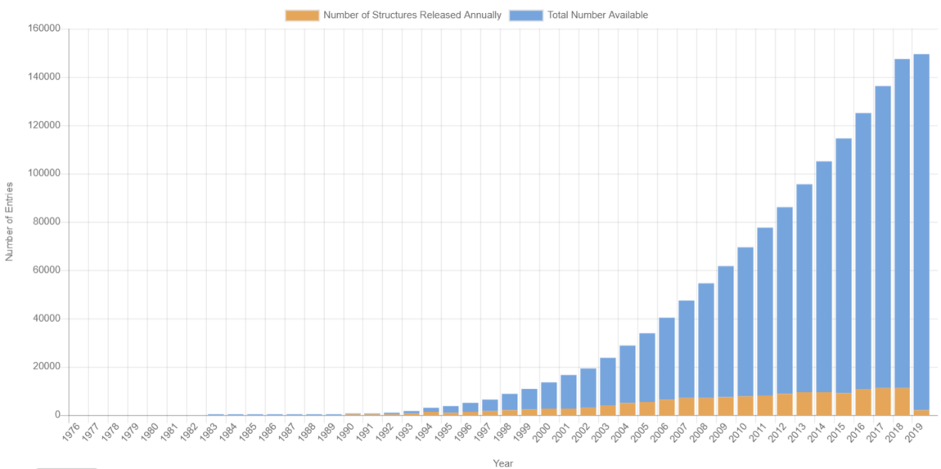
Structural genomics
Currently: 150K protein 3D structures
from around 46.4K sequences in UniProt (how do I know?)
146M sequences in UniProt
only 0.03%!
Notes:
PDB > Search > PDB Statistics / UniProt > Advanced search > Keyword 3D-structure

Slide 20
Structural genomics
Currently: 150K protein 3D structures
from around 46.4K sequences in UniProt (how do I know?)
146M sequences in UniProt
only 0.03%!
50% sequences covered (25% in 1995)

Slide 21
Relation between
sequence identity and accuracy/applications
From:
Baker and Sali (2001) Science

Slide 22
Homology modelling
Applications: target design
Query sequence
G
K
similar to
L
G
+
Leu
Gly
Lys
Gly
catalytic center
known 3D
model 3D by homology

Slide 23
Homology modelling
Applications: fit to low res 3D
Query sequence 1
Query sequence 2
low resolution 3D (electron microscopy)

Slide 24
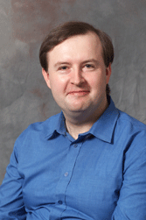
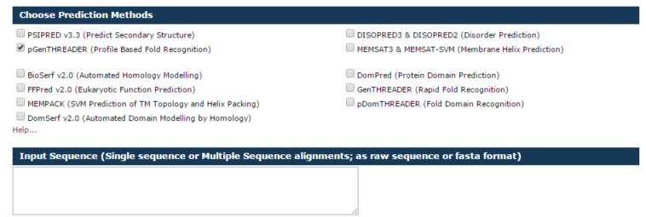
Homology modelling
GenTHREADER
David Jones http://bioinf.cs.ucl.ac.uk/psipred_new/
Input sequence or MSA
Typically 30 minutes, up to two hours
GenTHREADER Jones (1999) J Mol Biol

Slide 25

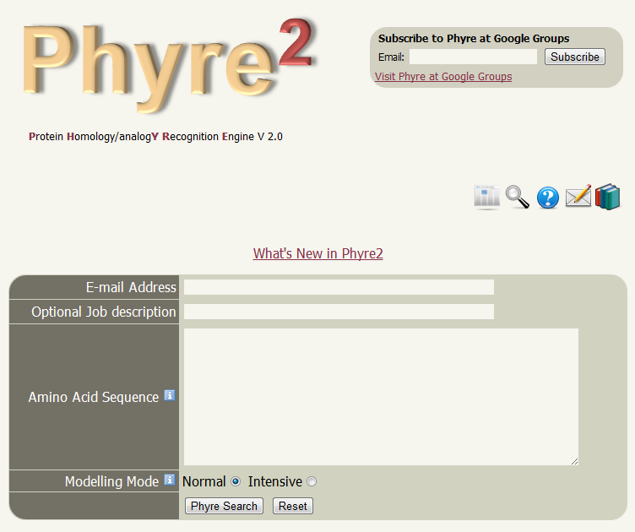
Homology modelling
Phyre
Mike Sternberg http://www.sbg.bio.ic.ac.uk/phyre2/
Kelley et al (2000) J Mol Biol
Kelley et al (2015)
Nature Protocols
Processing time can be hours

Slide 26
Homology modelling
Static solutions
Datasets of precomputed models / computations
Not flexible
Variable coverage
But you don’t have to wait

Slide 27
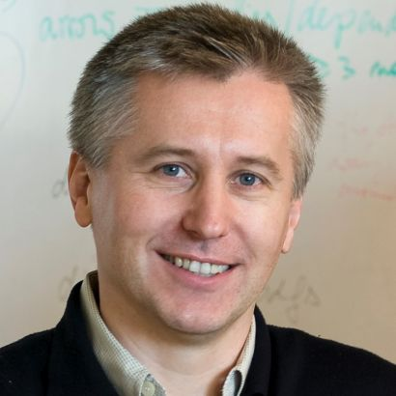
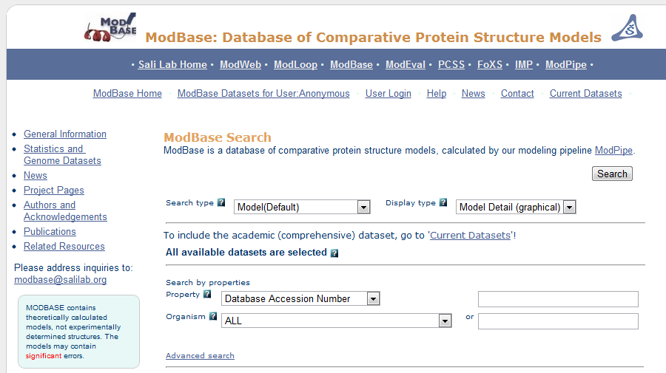
Homology modelling
MODbase
Andrej Sali http://modbase.compbio.ucsf.edu/
Pieper et al (2014) Nucleic Acids Research

Slide 28
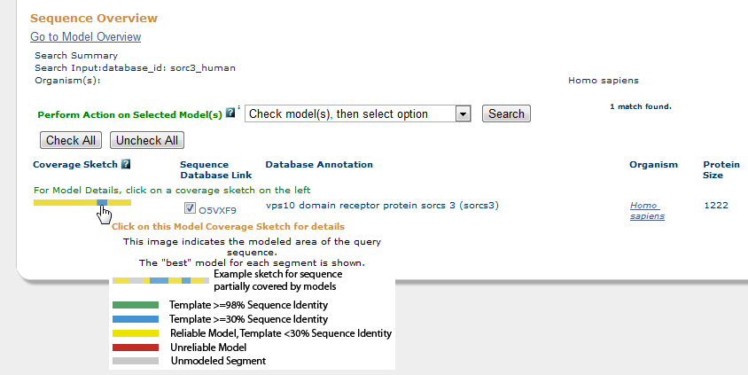
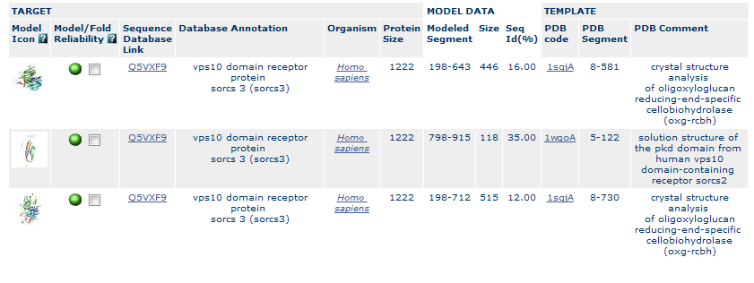
Homology modelling
MODbase

Slide 29
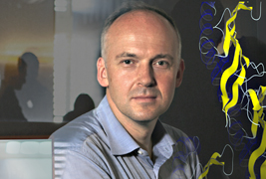
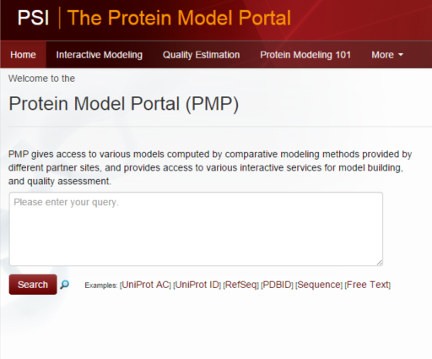
Homology modelling
Protein Model Portal
Torsten Schwede
Haas et al. (2013) Database

Slide 30

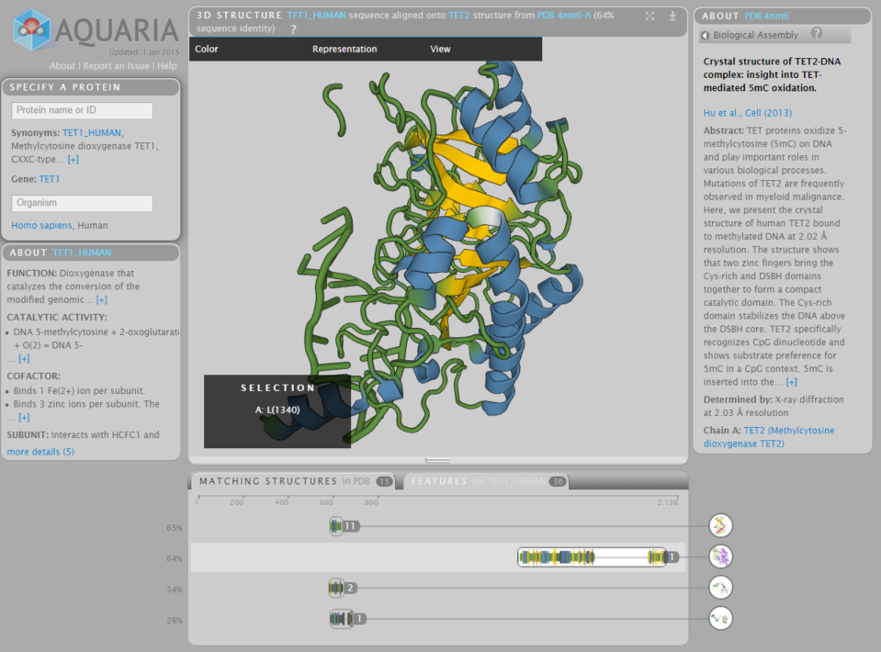
Aquaria
Sean O’Donoghue http://aquaria.ws/
O’Donoghue et al (2015) Nature Methods

Slide 31
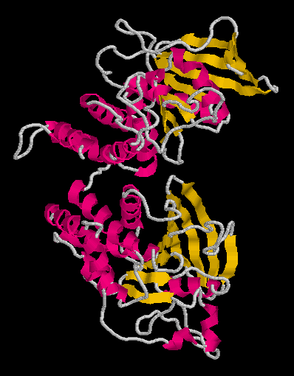
Domains
Protein domains are structural units (average 160 aa) that share:
Function
Folding
Evolution
Proteins normally are multidomain
(average 300 aa)

Slide 32
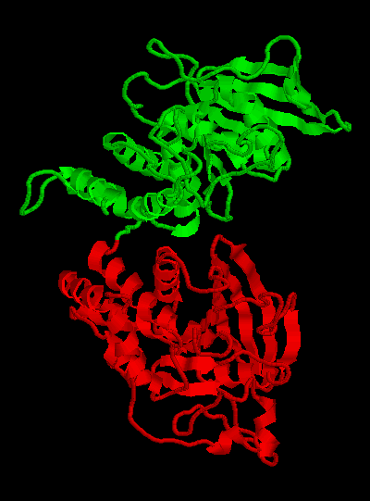
Domains
Protein domains are structural units (average 160 aa) that share:
Function
Folding
Evolution
Proteins normally are multidomain
(average 300 aa)

Slide 33
Domains
Query Sequence
Predict domains
Cut
Similar to PDB
sequence?
No
2D Prediction
3D Ab initio
3D Threading
Yes
3D Modeling by homology

Slide 34
3D structure prediction
Ab initio
Explore conformational space
Limit the number of atoms
Break the problem into fragments of sequence
Optimize hydrophobic residue burial and pairing of beta-strands
Limited success

Slide 35

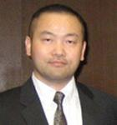
3D structure prediction
Threading
I-Tasser: Yang Zhang & Jeffrey Skolnick
Fold 66% sequences <200 aa long of low homology to PDB
Just submit your sequence and wait… (some days)
Output are predicted structures (PDB format)
Lee and Skolnick (2008) Biophysical Journal
Roy et al (2010) Nature Methods
Yang et al (2015) Nature Methods

Slide 36
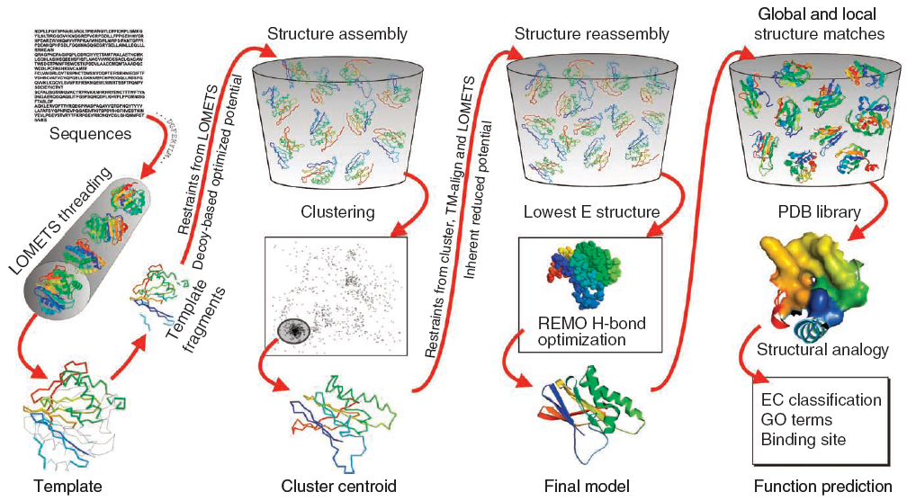
3D structure prediction
I-Tasser
Roy et al (2010) Nature Methods

Slide 37
Structure-based drug-design
Find a molecule that fits a protein
+
Leu
Gly
-
Lys
Gly
catalytic center
known 3D
model 3D by homology
or…

