Slide 1
Examining repeats with databases
Miguel Andrade
Faculty of Biology,
Johannes Gutenberg University
Mainz, Germany
andrade@uni-mainz.de

Slide 2
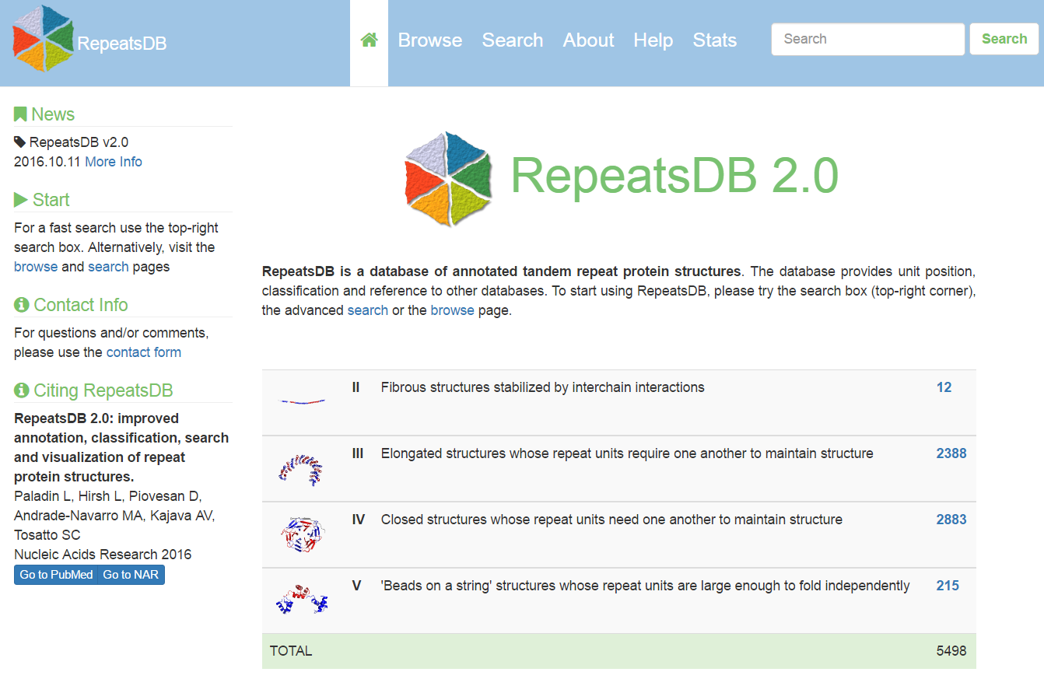
RepeatsDB

Slide 3
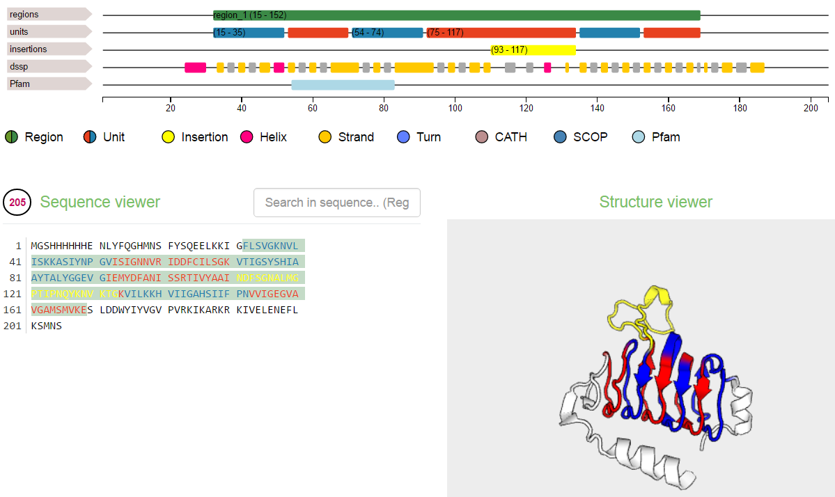
RepeatsDB
http://repeatsdb.bio.unipd.it/protein/3vbpA

Slide 4
Exercise 1. Examining repeat structures in repeatsDB
Go to RepeatsDB: http://repeatsdb.bio.unipd.it/
Go to Search, then select database RepeatsDB, and Search field, No.units (fill both From and To with the same number)
Choose one example (you might look for an unreviewed one) and write the PDB name in your card.
Check the assignment of the units. Is it correct? What about insertions? Are there mistakes? Write an evaluation in the card: Looks good / one repeat wrong / many mistakes / total mess

Slide 5
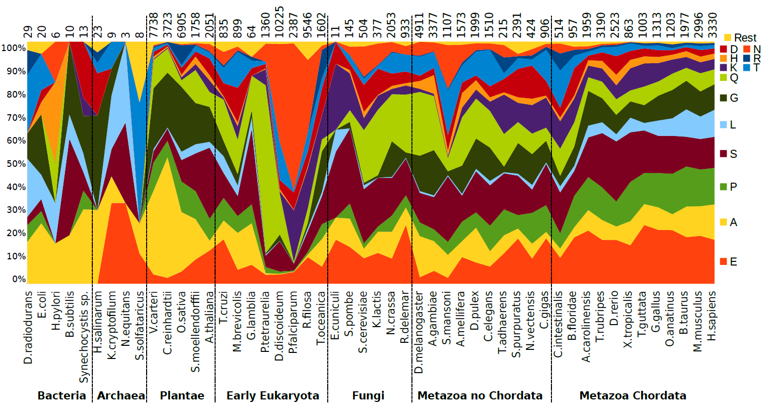

Evolution of homorepeats in 50 species
Pablo Mier

Slide 6
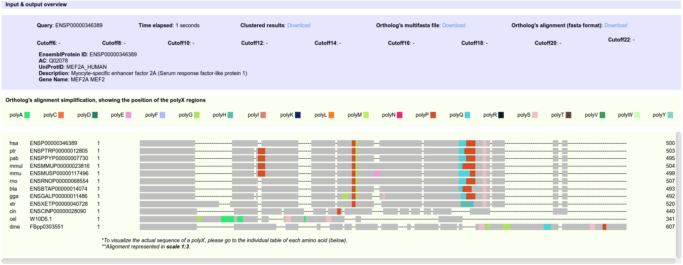

Context and evolution of homorepeats
dAtabase of PolyX Evolution
Mier et al. (2016) Bioinformatics

Slide 7
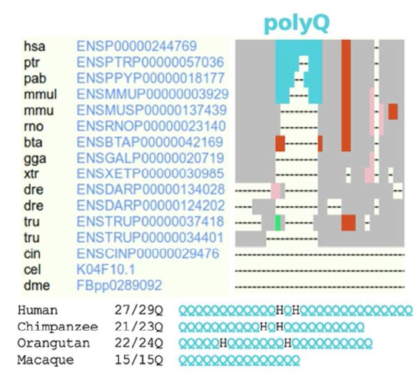
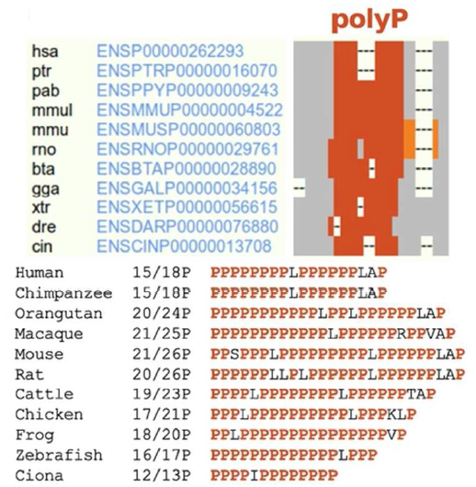
Context and evolution of homorepeats
dAtabase of PolyX Evolution
Mier et al. (2016) Bioinformatics
Notes:
Left: ataxin1; right: PRR11

Slide 8
Exercise 2. Viewing homorepeats in an alignment with dAPE
Find a random human protein in UniProt using this URL:
https://www.uniprot.org/uniprot/?query=organism%3Ahuman&random=yes. Write the Entry Name in your card.
Copy the Entry ID (e.g. P10275).
Go to the dAPE web page:
http://cbdm-01.zdv.uni-mainz.de/~munoz/polyx/
Use the Entry ID in option A
Hit the “Report the evolution of its polyX" button
Write down in you card: (1) Which type of polyX has the human protein? (2) Which additional polyX not in the human protein were found in the orthologs?

Slide 9
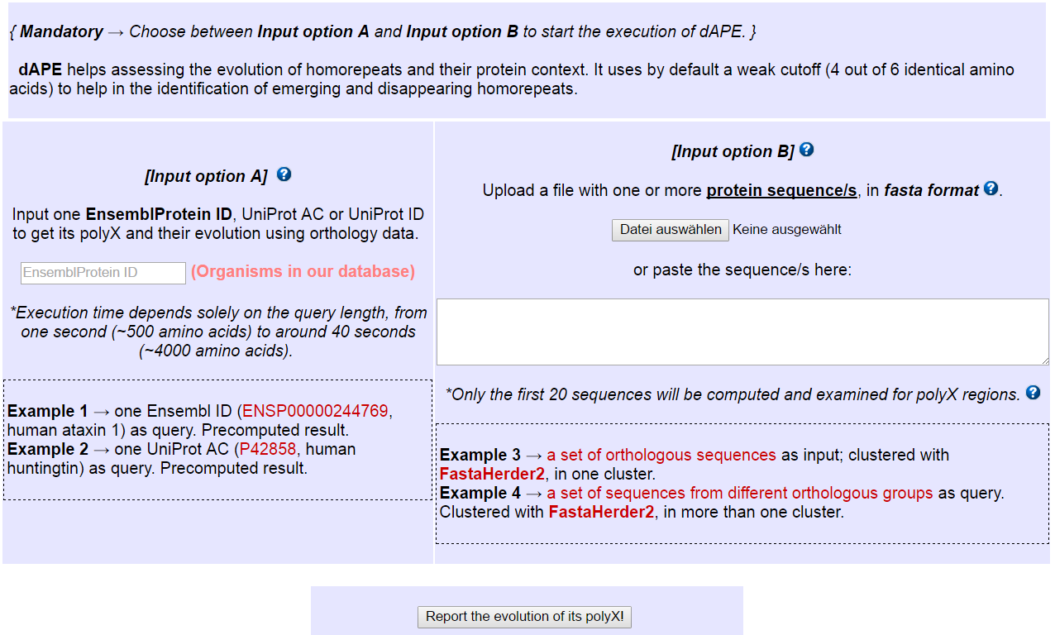
Exercise 2. Viewing homorepeats in an alignment with dAPE
Entry ID here

Slide 10


3D context of polyQ
Franziska Totzeck
Pablo Mier
3D
polyQ
3D
Totzek et al. PLoS ONE (2017)

Slide 11

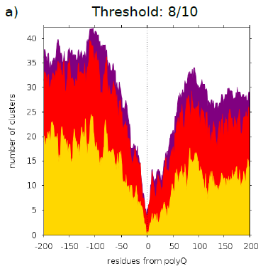
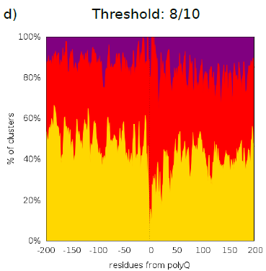
3D context of polyQ
Franziska Totzeck
Pablo Mier
Totzek et al. PLoS ONE (2017)

Slide 12
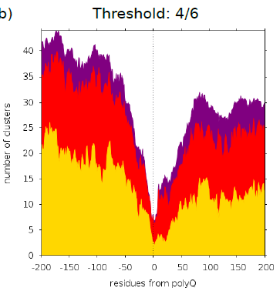
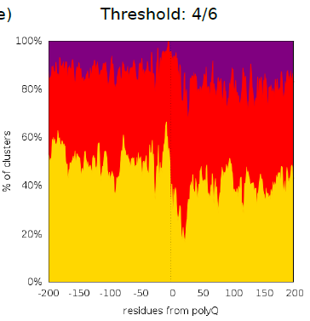
3D context of polyQ
Franziska Totzeck
Pablo Mier
Totzek et al. PLoS ONE (2017)

Slide 13
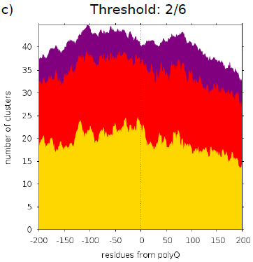
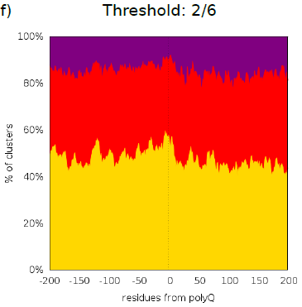
3D context of polyQ
Franziska Totzeck
Pablo Mier
Totzek et al. PLoS ONE (2017)

Slide 14
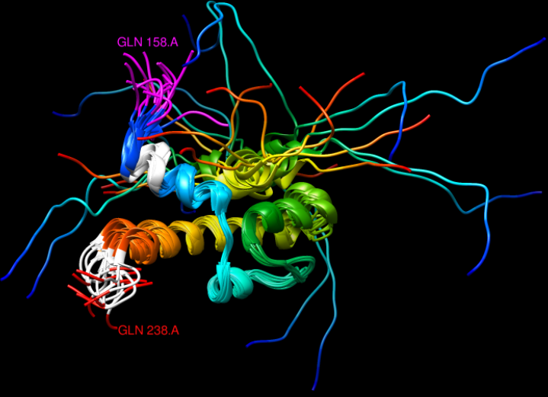
3D context of polyQ
Franziska Totzeck
Pablo Mier
Totzek et al. PLoS ONE (2017)

Slide 15
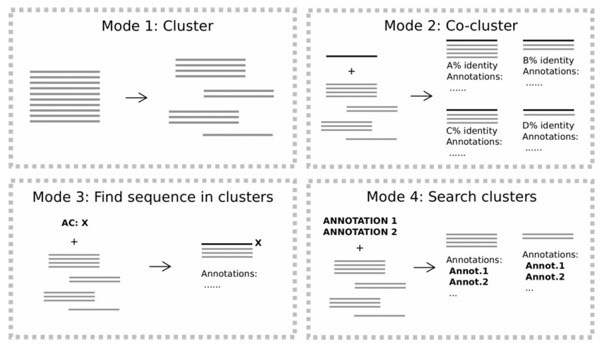
Fasta Herder 2
Pablo Mier
Mier and Andrade (2016) J. Comp. Biol.

Slide 16

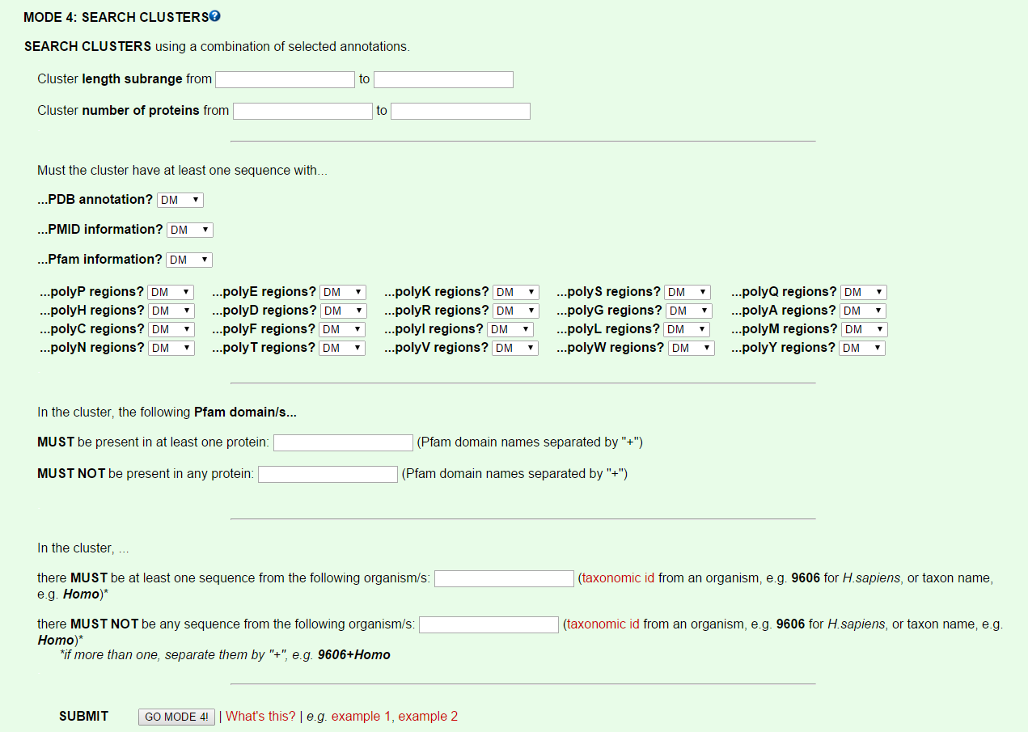

Slide 17
Exercise 3. Find a 3D of a polyQ ortholog
Go to FASTAHERDER2:
http://cbdm-01.zdv.uni-mainz.de/~munoz/fh2/
Find a cluster containing polyQ and a PDB using mode 4
Find the structure surrounding the place of polyQ insertion
Any problems?

Slide 18
Exercise 3. Find a 3D of a polyQ ortholog
Go to FASTAHERDER2:
http://cbdm-01.zdv.uni-mainz.de/~munoz/fh2/
Find a cluster containing polyQ and a PDB using mode 4
Find the structure surrounding the place of polyQ insertion
Any problems?
If yes, then use this example:
Species: “Escherichia coli”, PDB “yes”, and polyQ “yes”
Get the E. coli sequence and the one with polyQ and align them. Can you see the polyQ insertions?
Compare to PDB:4JNF (from DNAK_ECOLI P0A6Y8)

Slide 19
Exercise 3. Find a 3D of a polyQ ortholog
FH2 mode 3 with C4YKT4 / Candida albicans 288 aa with two polyQ
Align and compare to P01123 S. cerevisiae 206 alpha-helix and polyQ inserts after. See PDB 2BCG chain Y = YPT1

