Slide 1
Protein domains
Miguel Andrade
Faculty of Biology,
Institute of Organismic Molecular Evolution,
Johannes Gutenberg University
Mainz, Germany
andrade@uni-mainz.de

Slide 2
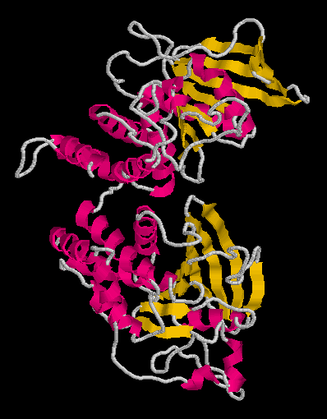
Introduction
Protein domains are structural units (average 160 aa) that share:
Function
Folding
Evolution
Proteins normally are multidomain
(average 300 aa)

Slide 3
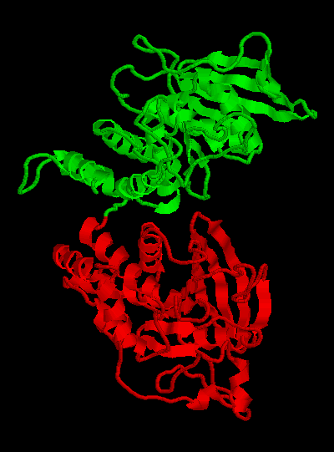
Introduction
Protein domains are structural units (average 160 aa) that share:
Function
Folding
Evolution
Proteins normally are multidomain
(average 300 aa)

Slide 4
Domains
Why to search for domains:
Protein structural determination methods such as X-ray crystallography and NMR have size limitations that limit their use.
Multiple sequence alignment at the domain level can result in the detection of homologous sequences that are more difficult to detect using a complete chain sequence.
Methods used to gain an insight into the structure and function of a protein work best at the domain level.

Slide 5
Domain databases
SMART
Peer Bork http://smart.embl.de/
Manual definition of domain (bibliography)
Generate profile from instances of domain
Search for remote homologs (HMMer)
Include them in profile
Iterate until convergence
Schultz et al (1998) PNAS
…
Letunic et al (2017) Nucleic Acids Research

Slide 6
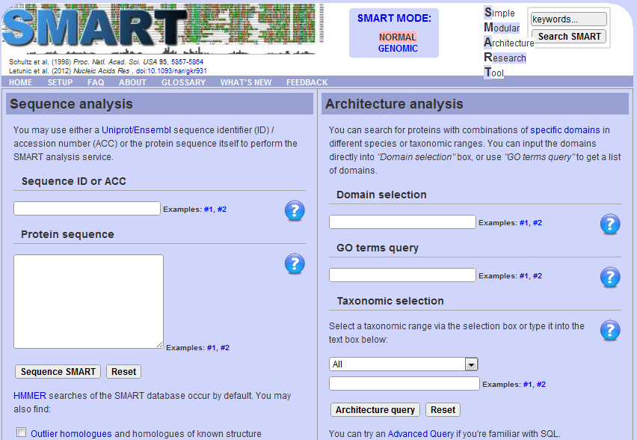
Domain databases

Slide 7
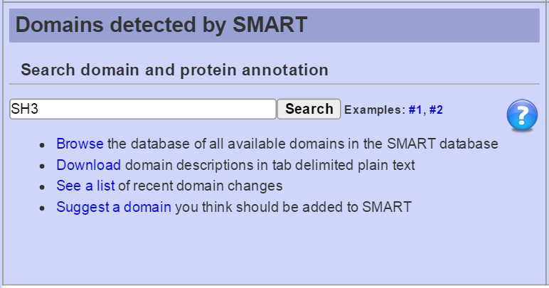
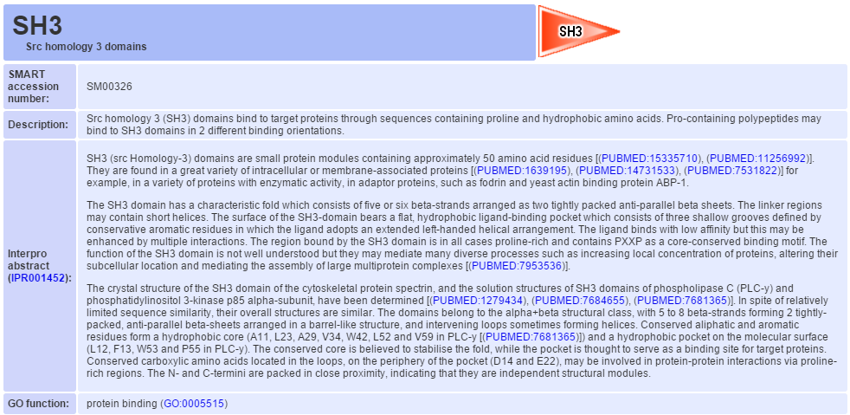
Domain databases
SMART

Slide 8
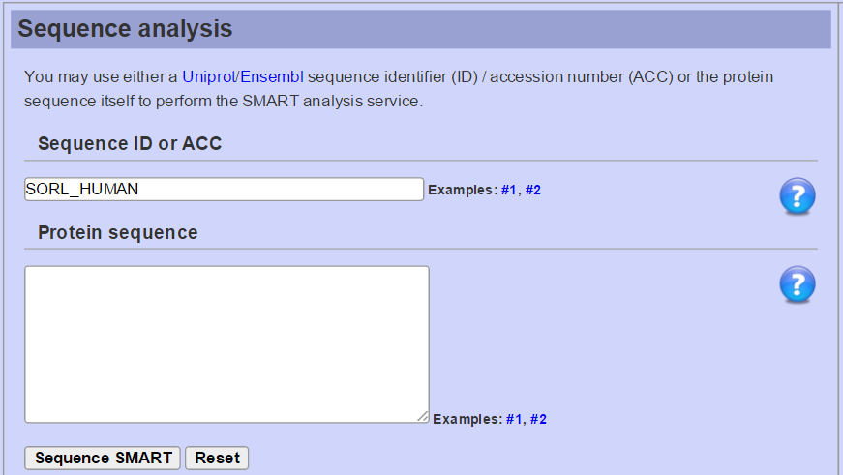
Domain databases
SMART
Notes:
SORL_HUMAN

Slide 9
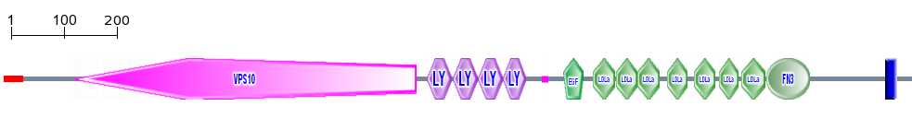
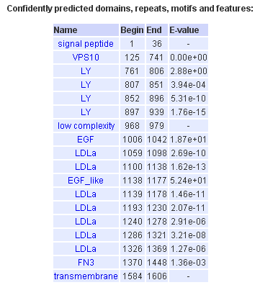
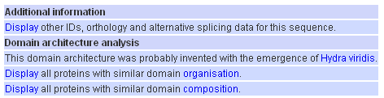
Domain databases
SMART
Extra features:
Signal-peptide,
low complexity, TM, coiled coils
Notes:
SORL_HUMAN

Slide 10
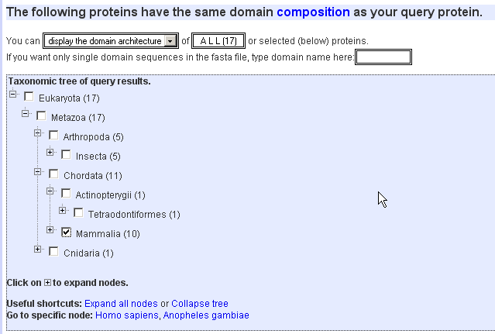
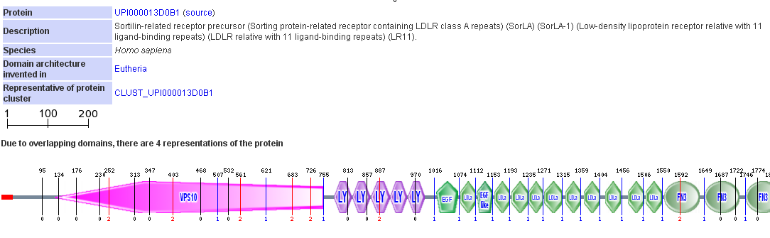

Domain databases
SMART

Slide 11
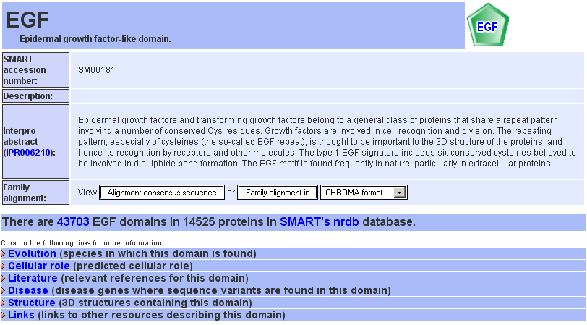
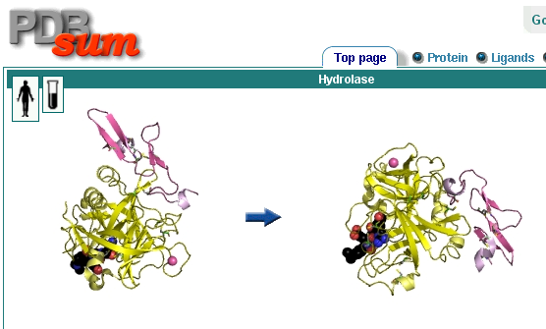
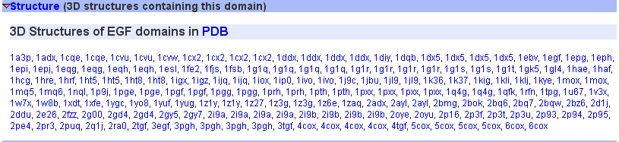
Domain databases
SMART

Slide 12
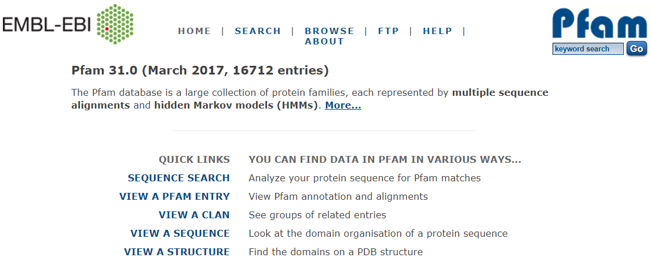
Domain databases
PFAM
Erik Sonnhammer/Ewan Birney/Alex Bateman http://pfam.xfam.org/
Sonnhammer et al (1997) Proteins
...
El Gebali et al (2019) Nucleic Acids Research

Slide 13
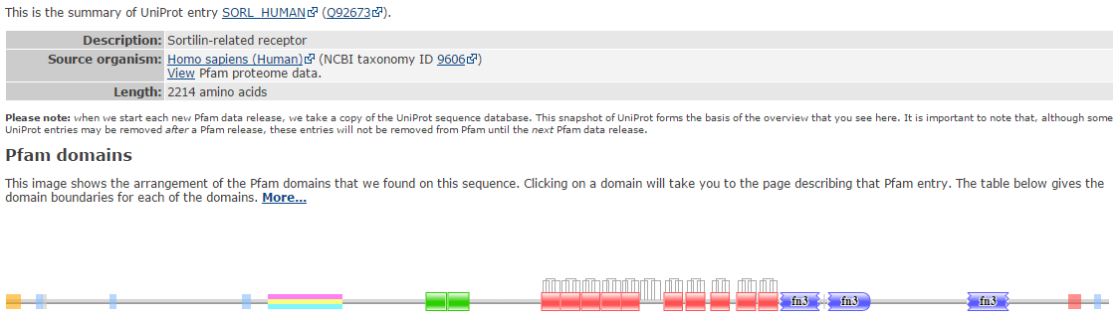
Domain databases
PFAM

Slide 14
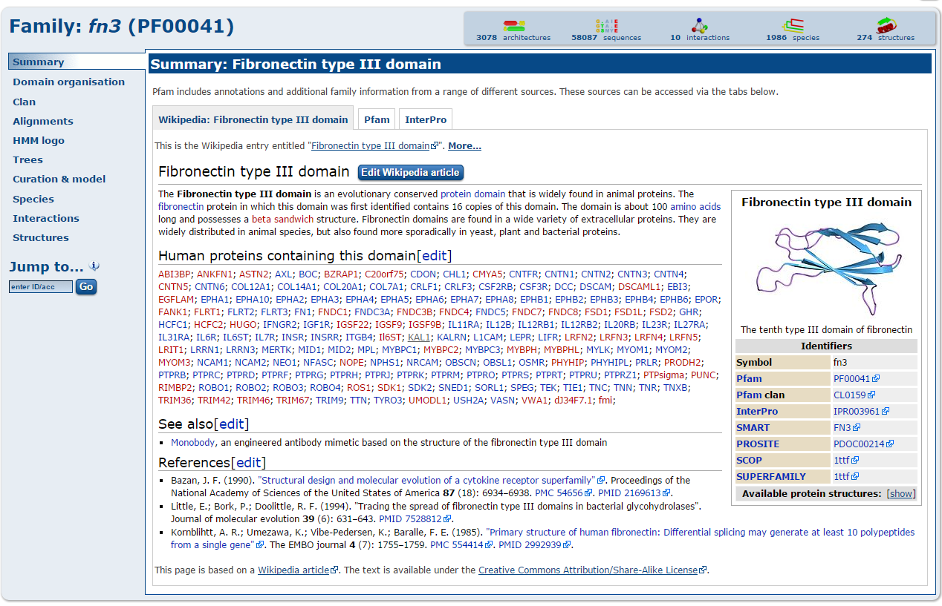
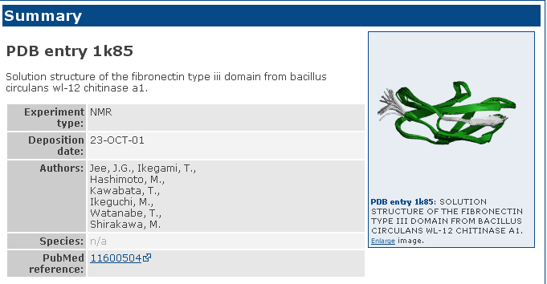
Domain databases
PFAM
Wikipedia rules!

Slide 15
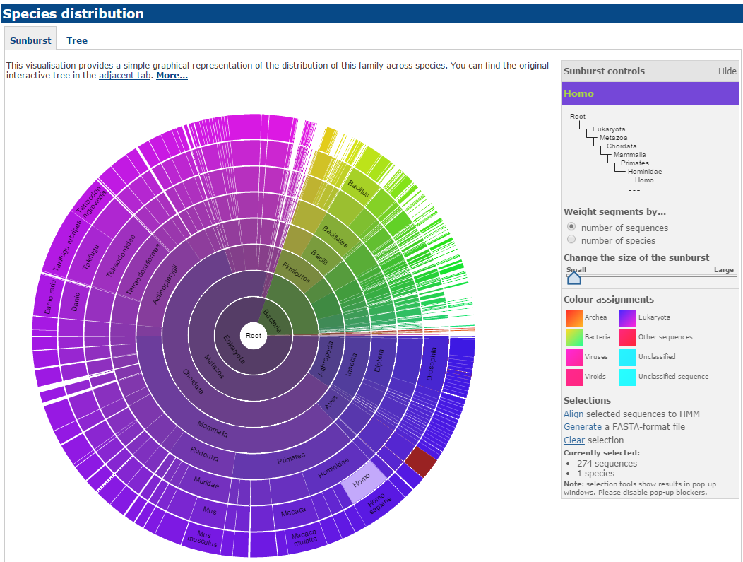
Domain databases
PFAM

Slide 16
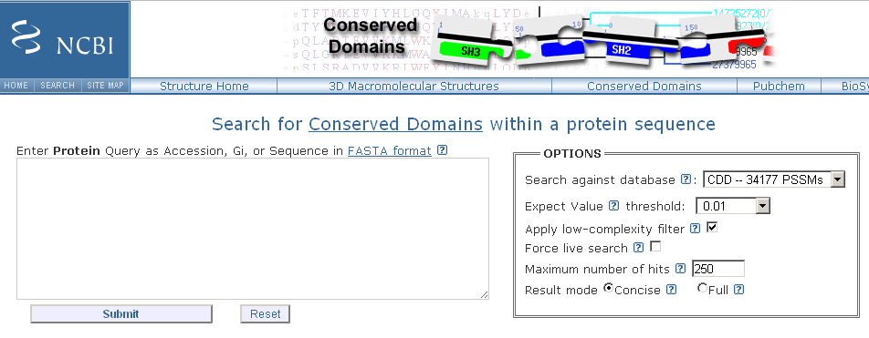
Domain databases
CDD
Stephen Bryant
http://www.ncbi.nlm.nih.gov/cdd
Marchler-Bauer et al (2017) Nucleic Acids Res

Slide 17
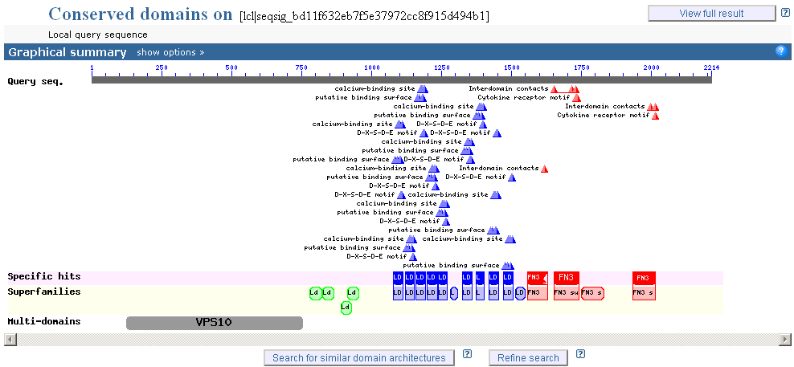
Domain databases
CDD

Slide 18
Domain databases
SORLA/SORL1 from Homo sapiens
SMART
PFAM
CDD

Slide 19
Exercise 1
Examine a UniProt Entry and find related PDBs
Let’s see whether human myosin X (UniProt id Q9HD67) or its homologs have a solved structure. Go to PDB’s BLAST page:
Menu > Search > Sequences
http://www.rcsb.org/pdb/secondary.do?p=v2/secondary/search.jsp#search_sequences
Obtain from UniProt the protein sequence “Q9HD67” and paste it the Entry Query Sequence window.
In the Choose Search Set you can select the database to search against: select as Database option "Protein Data Bank".

Slide 20
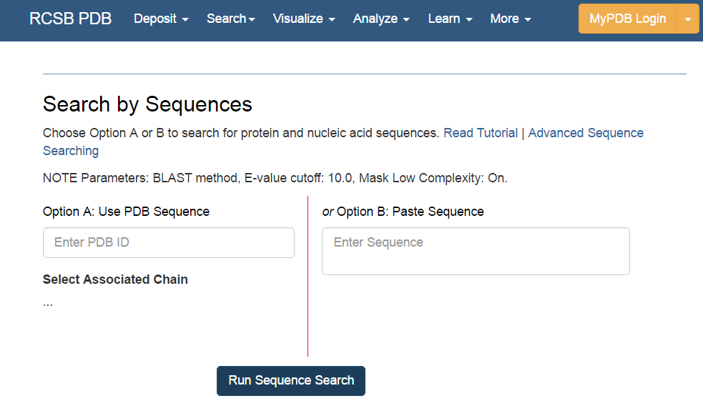
Exercise 1
Examine a UniProt Entry and find related PDBs
Paste sequence here

Slide 21
Exercise 1
Examine a UniProt Entry and find related PDBs
Hit the “Run Sequence Search” below the input window.
Considering that your query was a human myosin X, can you interpret the first three hits? Which part of your query was matched? Which protein was hit in the database?
What about the 4th hit?
Notes:
1st hit 3AU4 1486-2045 / 2nd 3AU5 1486-2045 / 3rd 3PZD 1503-2045 / 4th 5IOH 1-725

Slide 22
Exercise 1
Examine a UniProt Entry and find related PDBs
Hit the “Run Sequence Search” below the input window.
Considering that your query was a human myosin X, can you interpret the first three hits? Which part of your query was matched? Which protein was hit in the database?
What about the 4th hit?
Can you find a hit to a protein that is not human myosin X? Which part of your query was matched?
Notes:
1W9J myosin II Dictyostelium 58-725

Slide 23
Exercise 2
Analyse domain predictions with PFAM
Let’s look at the domains predicted for human myosin X. Go to PFAM: http://pfam.xfam.org/
Select the option VIEW A SEQUENCE
Type in the window the UniProt id of the protein sequence “Q9HD67” and hit the Go button.
Compare the positions of the domains predicted with the ranges of the BLAST matches in PDB from the previous exercise.
Which domains were matched in the human myosin X by each of those hits?
Notes:
Myosin_head 65-727 / MyTH4, RA, FERM_M

Slide 24
Exercise 3
Examine domains in Chimera
Open the structure of the 3rd hit (3PZD) in Chimera
Now colour the fragments corresponding to the PFAM domains MyTH4 (in purple), RAS associated (in orange) and FERM_M (in pink).
How do the PFAM annotations fit the structure?
How many more domains can you identify visually?
Chain B in this structure is a small peptide.
Which part of the human myosin X is interacting with this peptide in relation to the domains you have coloured? And what about the glycerol?
Notes:
MyTH4 :1586-1694a / RA :1711-1752a / FERM_M :1793-1958a

