Slide 1
Protein Biochemistry & Bioinformatics Dynamic modeling
Stefan Legewie & Sofya Lipnitskaya
Institute of Molecular Biology, Mainz

Slide 2
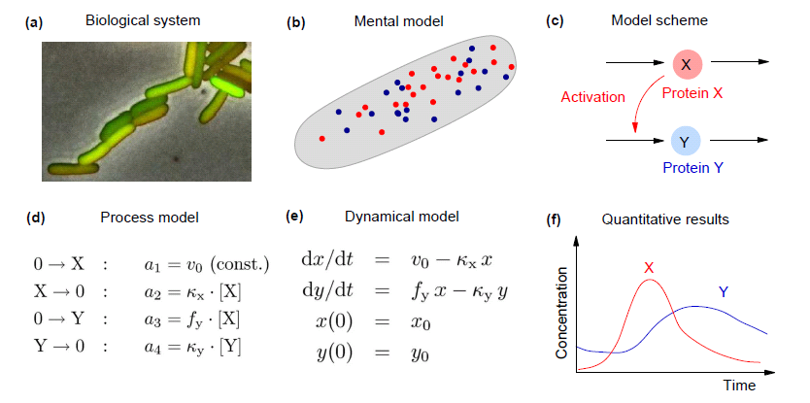
What is dynamic model of a biological system?
(g) Comparison/fitting to data

Slide 3
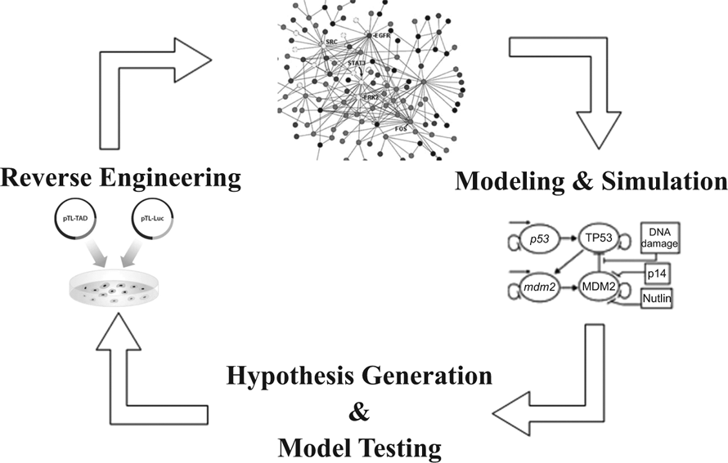
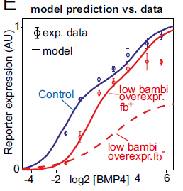
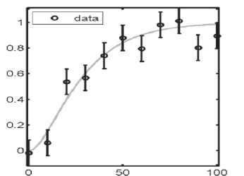
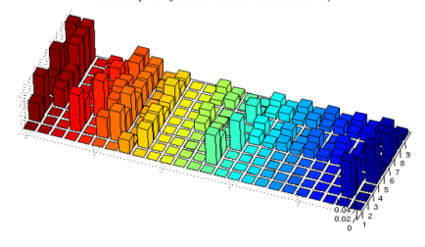
Iterative cycle of model and experiment
Using models for experimental design & refining models based on data
Model formulation
Experimental validation
Model analysis
Which network nodes are sensitive to perturbations?

Slide 4
Benefits of dynamic modeling approaches
Complex dynamical phenomena
Biological robustness
Stochastic effects
Cellular decision making
Oscillations
Interpretation of complex datasets
Large-scale perturbation screens
Multi-level Omics-data

Slide 5
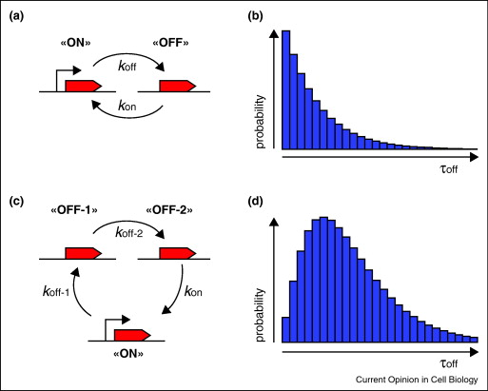
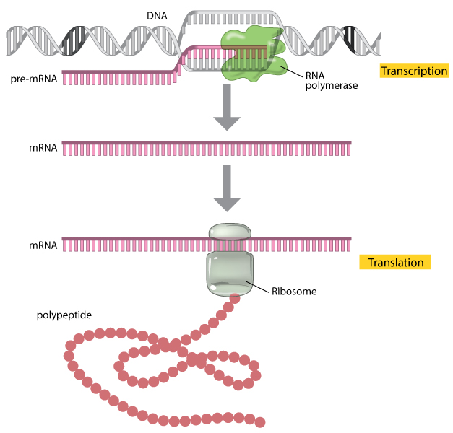
Outline I: Quantitative description of protein expression
What determines the kinetics of mRNA and protein expression?
How can we describe heterogeneous gene expression at the single-cell level?

Slide 6
Outline II
Simple deterministic model
of gene expression
Modeling circadian oscillators
Stochastic model of gene expression
captures cellular heterogeneity
Stochastic cellular
decision making

Slide 7
A simple model for transcriptional regulation of protein expression
Assumptions
Translation proportional to mRNA concentration
First-order decay of mRNA and protein
mRNA, Protein Variables/Concentrations
k_{i,} d_{i} Kinetic parameters

Slide 8
Assumptions underlying ordinary
differential equation models
Spatially homogenous
Cell assumed to
be well-stirred
Continous
Real concentration
of mRNAs/proteins
Deterministic
Average behavior of
large molecule numbers

Slide 9
What determines the protein dynamics in response to changes in transcription?
Analytical Solution (by integration)
k₁
1
Gene ON
0
Gene OFF
t=0
time
⇒ Approximate solution using numerical integration

Slide 10
Short primer on numerical integration

Slide 11
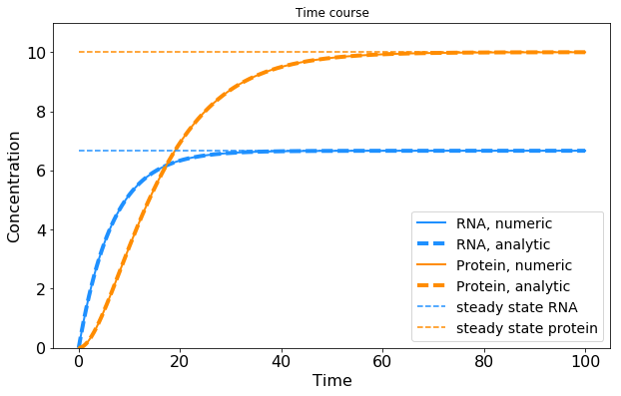
Time course of mRNA and protein in response to gene activation
k₁
1
Gene ON
0
Gene OFF
t=0
time
System asymptotically approaches steady state

Slide 12
What determines protein expression
level at steady state?
Steady state
= 0
= 0
Exercise 1
Calculate steady state
mRNA and protein levels
Steady state level set by ratio of synthesis and degradation rates
Transcription induces proportional changes in mRNA and protein levels

Slide 13
What determines the protein dynamics in response to changes in transcription?
Exercise 2
Plot Protein(t) and mRNA(t) for k₁ and d₁ varied separately
Which parameter affects response
time needed to reach steady state?
Which parameter affects the steady state level?
k₁
X
Gene ON
0
Gene OFF
t=0
time

Slide 14
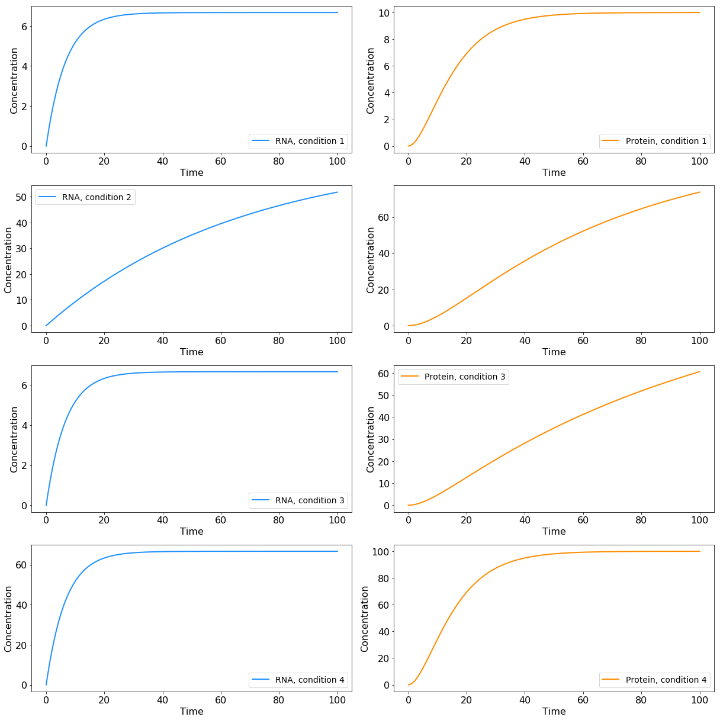
Protein dynamics solely determined by mRNA and protein degradation rates
mRNA degradation rate
changes final steady state
and response time
protein degradation rate
changes final steady state
and response time
mRNA and protein synthesis rates
change only final steady state

Slide 15
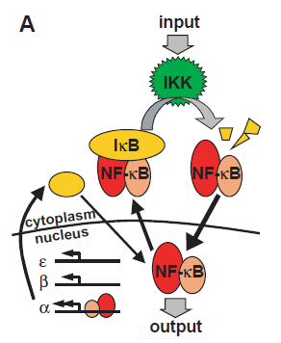
mRNA induction upon to TNFα stimulation
Schematic pathway representation
TNFα
Hao & Baltimore
Nature Immunology 2009
(PMID: 19198593)
Target genes

Slide 16
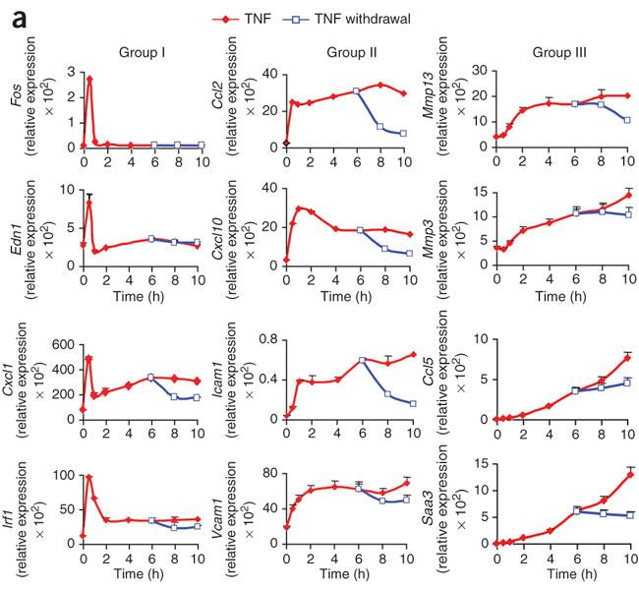
mRNA induction upon to TNFα stimulation
Schematic pathway representation
Quantitative transcriptome profiles
TNFα
Dynamics of target gene expression
Hao & Baltimore
Nature Immunology 2009
(PMID: 19198593)
Target genes
Genes decompose into three groups

Slide 17
TNFα stimulation induces three temporally ordered gene expression clusters
Schematic pathway representation
Quantitative transcriptome profiles
TNFα
Target gene expression clusters
fast and transient
slow and transient
slow and sustained
Hao & Baltimore
Nature Immunology 2009
(PMID: 19198593)
Target genes

Slide 18
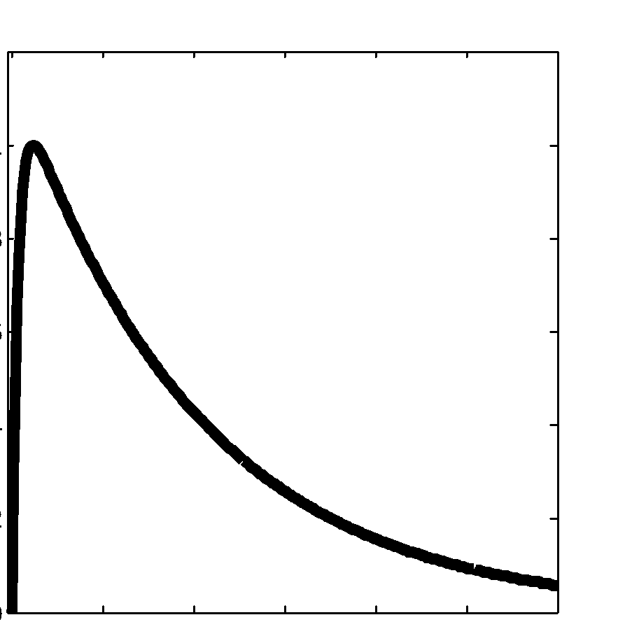
Adjusting the gene expression model to describe dynamics of clusters
NF-kB
NF-kB
mRNA
k_{N}
k_{deg}
v_{syn}
0
2
Ordinary differential equation (ODE)
Exercise 3
Adjust model parameters to match
the experimentally observed
gene expression clusters
Hao & Baltimore
Nature Immunology 2009
(PMID: 19198593)

Slide 19
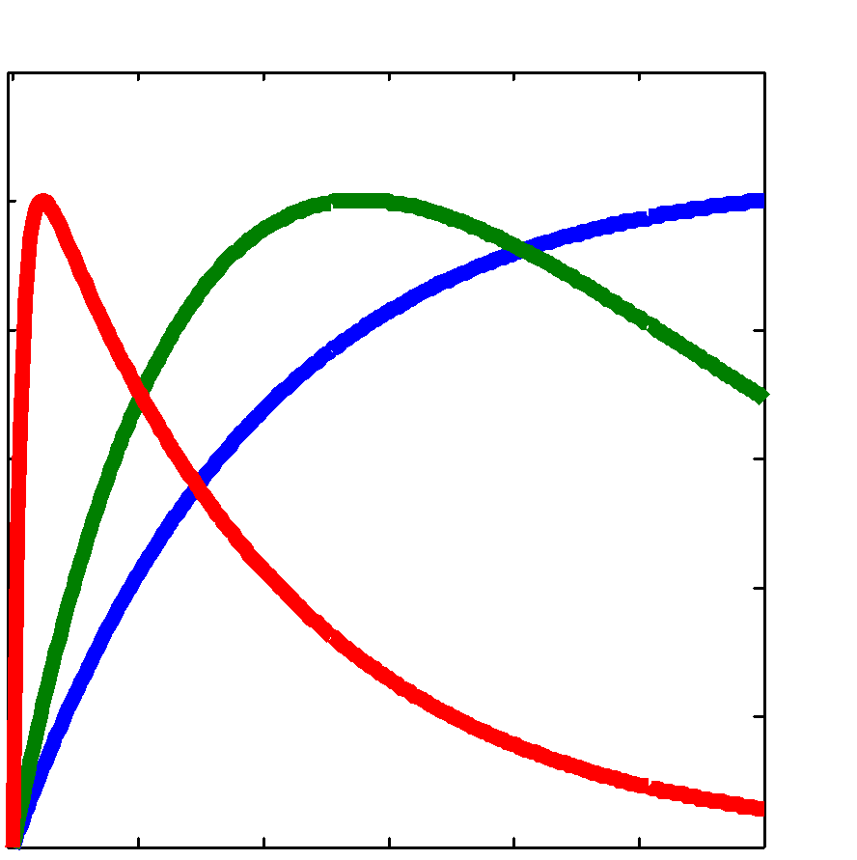
Target gene dynamics determined by mRNA half-life
NF-kB
NF-kB
mRNA
k_{N}
k_{deg}
v_{syn}
0
2
mRNA
Target gene dynamics solely determined
by NFkB decay and mRNA half-life
unstable mRNA
medium stable RNA
stable mRNA
Hao & Baltimore
Nature Immunology 2009
(PMID: 19198593)
Analytical solution
Numerical solution

Slide 20
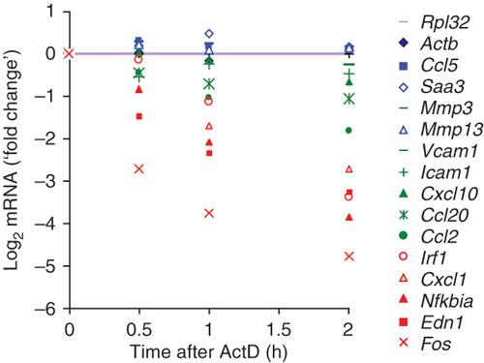
Experimental validation: mRNA half-life determines gene expression dynamics
Target gene expression clusters
mRNA half-life measurement
general transcription
inhibitor ActD added
Hao & Baltimore
Nature Immunology 2009
(PMID: 19198593)

Slide 21
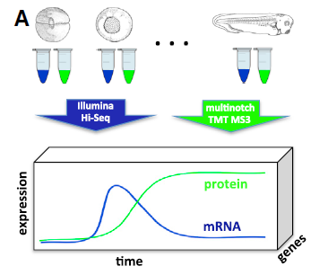
What is the relationship between
mRNA and protein levels?
Peshkin et al
Dev Cell 2015
(PMID: 26555057)

Slide 22
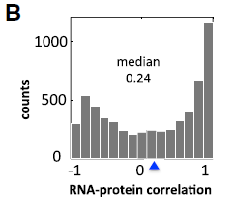
mRNA and protein levels do not show a general, simple linear correlation
Histogramm
protein
positive
correlation
mRNA
no
correlation
Poor overall correlation of mRNA
and protein time courses
negative
correlation
Extensive post-transcriptional
gene expression regulation?

Slide 23
Model-based analysis of the relationship between mRNA and protein levels
Exercise 4
Plot Protein(t) vs. mRNA(t) for
fast and slow protein decay
k₁
X
Gene ON
0
Gene OFF
t=0
time
Normalize Protein(t) and mRNA(t)
by their maximal values

Slide 24
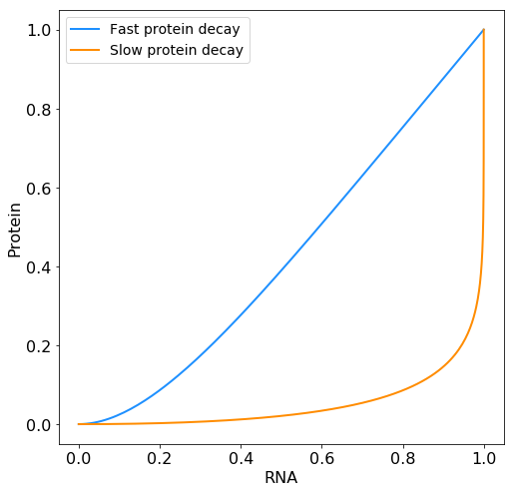
mRNA and protein time courses show a parameter-dependent correlation
Strong mRNA-protein correlation
for rapidly decaying proteins
mRNA
protein
Weak mRNA-protein correlation
for slowly decaying proteins
mRNA
protein
Poor mRNA-protein correlation does not
necessarily imply post-transcriptional regulation

Slide 25
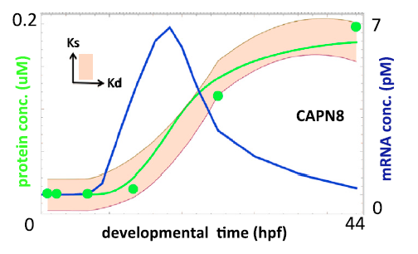
Most uncorrelated mRNA and protein changes explained by the simple expression model
Large-scale analysis
simple gene expression model separately fitted to 5800 genes
Model fit to data
Input: mRNA time course
Output: protein time course
Fitted parameters
free choice of mRNA translation and protein degradation rates
Conclusion
85% of all mRNA-protein pairs explained by basic model without the need to assume post-transcriptional regulation
measured mRNA
time course
Peshkin et al
Dev Cell 2015
(PMID: 26555057)

Slide 26
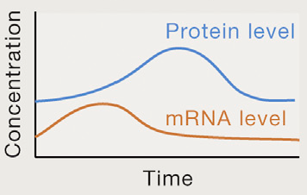
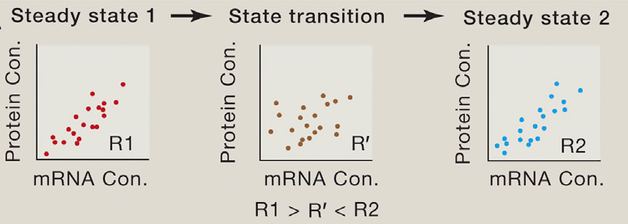
Global correlation over all mRNA-protein pairs decreases during dynamic transitions
Gene A
Gene B
Liu et al
Cell 2016
(PMID: 26555057)

Slide 27
Summary
Simple ordinary differential equation model of describes the dynamics of protein expression
mRNA and protein haf-lives determine kinetics and level of protein expression, whereas synthesis rates determine only expression
Uncorrelated mRNA and protein changes often arise from delayed protein synthesis and are explainable by protein expression model

Slide 28
Summary: Deterministic modeling with ordinary differential equations (ODEs)
Model scheme
ODEs
mRNA, Protein Variables/Concentrations
k_{i,} d_{i} Kinetic parameters
Assumptions
spatially homogeneous concentrations (‘well-stirred’ cell)
Sufficiently high molecule numbers/concentrations
Steady state condition
d(mRNA)/dt = 0
d(protein)/dt = 0
Temporal dynamics can be simulated
by numerical integration

Slide 29
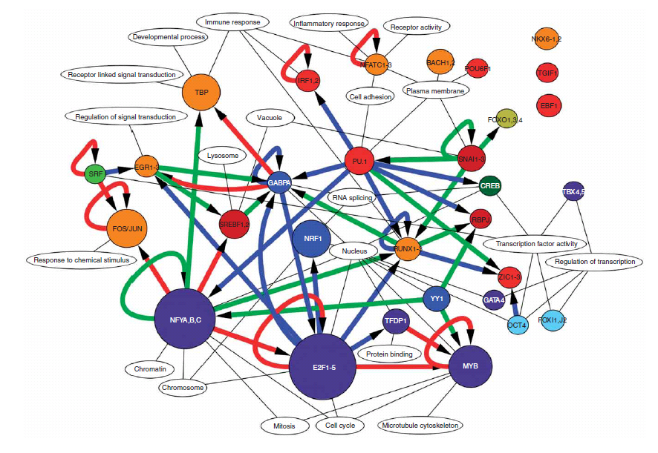
Genes are organized in complex networks
Single gene dynamics
Gene regulatory network dynamics
Transcription factor network
controlling monocyte differentiation
FANTOM
consortium, 2009

Slide 30
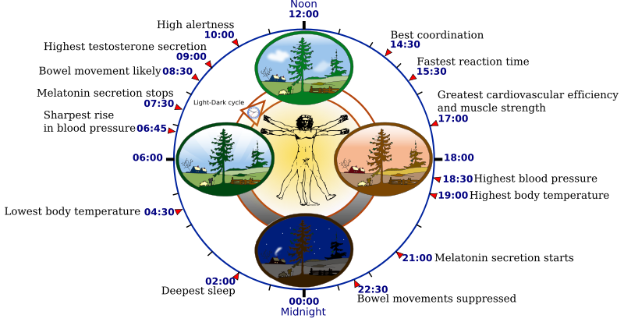
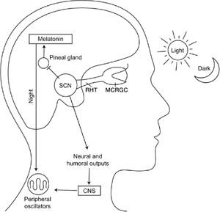
Protein expression in a more
complex network: Circadian rhythms

Slide 31
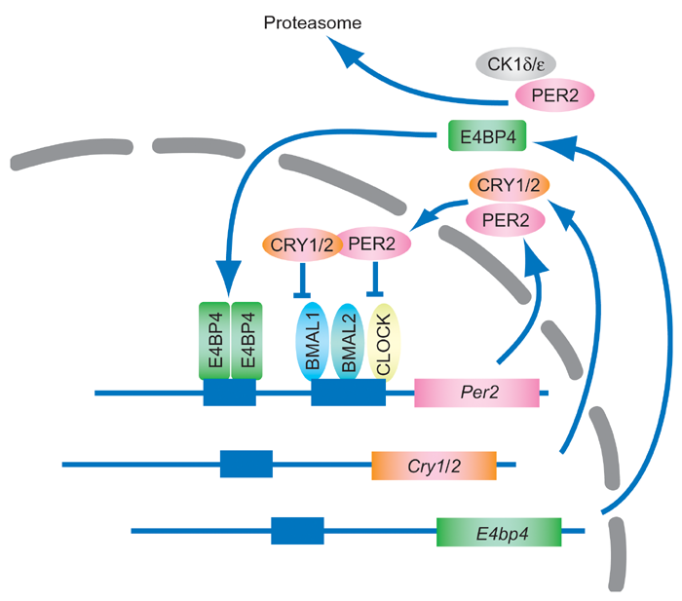
Circadian rhythmicity is established by a gene regulatory network with negative feedback

Slide 32
Circadian rhytmicity is established by a gene regulatory network with negative feedback
24h oscillations in Per2 expression
single-cell Luciferase reporter system
fibroblasts
Liu et al., Cell 2007

Slide 33
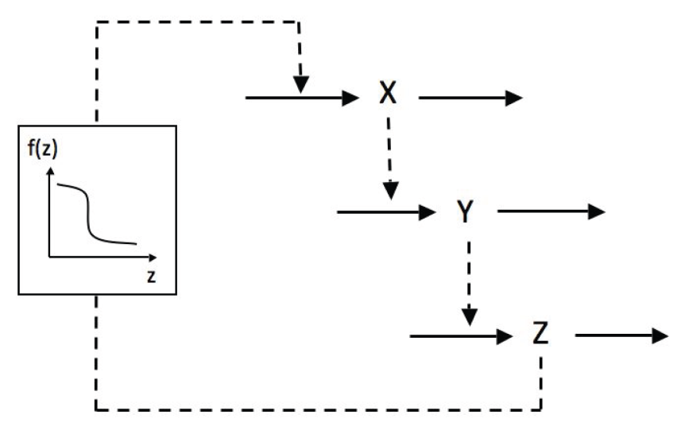
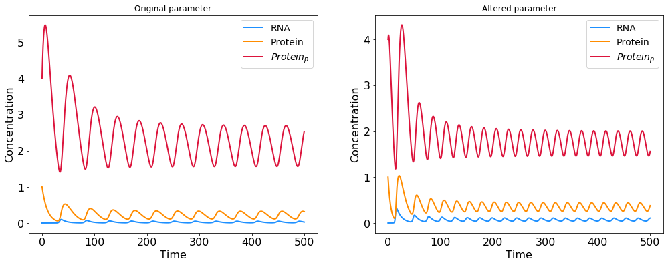
The Goodwin oscillator – a negative feedback model of circadian rhythmicity
Exercise 5
Implement negative feedback model and plot Z(t) for the following parameters
k₁= k₃=k₅=1
k₂= k₄=k₆=0.1
K_{i}=1, n=10
Goodwin oscillator
Ordinary differential equations
Per2 mRNA
Per2 protein
Per2 protein‘
Gonze et al., PLoS ONE 2007

Slide 34
Effect of parameter changes: how does protein degradation influence the oscillator period?
Exercise 6
What is the effect of increasing the protein degradation rate?
k₁= k₃=k₅=1
k₂= 0.1, k₄=k₆=0.2
K_{i}=1, n=10
Goodwin oscillator
Ordinary differential equations
Per2 mRNA
Per2 protein
Conclusion: Faster protein degradation
shortens circadian period
Per2 protein‘
Gonze et al., PLoS ONE 2007

Slide 35
Human sleep disorders are caused by mutations in the circadian clock network
Familar advanced sleep phase syndrome (FASPS)
FASPS mutations in Per2 phosphorylation sites
Increase Per2 protein degradation
Shorten the circadian period
Leloup and Goldbeter, Bioessays 2008

Slide 36
Detailed model of FASPS mutation effects confirms relation of oscillator period with Per2 protein stability
Per2 phosphorylation
and degradation
Auto-
repression
Nuclear
translocation
Principle of period determination by protein half-life
translates into clinically relevant setting!
Vanselow et al., Genes & Dev 2006

Slide 37
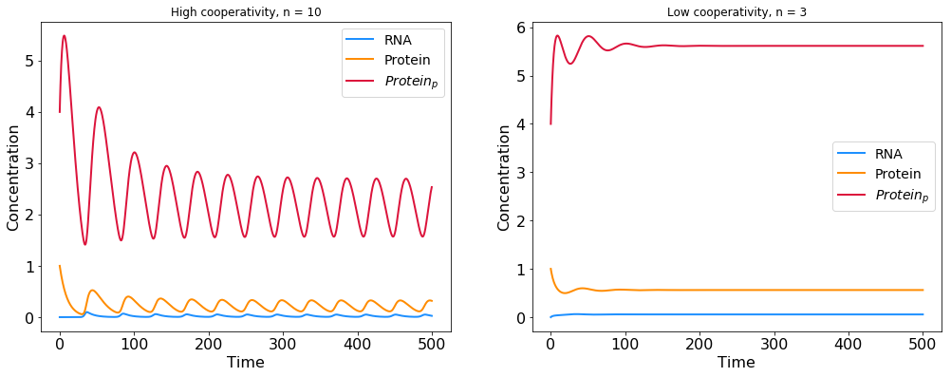
Role of cooperative feedback inhibition in maintaining stable oscillations
Exercise 7
What is the effect of reducing the cooperativity factor n?
k₁= k₃=k₅=1
k₂= k₄=k₆=0.1
K_{i}=1, n=3
Goodwin oscillator
Ordinary differential equations
Per1 mRNA
Per1 protein
Conclusion: Cooperative feedback required for oscillations
Per1 protein‘
Gonze et al., PLoS ONE 2007

Slide 38
Summary: requirements for oscillatory behavior in biological systems
1. Negative feedback loop
2. Time delay
determines oscillation period
Set by mRNA/protein half-life
3. Strong and cooperative feedback
Brown et al., Dev Cell 2012

Slide 39
Oscillations due to negative feedback shape decision making in the p53 tumor suppressor network
DNA repair
γ-irradiation
Apoptosis
Singl-cell response
Digital decision making
* Dynamics of the p53-Mdm2 feedback loop in individual cells. Nat Genet(2004).Lahav G,..,Alon U.

Slide 40
Outline: Quantitative description of protein expression
What determines the kinetics of mRNA and protein expression?
How can we describe heterogeneous gene expression at the single-cell level?

Slide 41
Analysis of gene expession at the single-cell level
higher throughput
more informative

Slide 42
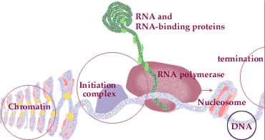
Gene expression – a stochastic process
Stochastic dynamics shown for transcription initiation and elongation
Randomness arises from low molecule numbers!
each cell contains few copies of each gene
transcription factors often present in low amounts

Slide 43
Stochasticity in gene expression revealed
by dual reporter experiment in E. Coli
Strong variations in fluorescence confirm the existence of gene expression noise
Elowitz et al., Science 2002

Slide 44
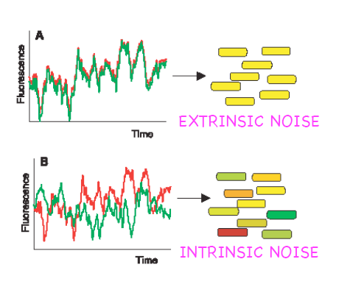
Intrinsic and extrinsic sources of gene expression variability
Fluctuations in biosynthetic machinery (polymerases, ribosomes)
Eukaryotes
Random binding of transcription machinery
to each promoter
(low copy numbers!)
Bacteria
Eukaryotes
Elowitz et al., Science 2002

Slide 45
Stochastic models account for event probabilities at low molecule numbers
Deterministic ODE model vs. Stochastic model
Average behavior of
large molecule numbers
Probabilistic behavior (randomness)
at the single-molecule level
Continuous: Concentration
of mRNAs/proteins
Discrete: Absolute
molecule counts

Slide 46
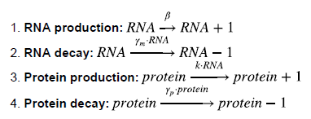
Stochastic version of simple protein expression model
Reactions occur with certain probabilities
mRNA and protein given as absolute molecule count (discrete)
Simulation by Gillespie algorithm
selects most probable next reaction
updates molecule counts

Slide 47
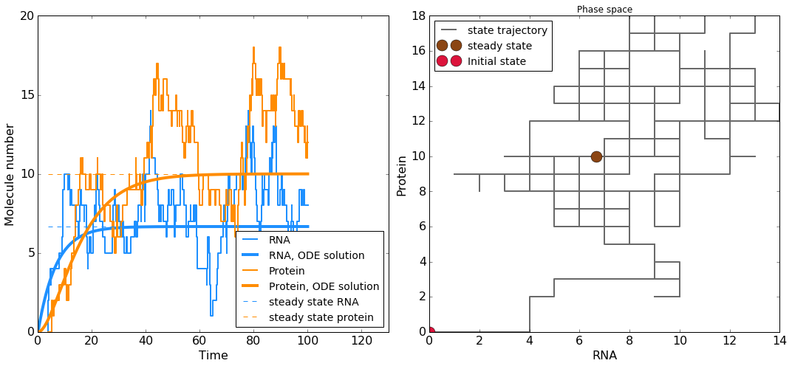
Simulated temporal evolution of mRNA and protein in a stochastic model

Slide 48
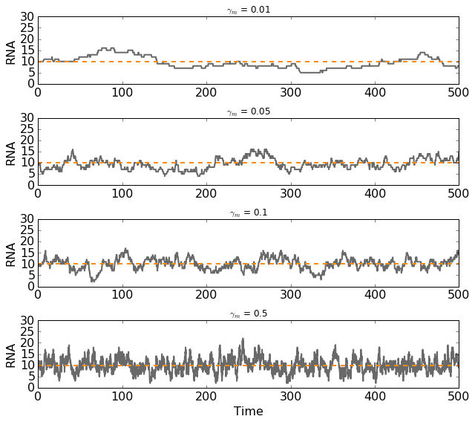
Time-scale of stochastic mRNA fluctuations depends on RNA degradation rate
Slow mRNA decay
Fast mRNA decay

Slide 49
How do protein fluctuations depend on mRNA and protein synthesis rates?
Exercise 8
Plot protein fluctuations for various transcription and translation rates while keeping average expression constant
Quantify the noise by calculating the coefficient of variation (CV=std/mean) and histogram of the time courses

Slide 50
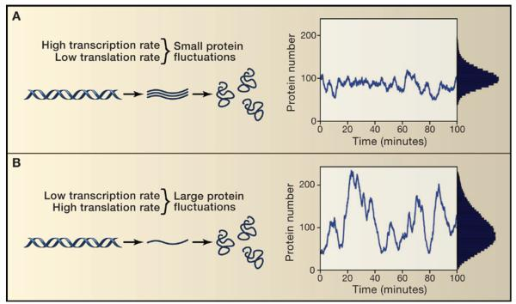
Fine-tuning of noise a given expression by changing transcription and translation rates
Obzudak et al., Nat Genet 2002

Slide 51
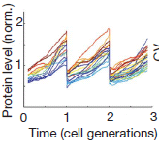
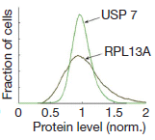
Human proteins are log-normally distributed and vary ~2-3-fold between individual cells
Temporal profile
Expression distribution
(TOP1-YFP)
Sigal et al., Nature (2006)

Slide 52
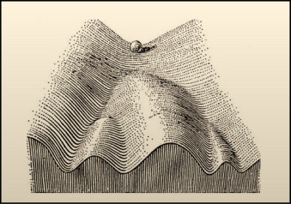
Stochastic gene expression is important for cellular decision making
Waddington's Classical Epigenetic Landscape In 1957, Conrad Waddington proposed the concept of an epigenetic landscape to represent the process of cellular decision-making during development.

Slide 53
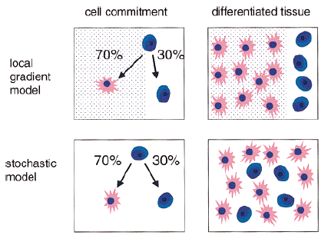
Stochastic model of cell differentiation
Fiering et al., Bioessays 2000

Slide 54
Consequences of stochastic gene expression
Stochastic cell differentiation in multicellular organisms
Stochastic differentiation
Stem cell differentiation (Chang, Nature 2008)
Competence in B. Subtillis (Mamaar et al., Science 2007)
B cell differentiation (Duffy et al., Science 2012)
PC12 neuronal differentiation (Chen et al., Mol Cell 2012)
Stochastic photoreceptor expression
in the Drosophila eye
Fiering et al., Bioessays 2000

Slide 55
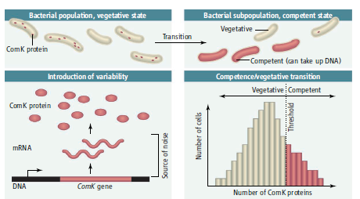
Consequences of stochastic gene expression
Expression noise determines cell fate in Bacillus subtilis
Mettetal et al., Science 2007

Slide 56
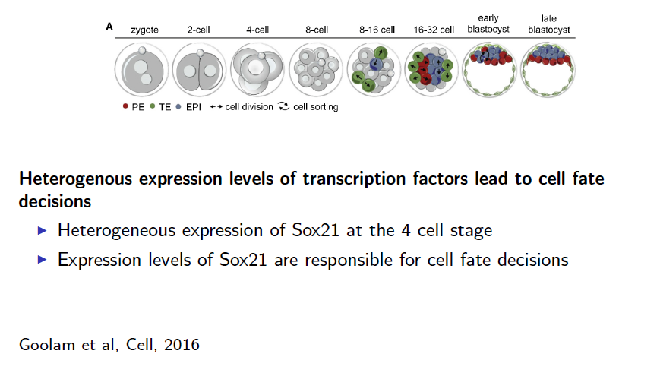
Consequences of stochastic gene expression
Expression noise determines embryonic cell fates
Mettetal et al., Science 2007

Slide 57
Summary
Gene expression at the single-cell level is a stochastic event due to low molecule numbers
1) only two copies of each gene per cell
2) low concentrations of regulating transcription factors
Gene expression noise can be fine-tuned by transcription and translation kinetics
low transcription rate + high translation rate => large protein fluctuations
Noise gene expression is important for stochastic cellular decision making
Heterogeneous expression of master transcription factors governs stochastic choice of cellular differentiation program

