Slide 1

Protein Biochemistry & Bioinformatics
Dynamic modeling
Stefan Legewie & Stephan Baumgaertner
Institute of Molecular Biology, Mainz

Slide 2
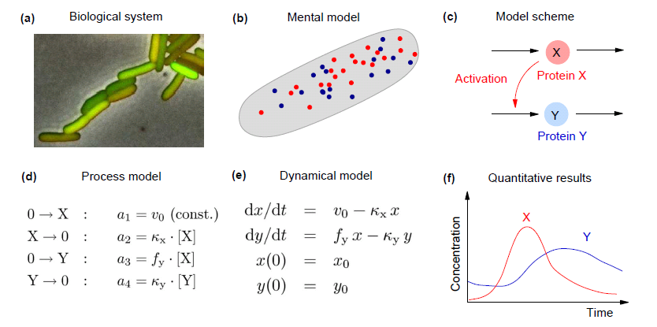
What is model of a biological system?
(g) Comparison/fitting to data

Slide 3
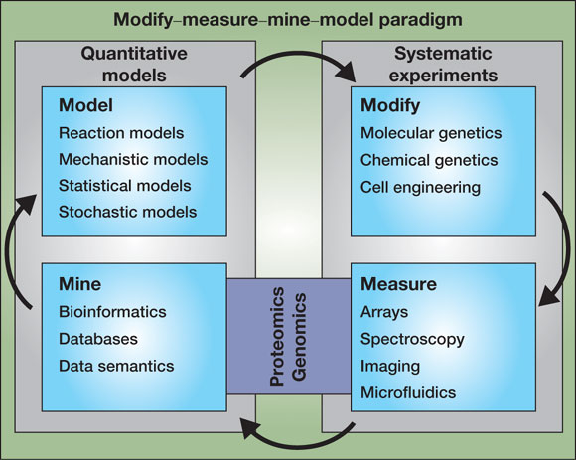
Iterative cycle of model and experiment
Using models for experimental design & refining models based on data
Design
Validate

Slide 4
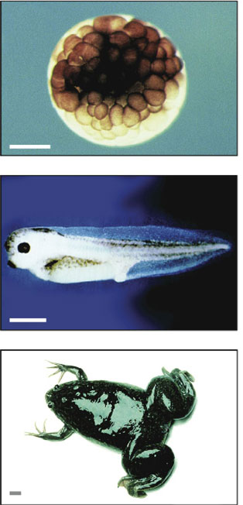
Benefits of quantitative modeling approaches
Complex dynamical phenomena
Biological robustness
Stochastic effects
Cellular decision making
Oscillations
Interpretation of complex datasets
Large-scale perturbation screens
Multi-level Omics-data

Slide 5
Outline of my presentation
Simple deterministic model
of gene expression
Modeling circadian oscillators
Stochastic model of gene expression
captures cellular heterogeneity
Stochastic cellular
decision making

Slide 6
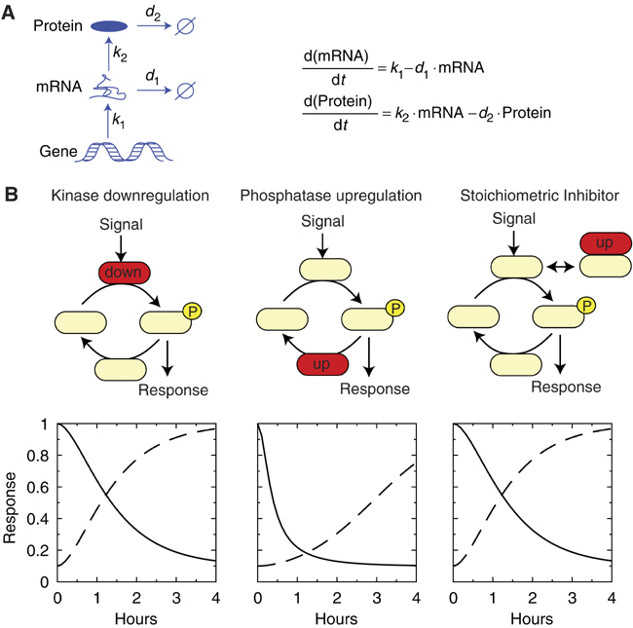
A simple model for transcriptional regulation of protein expression
Assumptions
Translation proportional to mRNA concentration
First-order decay of mRNA and protein
mRNA, Protein Variables/Concentrations
k_{i,} d_{i} Kinetic parameters

Slide 7
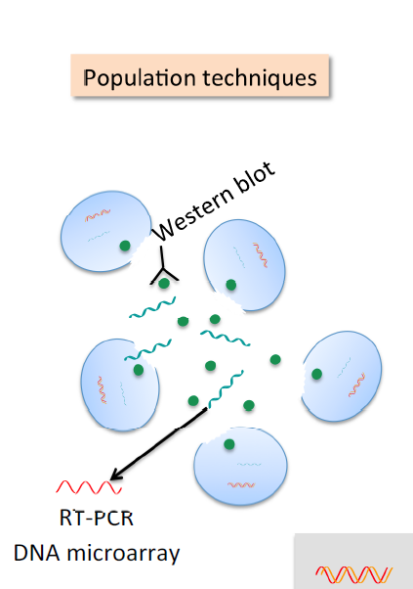
Assumptions underlying ordinary
differential equation models
Spatially homogenous
Cell assumed to
be well-stirred
Continous
Real concentration
of mRNAs/proteins
Deterministic
Average behavior of
large molecule numbers

Slide 8


What determines protein expression
level at steady state?
Steady state
= 0
= 0
Exercise 1
Calculate steady state
mRNA and protein levels
$$\overline{mRNA}=\frac{k_{1}}{d_{1}}$$
$$\overline{Protein}=\frac{{k_{1}k}_{2}}{d_{1}d_{2}}$$
Steady state level set by ratio of synthesis and degradation rates
Transcription induces proportional changes in mRNA and protein levels

Slide 9

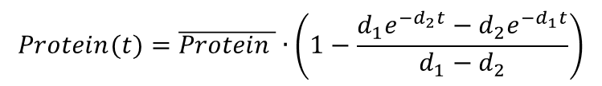
What determines the protein dynamics in response to changes in transcription?
Analytical Solution
$$mRNA(t)=\overline{mRNA }∙(1−e^{−d_{1}t})$$
k₁
1
Gene ON
$$Protein(t)=\overline{Protein }∙\left(1−\frac{d_{1}e^{−d_{2}t}−d_{2}e^{−d_{1}t}}{d_{1}−d_{2}}\right)$$
0
Gene OFF
t=0
time
⇒ Approximate solution using numerical integration

Slide 10
What determines the protein dynamics in response to changes in transcription?
Exercise 2
Plot Protein(t) and mRNA(t) for k₁ and d₁ varied separately
Which parameter affects response
time needed to reach steady state?
Which parameter affects the steady state level?
k₁
X
Gene ON
0
Gene OFF
t=0
time

Slide 11
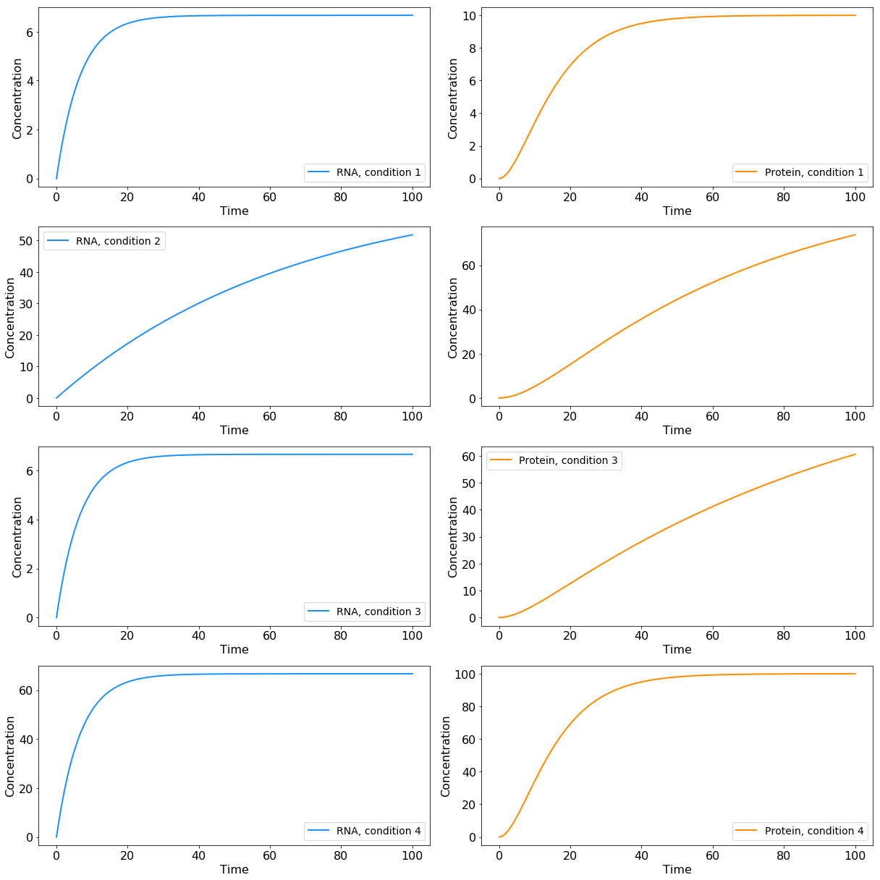

Protein dynamics solely determined by mRNA and protein degradation rates
$$Protein(t)=\overline{Protein }∙\left(1−\frac{d_{1}e^{−d_{2}t}−d_{2}e^{−d_{1}t}}{d_{1}−d_{2}}\right)$$
mRNA degradation rate
changes final steady state
and response time
protein degradation rate
changes final steady state
and response time
mRNA and protein synthesis rates
change only final steady state

Slide 12
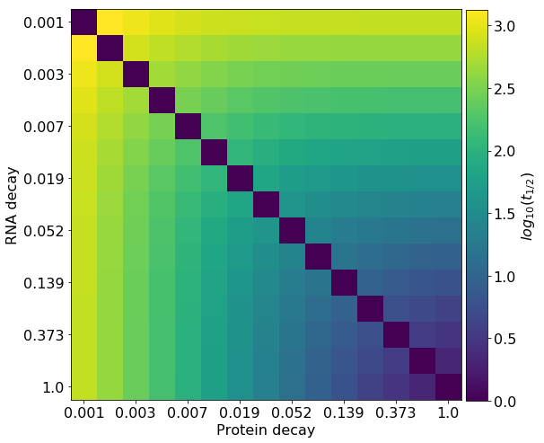
Protein dynamics solely determined by mRNA and protein degradation rates
Systematic parameter scan for response time t₅₀
required to reach 50% of steady state (see notebook for code)

Slide 13
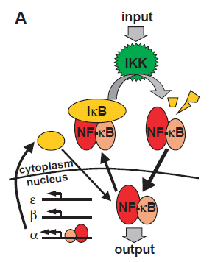
mRNA induction upon to TNFα stimulation
Schematic pathway representation
TNFα
Hao & Baltimore
Nature Immunology 2009
(PMID: 19198593)
Target genes

Slide 14
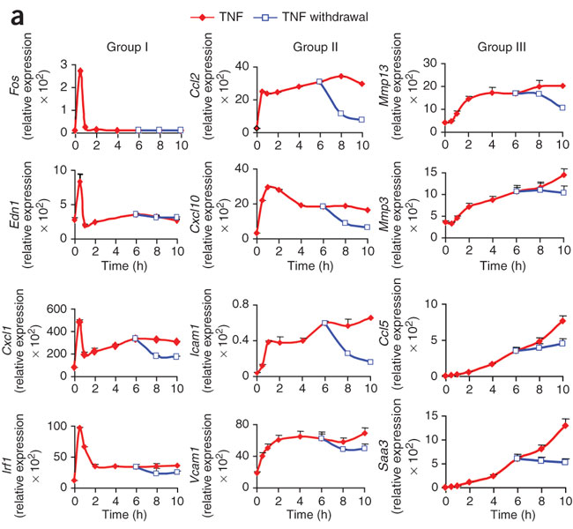
mRNA induction upon to TNFα stimulation
Schematic pathway representation
Quantitative transcriptome profiles
TNFα
Dynamics of target gene expression
Hao & Baltimore
Nature Immunology 2009
(PMID: 19198593)
Target genes
Genes decompose into three groups

Slide 15
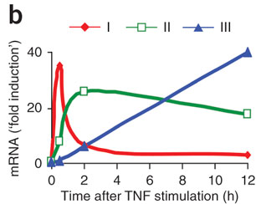
TNFα stimulation induces three temporally ordered gene expression clusters
Schematic pathway representation
Quantitative transcriptome profiles
TNFα
Target gene expression clusters
Hao & Baltimore
Nature Immunology 2009
(PMID: 19198593)
Target genes

Slide 16


Adjusting the gene expression model to describe dynamics of clusters
NF-kB
NF-kB
mRNA
k_{N}
k_{deg}
v_{syn}
0
2
$$\frac{d[mRNA]}{dt}=k_{syn}∙[NFkB]−k_{deg}∙[mRNA]$$
Ordinary differential equation (ODE)
mRNA
[mRNA](t)$=\frac{k_{syn}{[NFkB]}_{0}}{k_{deg}−k_{N}}\left(e^{{−k}_{deg}t}−e^{−k_{N}t}\right)$
Exercise 3
Adjust model parameters to match
the experimentally observed
gene expression clusters
Target gene dynamics solely determined
by NFkB decay and mRNA half-life
unstable mRNA
stable mRNA
Hao & Baltimore
Nature Immunology 2009
(PMID: 19198593)

Slide 17
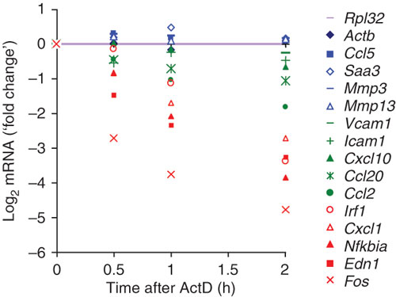
The mRNA half-life determines gene expression dynamics
Target gene expression clusters
mRNA half-life measurement
general transcription
inhibitor ActD added
Hao & Baltimore
Nature Immunology 2009
(PMID: 19198593)

Slide 18
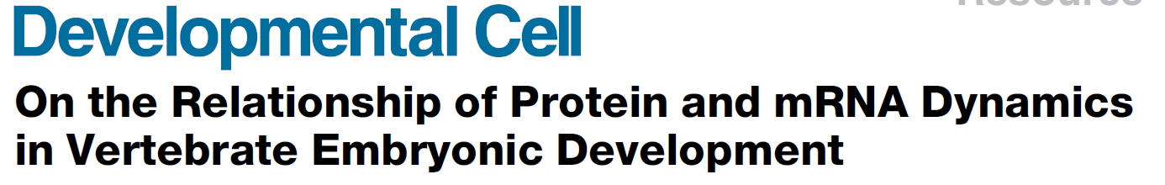
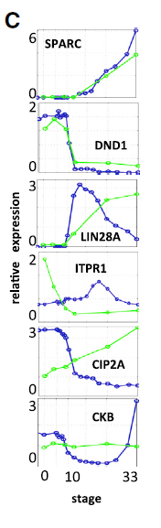
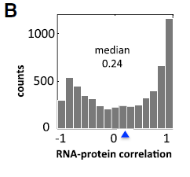
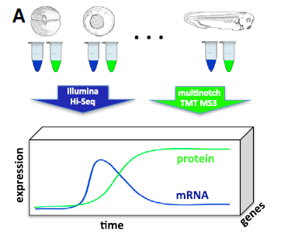
What is the relationship between
mRNA and protein levels?
Poor correlation of mRNA
and protein time courses
Extensive post-transcriptional
gene expression regulation?
Peshkin et al
Dev Cell 2015
(PMID: 26555057)

Slide 19
What is the relationship between
mRNA and protein levels?
Exercise 4
Plot Protein(t) vs. mRNA() for
fast and slow protein decay
k₁
X
Gene ON
0
Gene OFF
t=0
time

Slide 20
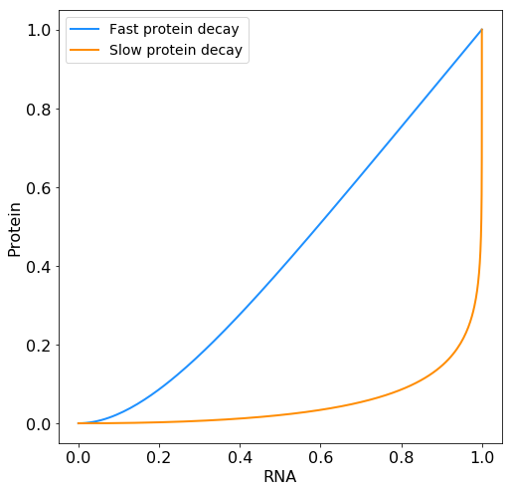
mRNA and protein time courses show a parameter-dependent correlation
Strong mRNA-protein correlation
for rapidly decaying proteins
Weak mRNA-protein correlation
for slowly decaying proteins
Poor mRNA-protein correlation does not
necessarily imply post-transcriptional regulation

Slide 21
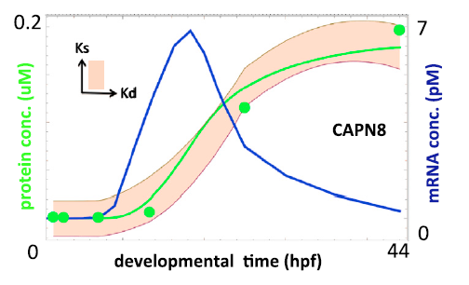
Most uncorrelated mRNA and protein changes explained by the simple expression model
Model fit to data
85% of all mRNA-protein pairs explained by basic protein expression model
Degrees of freedom: free choice of mRNA translation and protein degradation rates
measured mRNA
time course

Slide 22
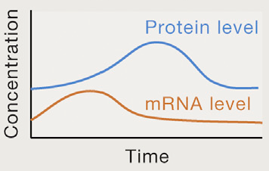
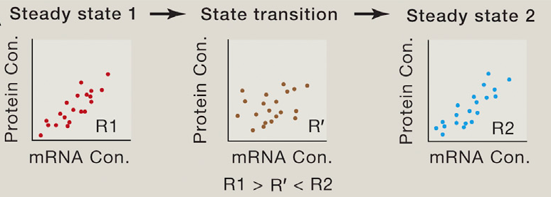
Global correlation over all mRNA-protein pairs decreases during dynamic transitions
Gene A
Gene B
Liu et al
Cell 2016
(PMID: 26555057)

Slide 23
Summary
Simple ordinary differential equation model of describes the dynamics of protein expression
mRNA and protein haf-lives determine kinetics and level of protein expression, whereas synthesis rates determine only expression
Uncorrelated mRNA and protein changes often arise from delayed protein synthesis and are explainable by protein expression model

Slide 24
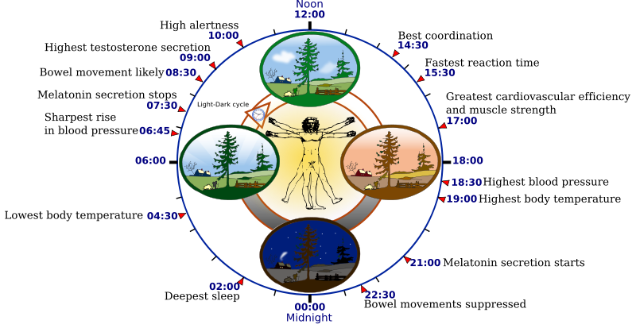
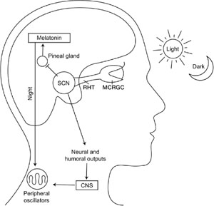
Protein expression in a more
complex network: Circadian rhythms

Slide 25
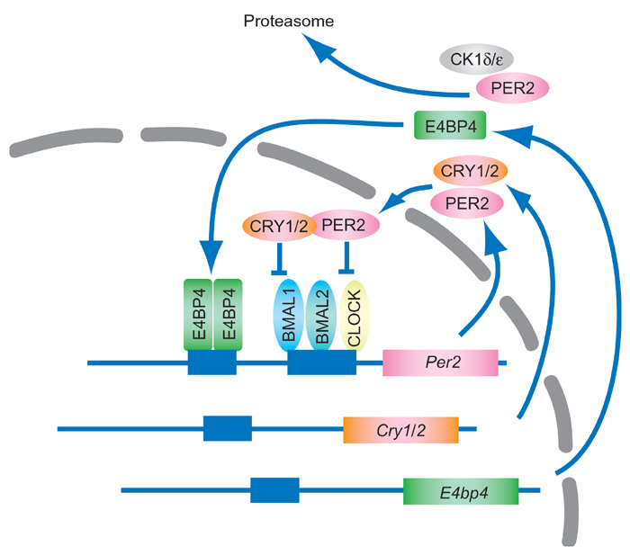
Circadian rhytmicity is established by a gene regulatory network with negative feedback

Slide 26
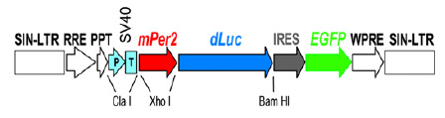
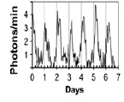
Circadian rhytmicity is established by a gene regulatory network with negative feedback
24h oscillations in Per2 expression
single-cell Luciferase reporter system
fibroblasts
Liu et al., Cell 2007

Slide 27
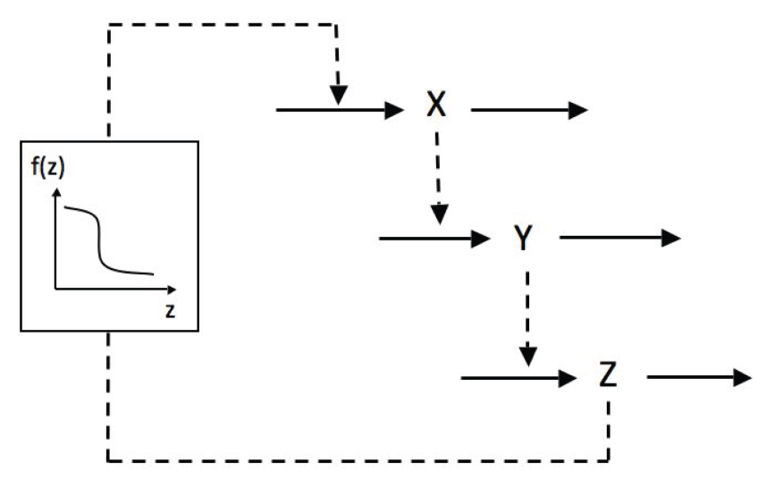
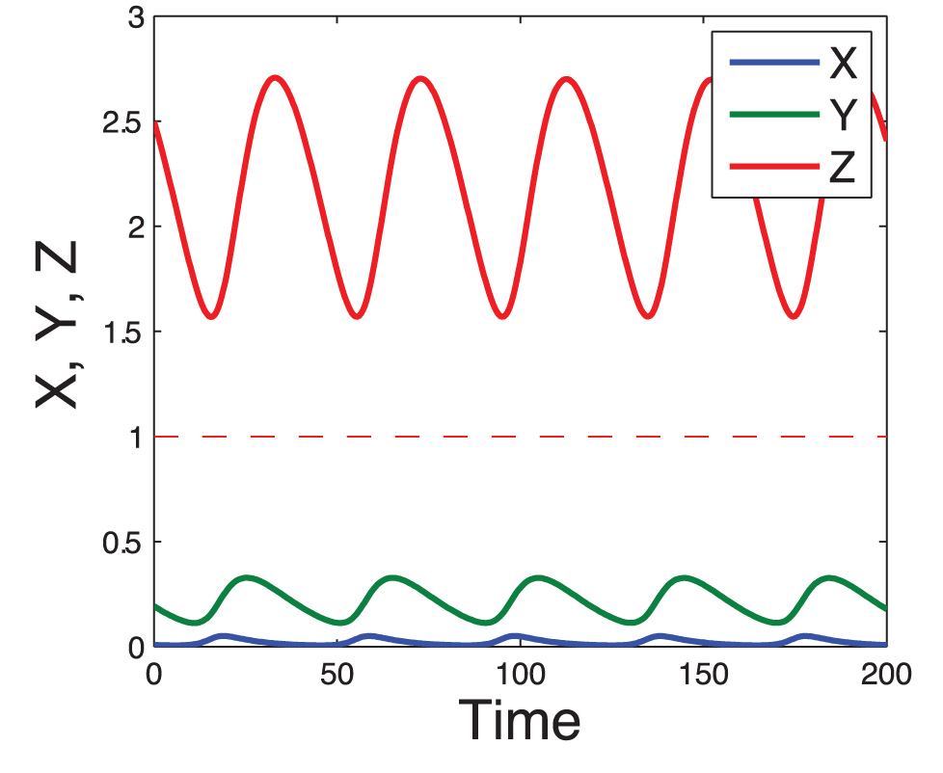
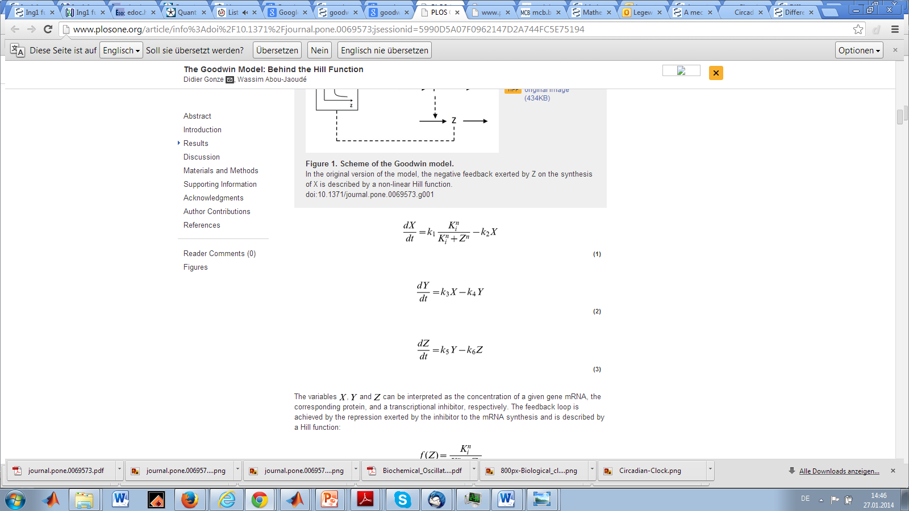
The Goodwin oscillator – a negative feedback model of circadian rhythmicity
Exercise 5
Implement negative feedback model and plot Z(t) for the following parameters
k₁= k₃=k₅=1
k₂= k₄=k₆=0.1
K_{i}=1, n=10
Goodwin oscillator
Ordinary differential equations
Per2 mRNA
Per2 protein
Per2 protein‘
Gonze et al., PLoS ONE 2007

Slide 28
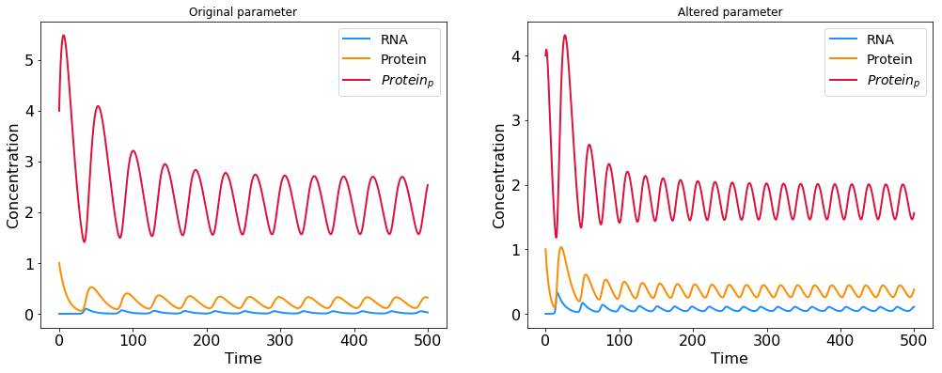
Effect of parameter changes: how does protein degradation influence the oscillator period?
Exercise 6
What is the effect of increasing the protein degradation rate?
k₁= k₃=k₅=1
k₂= 0.1, k₄=k₆=0.2
K_{i}=1, n=10
Goodwin oscillator
Ordinary differential equations
Per2 mRNA
Per2 protein
Increased protein degradation
shortens circadian period
Per2 protein‘
Gonze et al., PLoS ONE 2007

Slide 29
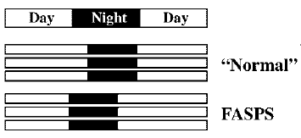
Human sleep disorders are caused by mutations in the circadian clock network
Familar advanced sleep phase syndrome (FASPS)
FASPS mutations in Per2 phosphorylation sites
Increase Per2 protein degradation
Shorten the circadian period
Leloup and Goldbeter, Bioessays 2008

Slide 30
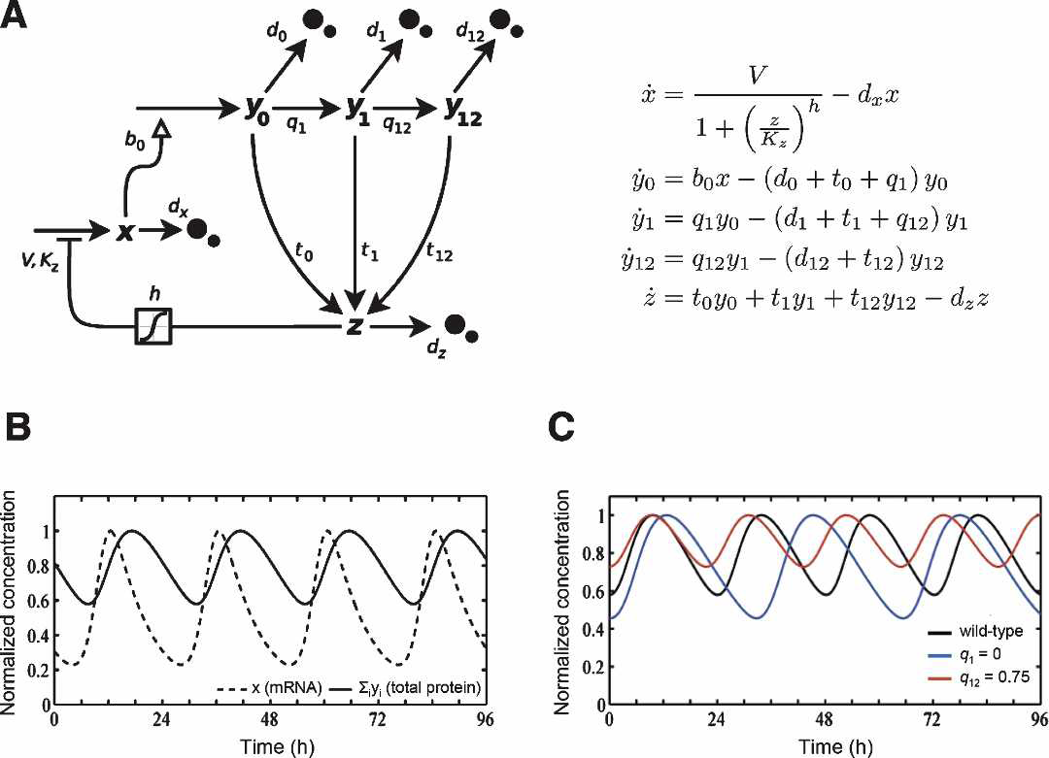
Detailed model of FASPS mutation effects confirms relation of oscillator period with Per2 protein stability
Per2 phosphorylation
and degradation
Auto-
repression
Nuclear
translocation
Principle of period determination by protein half-life
translates into clinically relevant setting!
Vanselow et al., Genes & Dev 2006

Slide 31
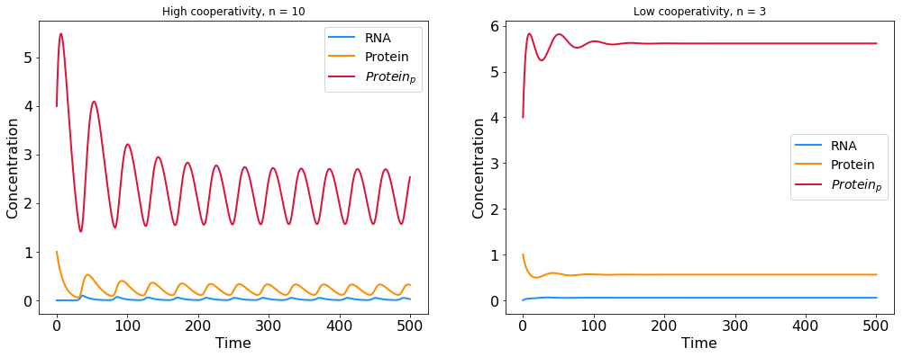
Role of cooperative feedback inhibition in maintaining stable oscillations
Exercise 7
What is the effect of reducing the cooperativity factor n?
k₁= k₃=k₅=1
k₂= k₄=k₆=0.1
K_{i}=1, n=3
Goodwin oscillator
Ordinary differential equations
Per1 mRNA
Per1 protein
Cooperative feedback required for oscillations
Per1 protein‘
Gonze et al., PLoS ONE 2007

Slide 32
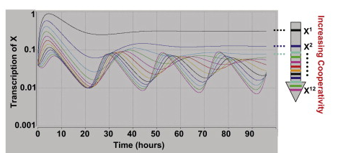
Summary: requirements for oscillatory behavior in biological systems
1. Negative feedback loop
2. Time delay
determines oscillation period
Set by mRNA/protein half-life
3. Strong and cooperative feedback
Brown et al., Dev Cell 2012

Slide 33
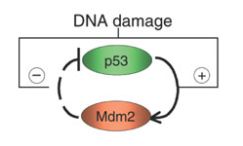
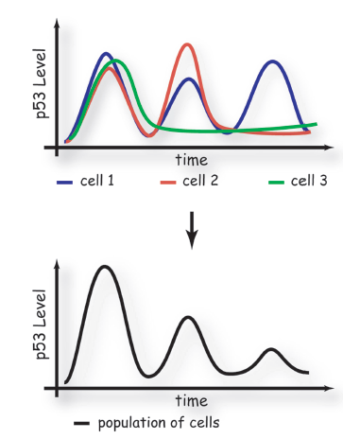
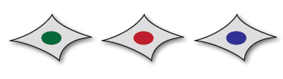
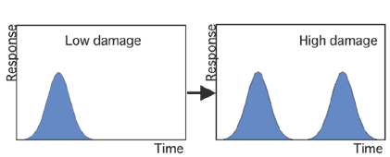
Oscillations due to negative feedback shape decision making in the p53 tumor suppressor network
DNA repair
γ-irradiation
Apoptosis
Singl-cell response
Digital decision making
* Dynamics of the p53-Mdm2 feedback loop in individual cells. Nat Genet(2004).Lahav G,..,Alon U.

